Slide 1
Unit 3 - Multi Rate Signal Processing and Digital Generation of signals

Slide 2
Introduction
"Multirate" means "multiple sampling rates". A multirate DSP system uses multiple sampling rates within the system. Whenever a signal at one rate has to be used by a system that expects a different rate, the rate has to be increased or decreased, and some processing is required to do so.
"Resampling" means combining interpolation and decimation to change the sampling rate by a rational factor.
Resampling is done to interface two systems with different sampling rates.
Ex: Professional audio equipment uses a sampling rate of 48 kHz, but consumer audio equipment uses a rate of 44.1 kHz.

Slide 3
Introduction
To transfer music from a professional recording tape to a CD, the sampling rate must be changed by a factor of 44100 / 48000 = 441/480=147/160. Therefore we would interpolate by a factor of L=147 then decimate by a factor of M=160. The resampling factor is 147 / 160 = 0.91875
The Nyquist criteria must be met relative to the resulting output sampling rate to prevent aliasing
Multirate DSP consists of:
  1. Decimation: It is a process to decrease the sampling rate.
  2. Interpolation: It is a process to increase the sampling rate.

Slide 4
Application
Used in A/D and D/A converters.
Used to change the rate of a signal. When two devices that operate at different rates are to be interconnected, it is necessary to use a rate changer between them.
Interpolation.
Some efficient implementations of single rate filters are based on multirate methods.
Filter banks and wavelet transforms depend on multirate methods.

Slide 5
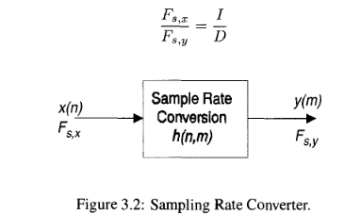
Sample Rate Conversion Principle
A data stream can be downsampled to a lower sampling rate or upsampled to a higher sampling rate.
The sampling rate converter can be thought of as the time-varying filter h(n, m).
The sampling rate conversion factor is expressed as the ratio of two relatively prime numbers

Slide 6
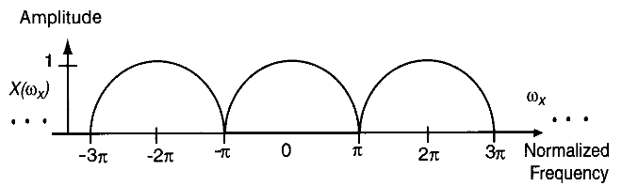
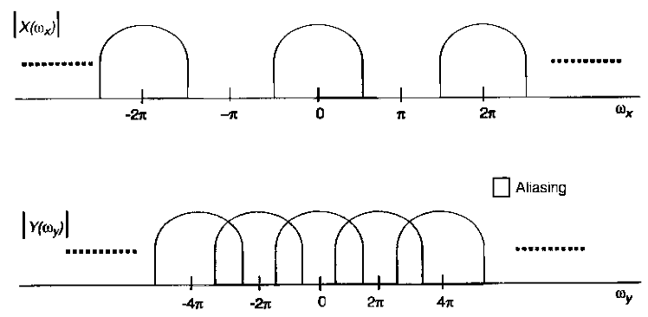
Decimation
Decimation is the process by which high-frequency information is eliminated from a signal to reduce the sampling frequency without resulting in aliasing.
A sampled signal, seen in Figure 3.3, repeats its spectrum every 2 π radians.
If decimation without filtering were performed, aliasing would occur

Slide 7
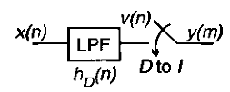
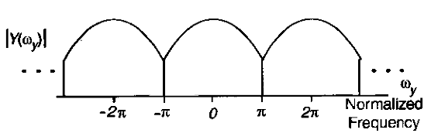
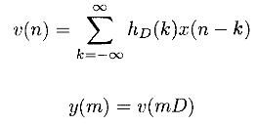

Decimation
The operation is composed of low pass filtering followed by down sampling.
The down sampler picks a subset of the samples that are passed through the low pass filter (LPF).
The LPF used is designed to avoid aliasing and has a cutoff of π/D
The end result of the decimation procedure is the content of the original signal below π/D
Two processes are used in the decimation procedure: filtering and down sampling.
Equation 3.2 shows filtering performed with filter h_{D} (n) on signal x{n) in the time domain.
Subsampling is the selection of every Dth sample, shown in Equation 3.3.
expected spectrum of the decimated signal

Slide 8
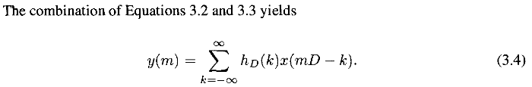


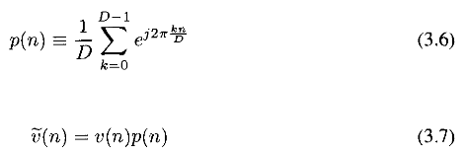
Decimation
model as u(n) sampled with impulse train p(n), where p(n) is defined in Equation 3.6 using the Fourier series for a sampling impulse of period D. v(n) is shown in Equation 3.7

Slide 9
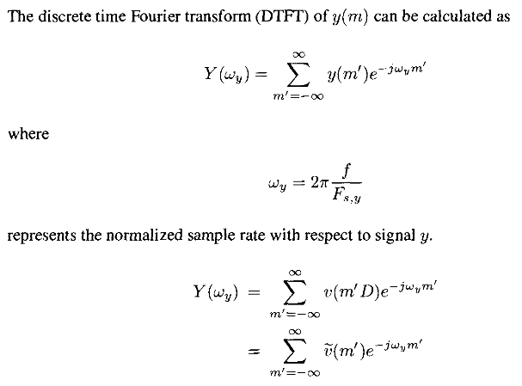
Decimation

Slide 10
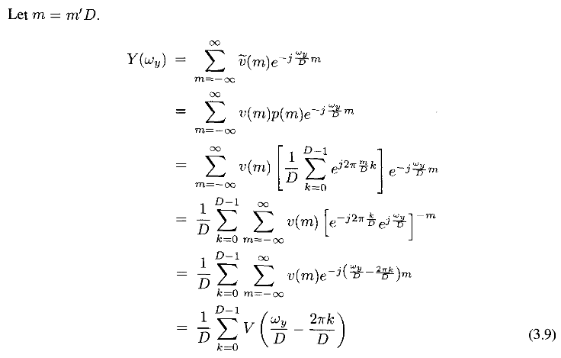
Decimation

Slide 11
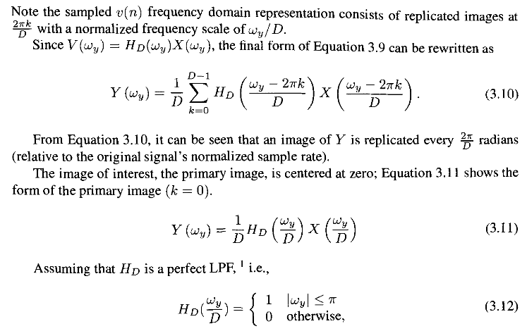
Decimation

Slide 12

Decimation

Slide 13
Interpolation
Upsampling is the process to increase the number of points per unit time used to describe a signal.
The spectral content of the signal does not change
When upsampling is employed, no new information is added to the signal.
The process of upsampling decreases the time between samples of a signal.
This process can be used for matching sampling rates between two systems or as the last step before the DAC to help relax the requirements for the reconstruction filter

Slide 14
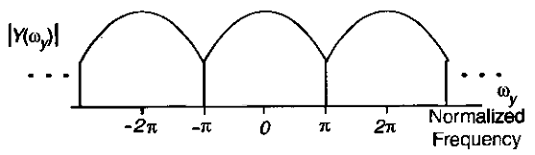
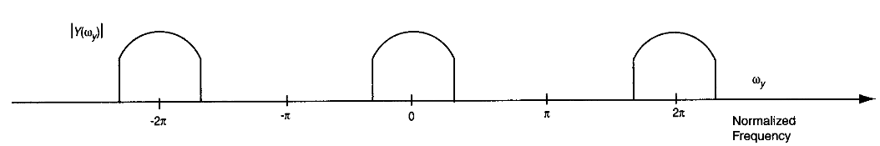
Interpolation
If the signal shown in above figure, X(ω_{X}), were sampled at twice the rate, its spectrum would appear as shown in below.

Slide 15
Interpolation
Several methods of interpolation are presented in this section:
  zero-insertion,
  zero-order-hold (ZOH),
  zero-insertion and raised-cosine filtering, and
  fast Fourier transform (FFT) expansion.
  Zero-Insertion Interpolation
In this method, zeros are inserted between samples of a signal, generating a new signal.
This new signal is then lowpass filtered, yielding an upsampled version of the original

Slide 16
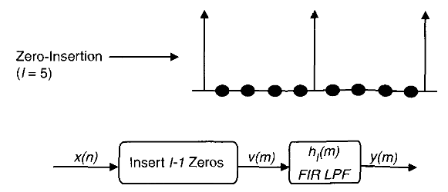

Zero Insertion Interpolation
For the purpose of analysis, assume that the original signal is x(n) and that the goal is to upsample it by a factor of 7. 7 — 1 zeros are inserted between each pair of consecutive samples of x(n), yielding v(m), which can then be defined as

Slide 17
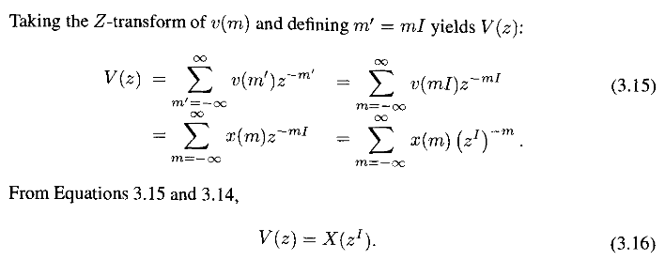
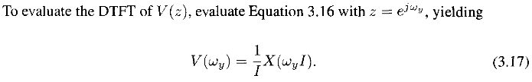

Slide 18
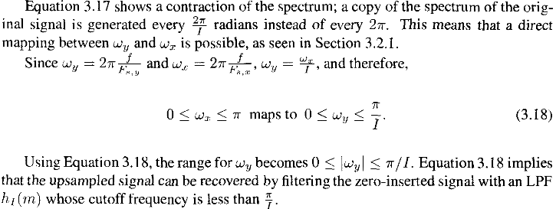

Slide 19
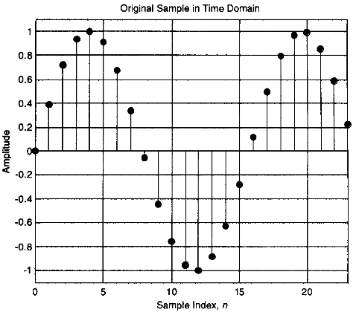
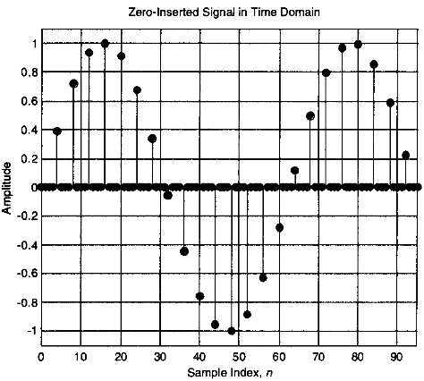

Slide 20
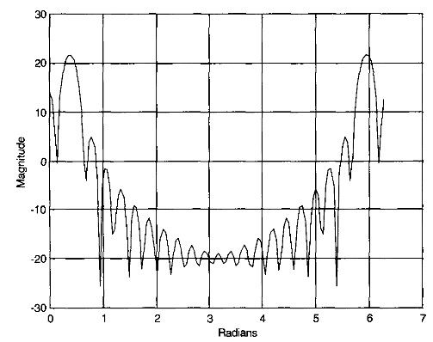
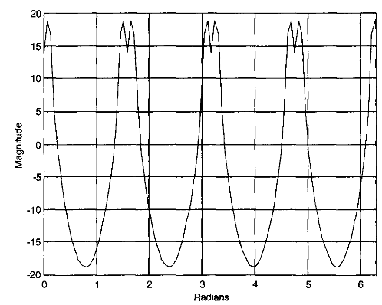

Slide 21
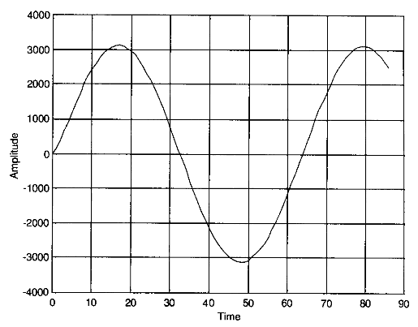
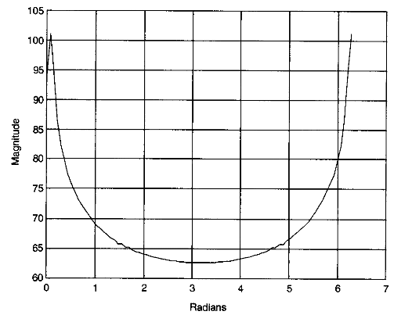

Slide 22
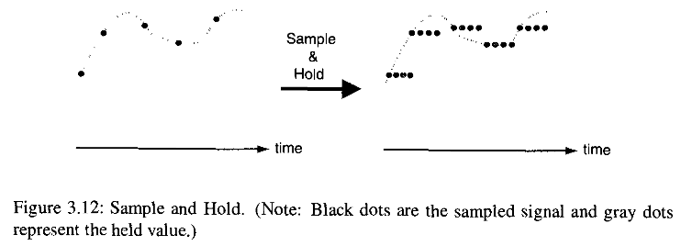
Zero-Order-Hold Interpolation
In this method, space between two samples is filled with a sample generated using some function.
This method is computationally more expensive and generates less distortion at the higher frequencies for a given interpolation filter
In zero-order interpolation, a signal is upsampled by extending a sample's value over several samples, as seen in Figure, before lowpass filtering.

Slide 23



Zero-Order-Hold Interpolation
Sample n from the original sequence x[n] is placed in samples v[4n], v[4n + 1],v[4n + 2], and v[4n + 3] of the new sequence v[m] of size 4n.
In the ZOH version of this signal, v(m) can be generated by Equations 3.19 and 3.20. A ZOH can be considered as the sum of the sampled signal plus 7 — 1 delayed copies of v(m), shown in Equation 3.20.

Slide 24
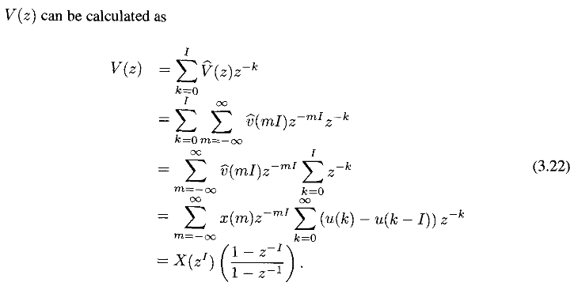
Zero-Order-Hold Interpolation

Slide 25
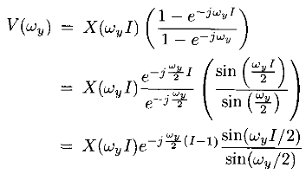
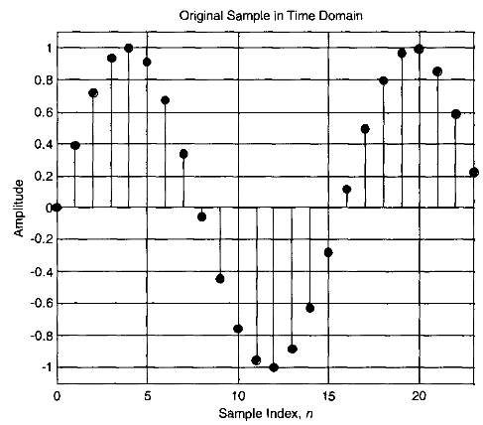
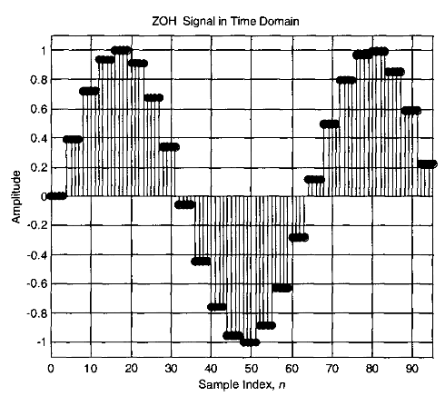

Slide 26
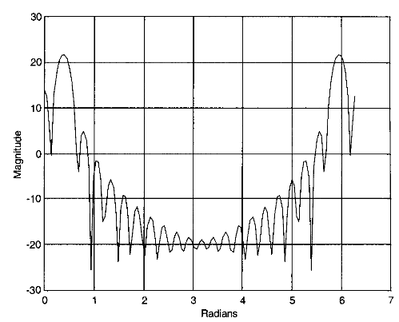
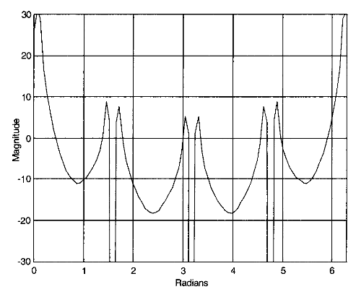
Zero-Order-Hold Interpolation

Slide 27
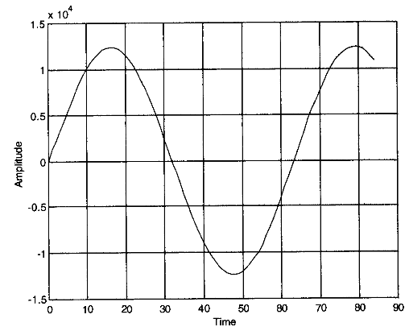
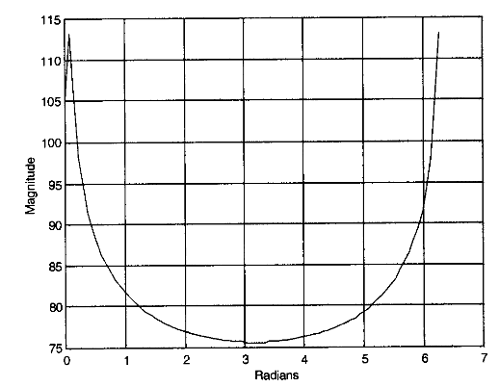
Zero-Order-Hold Interpolation

Slide 28
Zero-Insertion and Raised-Cosine
To minimize inter-symbol interference (ISI), the use of raised-cosine pulse-shaping is important.
If the upsampling of a pulse code modulation (PCM) signal is to be performed at the transmitter, the upsampling and raised-cosine filtering can be combined to simplify the overall design.
This combination is performed by using the zero-insertion interpolation method described earlier but with a raised-cosine filter instead of a lowpass interpolation filter
In practice, the LPF can be ignored since the raised-cosine filter has a smaller bandwidth than the interpolating LPF

Slide 29
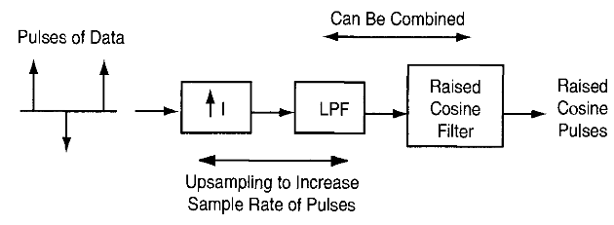
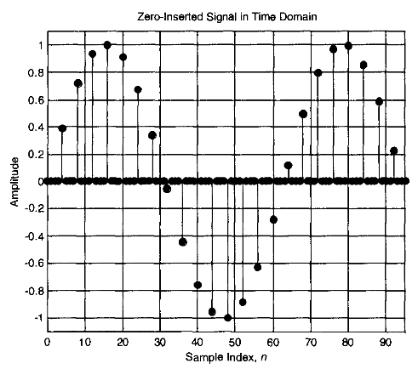
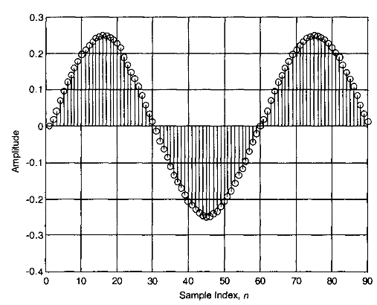

Slide 30


Sampling Rate Conversion by Stages
When large changes in sampling rate are required, multiple stages of sample rate conversion are found to be more computationally efficient.
The decimation in above figure can be realized in two stages if the decimation factor D can be expressed as a product of two integers, D1 and D2.
in the first stage, the signal x(n) is decimated by a factor of D. The output, v(p) is further decimated by D2 in the second stage resulting in an overall decimation of x(n) by D = (D1D2)
Decimation in a Single Stage

Slide 31
The filters Hi(z) and H2(z) are so designed that the aliasing in the band of interest is below a prescribed level and that the overall passband and stopband tolerances are met.
This multi-stage sampling rate conversion system offers less computation and more flexibility in filter design.
Example:
We have a discrete time signal with a sampling rate of 90 kHz. The signal has the desired information in the frequency band from 0 to 450 Hz (passband), and the band from 450 to 500 Hz is the transition band. The signal is to be decimated by a factor of ninety. The required tolerances are a passband ripple of 0.002 and a stopband ripple of 0.001

Slide 32


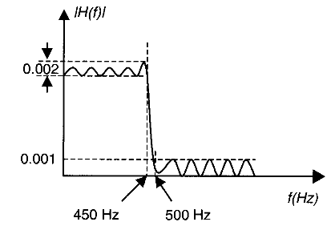

Decimation in a Single Stage
First we consider a single-stage design as shown in Figure (a). The specifications of the required LPF are shown in Figure (b).
According to the formula by Kaiser, the approximate length of an FIR filter is given by ,
where peak passband ripple (linear)
δ_{p} = 0.002, peak stopband ripple (linear)
δ_{s} = 0.001. Normalized transition bandwidth

Slide 33

Passband edge frequency f_{p} = 450Hz and stopband edge frequency f_{s}=500Hz, Sampling frequency F_{s}=90KHz
From Equation 1, the lowpass FIR filter H(z) has a length of N ≅ 5424. Therefore, the number of multiplications per second, M_{sec}, needed for this single-stage decimator is
Since only one out of ninety samples is actually used, the computation rate is based on the decimated signal rate.

Slide 34

Decimation in Two Stages
Let us now consider the two-stage implementation of the decimation process as shown in Figure
Due to the cascade decomposition, each of the two filters, H1 (z) and H2 (z), must have a linear passband ripple specification half of that specified for the single-stage filter, H(z).
The stopband ripple specifications for these two filters can be the same as that of H(z) since the cascade connection will only reduce the stopband ripple.

Slide 35
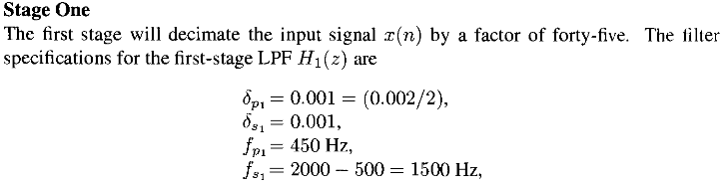
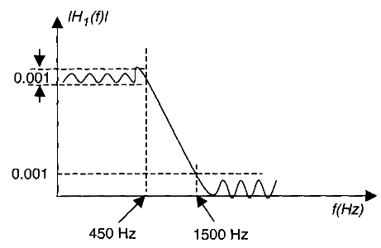

The reason for choosing this value of the stopband edge is that, after decimation by a factor of forty-five, the residual energy of the signal in the band from 1000 to 2000 Hz will be aliased back to the band from 0 to 1000 Hz. Due to the attenuation in the stopband, the energy of the signal in the band from 1500 to 2000 Hz is very small compared to that in 1000 to 1500 Hz. So the amount of aliasing in the desired band of interest (0 to 450 Hz) will also be small, resulting in very little signal distortion.

Slide 36

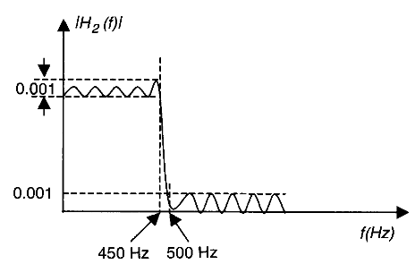
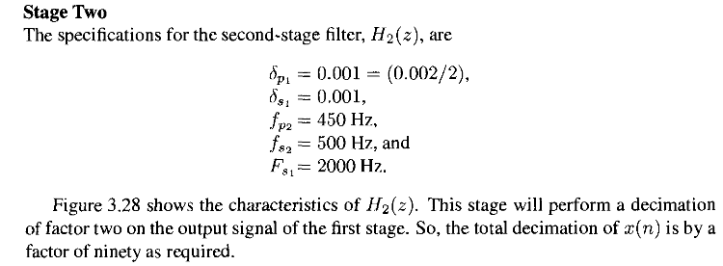


Slide 37
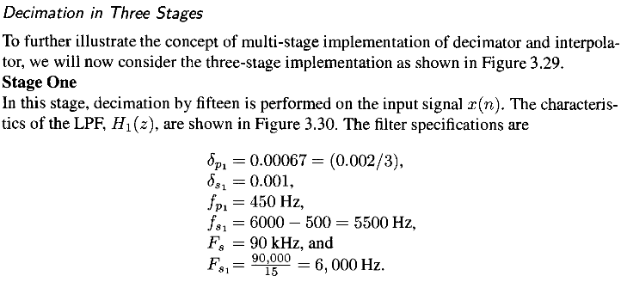

Slide 38
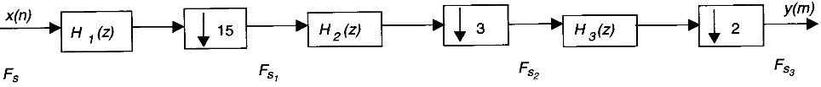
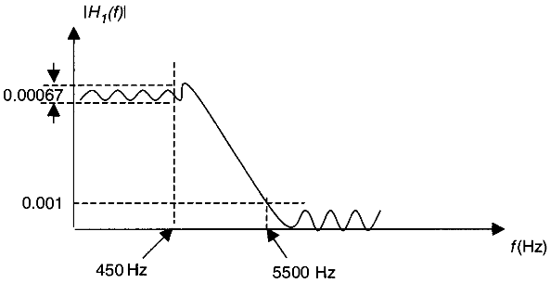

As in the two-stage case, the choice of stopband edge frequency can be extended to the point for which negligible aliasing occurs in the passband (band of interest).
The approximate length of the filter as given by Equation 3.37 is N1= 60. The number of multiplications per second for this stage is calculated as

Slide 39
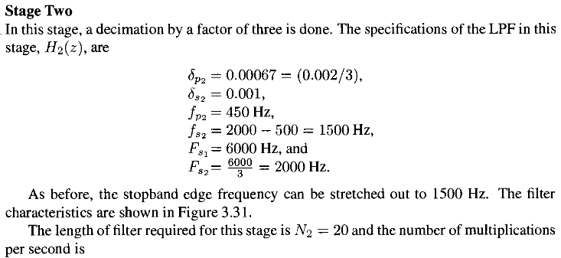


Slide 40

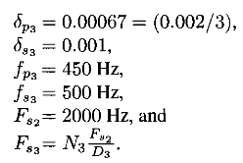
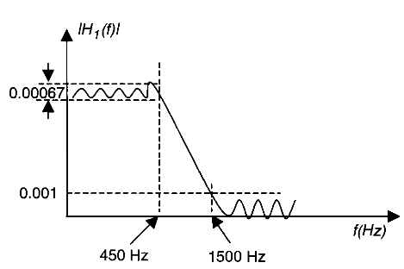


Slide 41
