Slide 1
Frequency Scanned Array
Scanning is obtained by varying the frequency
To obtain freq., scanned array, a length of transmission line is used to feed the array by means of directional couplers.
Two adjacent elements of the array, spaced by a distance ‘a’ are fed by 2 couplers separated in the transmission line by a length ‘b’.
The array and the transmission line properties allows us to show that a frequency deviation ‘df’ about the central freq., f_{o} produces an angular scanning dτ

Slide 2



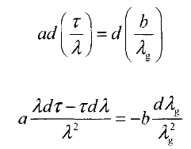

The phase shift produced by the length of the txn., line is given by,
For τ=0

Slide 3
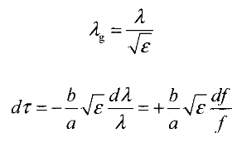



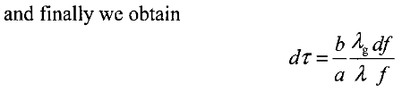

Slide 4
ANALOGUE BEAMFORMING MATRICES
Multiple beam antennas are used in RADAR and SONAR applications as an alternative to electronic scanning to improve range and angular resolution of equipment.
Multiple beams and electronic scanning are combined to increase the duration of the illumination of targets.
Such antennas can be realized by using a kind of retina of multiple primary elements on the focal surface of a reflector or a lens. A reflectarray or an active lens can be used.
This technique is valid as long as the angular domain covered by the multiple beams is not too large (about 5 to 6 degrees) .
The use of array antennas combined with beamforming matrices allows to avoid these limitations.

Slide 5
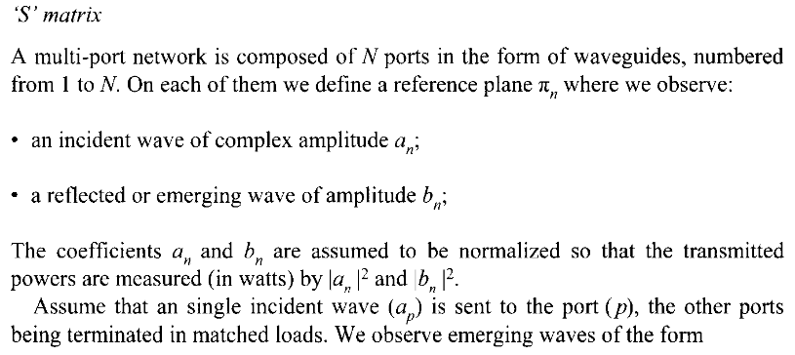

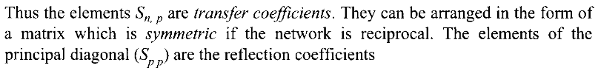

Slide 6
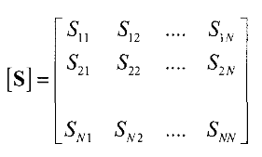
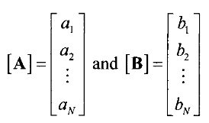

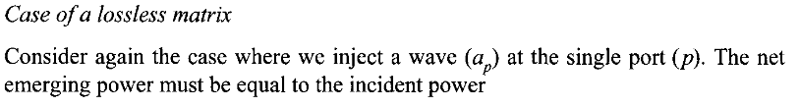

Slide 7
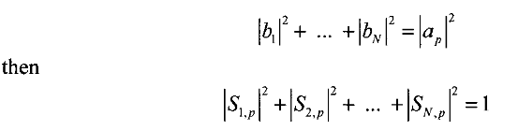
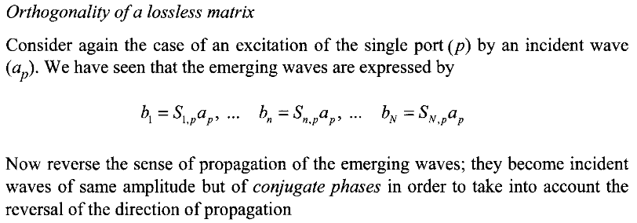


Slide 8


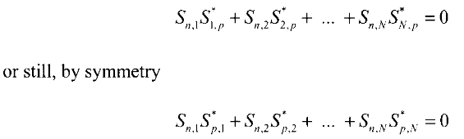

Slide 9
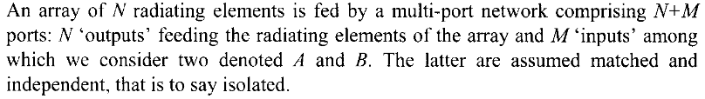
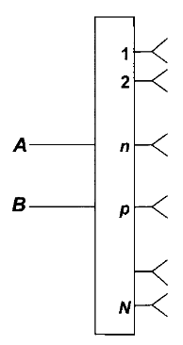



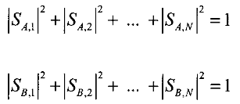



Slide 10

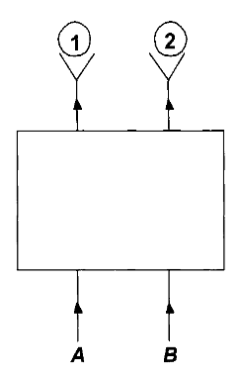
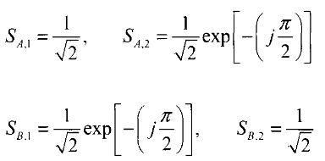
Butler Matrix
Two-element array : A 3 dB coupler can feed a two-element array and form two decoupled orthogonal beams.
Consider the two ports A and B and
the outputs 1 and 2 which excite the two elements of the array, the transfer
coefficients characterizing the two illuminations are

Slide 11
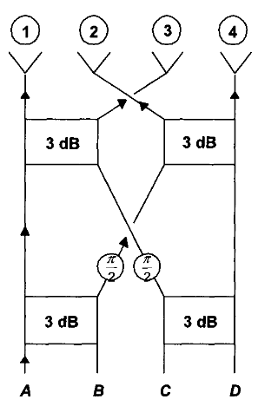
The drawback of Butler matrices is in the complexity of their interconnection, particularly for large matrices.
For large arrays it is better to use other types such as Blass matrices or quasi-optical matrices.

Slide 12
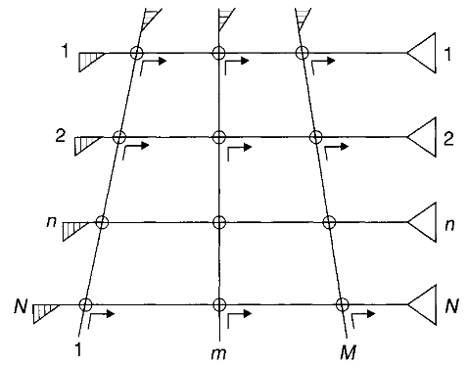
Blass matrix
The M excitation guides (1, 2, ... m, ... M) are connected to the N guides feeding the elements of the array (1, ' " n, ... N) through directional couplers.
The coupling coefficients are chosen so that the transfer coefficients S_{m ,n} follow the desired illumination.
The guides are terminated with matched loads

