Slide 1
Unit 4
Antenna measurements

Slide 2
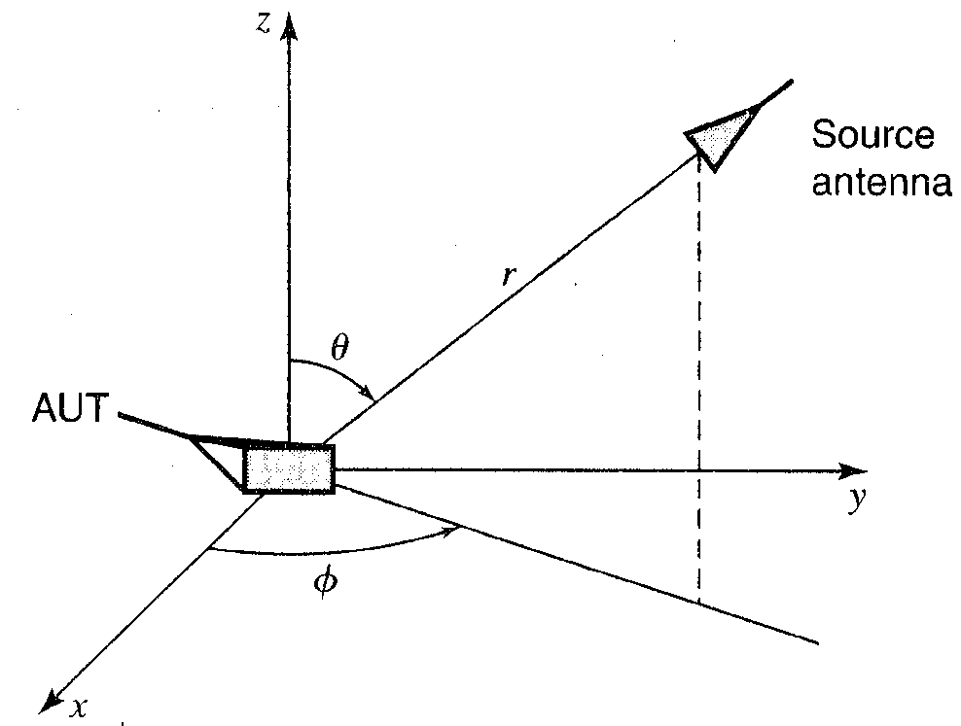
Typical configuration for the measurement of radiation properties of an antenna

Slide 3
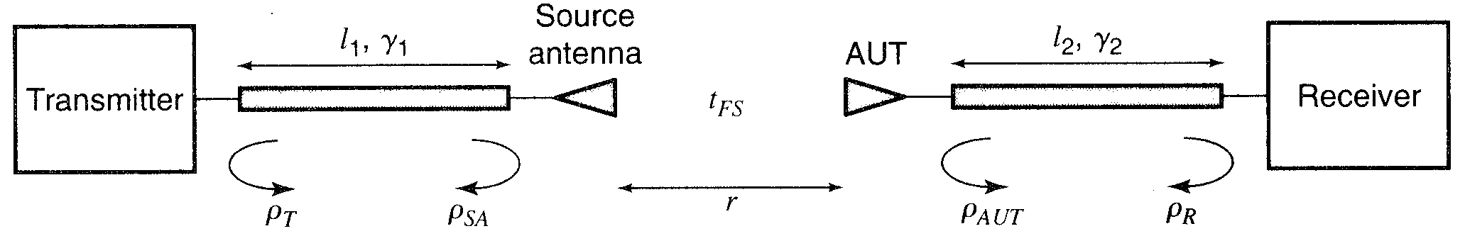
Typical instrumentation for the measurement of radiation properties of AUT

Slide 4
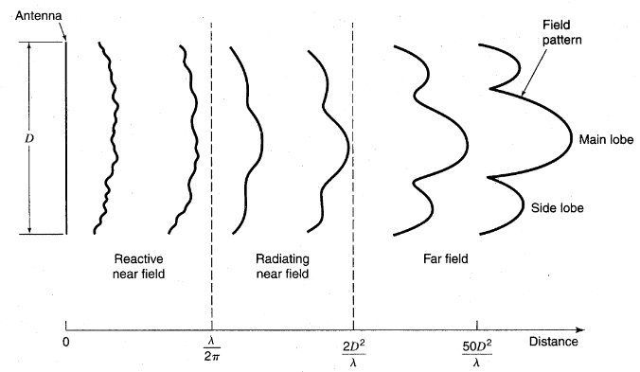
Radiation pattern in near and far field regions

Slide 5
Measurement ranges
Elevated range
Ground reflection range
Anechoic chamber & absorbing materials
Compact antenna test range
Near field range
Testing of ranges
Instrumentation

Slide 6
Indoor & Outdoor range

Slide 7
INDOOR RANGE
It is not desirable to have reflecting surfaces in an antenna range.
A closed chamber can be made reflection-free or echo-free by lining all the surfaces of the chamber with absorbing material.
Such a chamber is known as an anechoic chamber.

Slide 8
Differences between Indoor and outdoor ranges
S. No. | Indoor range | Outdoor range
1. | These are protected from external EMI | These are susceptible to EMI
2. | Space is limited | Space is unlimited
3. | Only small antennas can be tested | Antennas of any size can be tested
4. | Ground and other reflections are controlled | Ground and other reflections cannot be controlled fully
5. | They have controlled environment | They have uncontrolled environment
6. | They have all weather capability | They do not have all weather capability.

Slide 9
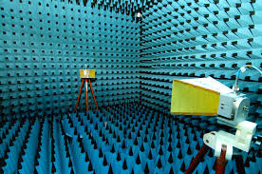
Anechoic chamber

Slide 10
Elevated range
Antennas are placed high on towers, buildings or hills to reduce the effect of environment.
AUT is operated as a receiving antenna
If source antenna is near the ground & AUT is on a tower, the range is called slant range.

Slide 11
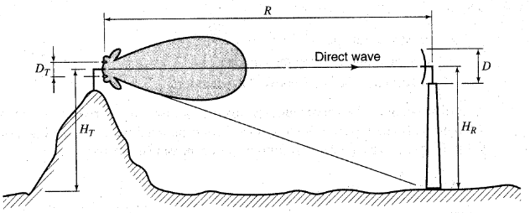
Elevated range to minimize reflections

Slide 12
Source antenna diameter,
From the maximum accepted amplitude taper of 0.25 dB, the upper limit for the source antenna diameter is

Slide 13
Ground reflection ranges
Antennas are placed above a flat reflecting surface with (or without) buried ground screen.
The peak of the first lobe is at the height
Height of the source antenna or AUT may need to be adjusted for each measurement frequency.

Slide 14
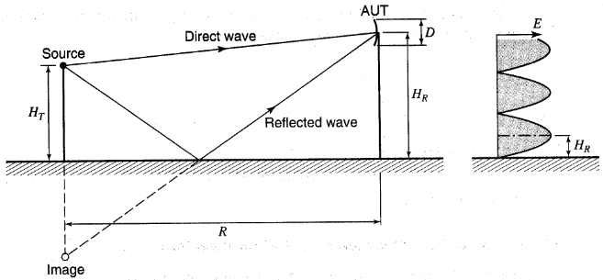
Ground reflection range with direct & reflected waves

Slide 15
The surface of a ground reflection range should be smooth, which requires that the rms height variation of the surface Δh, is small enough:

Slide 16
Anechoic chamber & absorbing materials
Types of absorbers;
1. Pyramids
2. Wedges

Slide 17
Anechoic chamber

Slide 18
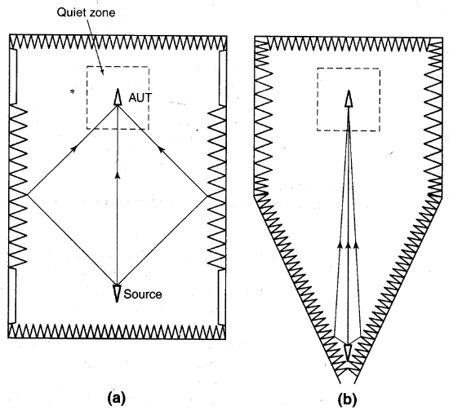
Anechoic chamber types
Rectangular chamber
Tapered chamber

Slide 19
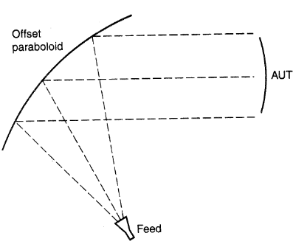
Compact antenna ranges
CATR is usually installed in indoors in an anechoic chamber but very large CATRs are outdoor ranges.

Slide 20
A paraboloid reflector can be used to collimate the energy from a feed located at its focal point.
An offset feed is generally used to reduce the aperture blockage.
The size of the reflector needs to be at least three times the size of the AUT so that the illumination at the test antenna is approximately a plane wave.

Slide 21
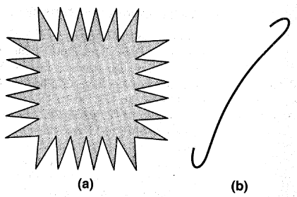
Edge treatment of CATR reflector
Serrated edge
Rolled edge

Slide 22
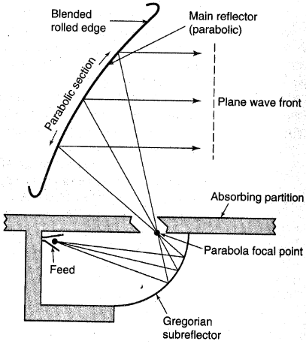
Dual chamber Gregorian-fed CATR

Slide 23
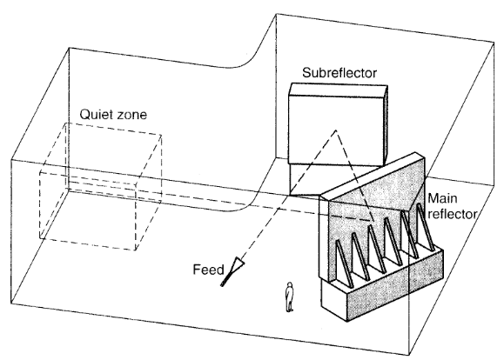
Dual reflector CATR

Slide 24
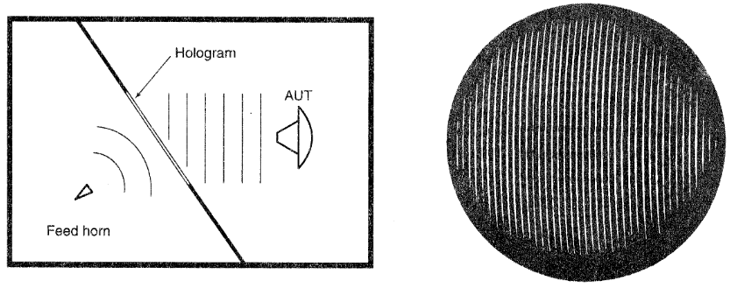
CATR based on a hologram

Slide 25
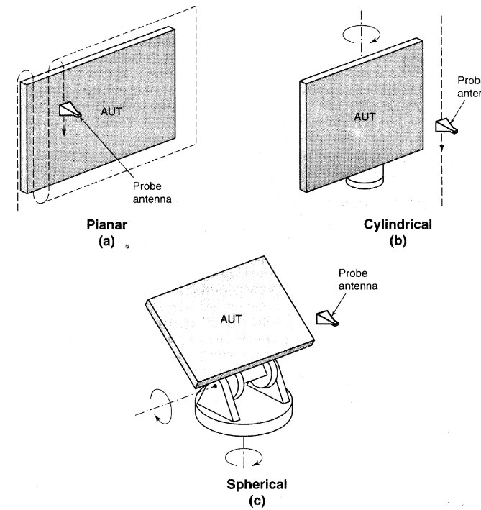
Near field ranges

Slide 26
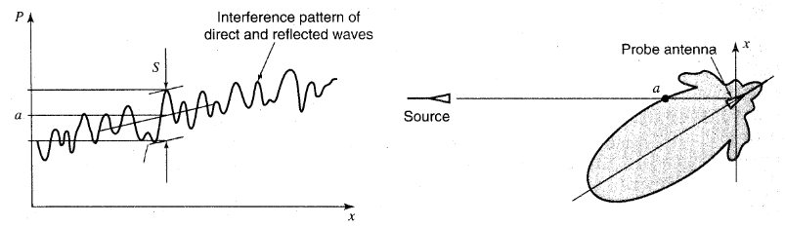
Testing of ranges

Slide 27
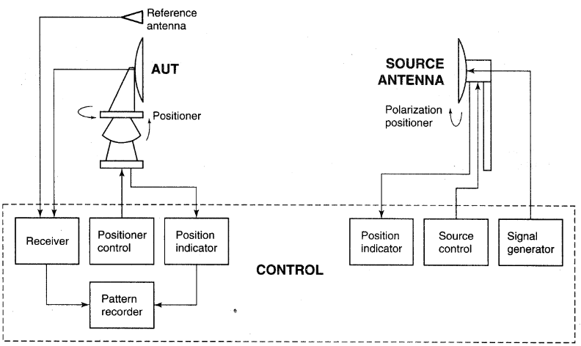
Instrumentation

Slide 28
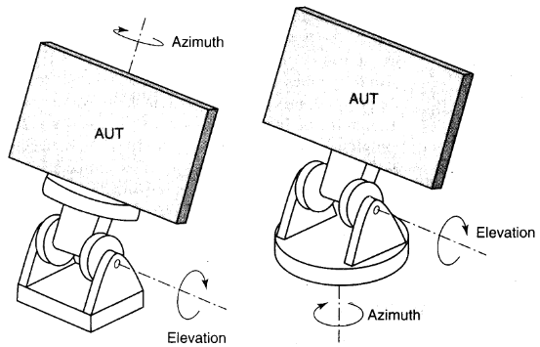
Antenna positioners

Slide 29
Measurement of different antenna parameters
Directional pattern:

Slide 30
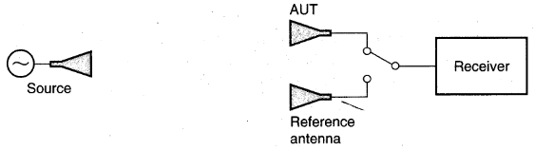
Gain and Directivity
Absolute gain measurement
Gain transfer method
Gain measurement by comparing AUT with a reference antenna

Slide 31
Absolute method
  The absolute method is based on the Friis transmission formula;
  2 methods are used;
  1. 2 antenna method
  2. 3 antenna method

Slide 32
In 2 antenna method, 2 identical antennas are required. (GT=GR)
The gain of the antenna is determined from R, λ and power using Friis transmission equation.
If 2 identical antennas are not available, then a third antenna is needed.

Slide 33
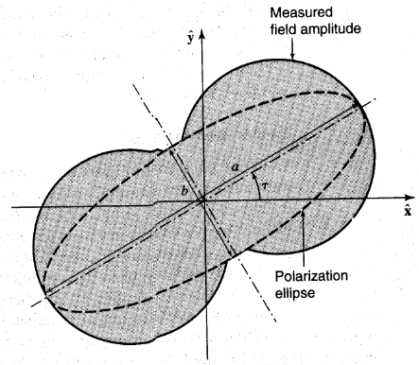
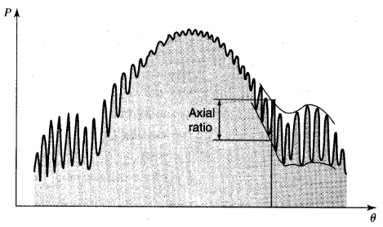
Polarization measurement

Slide 34
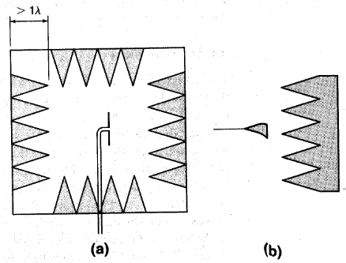
Impedance measurement
Omni directional antenna in an absorber box
Directive antenna pointing towards an absorber

