Slide 1
Software Defined Radio
UNIT –II (PART 2)

Slide 2
Importance of the Components to Overall Performance
Antennas
The antenna is perhaps the weakest link in the overall design, and its importance in the design process is usually important.
For a software radio, which is designed to support multiple modes and multiple bands, the antenna choice becomes an even more crucial issue
multimode radios that cover the cellular band at 900 MHz and 2 GHz are difficult to support with a single antenna
In handsets, the form factor of the antenna is very important and the potential body coupling may help or hurt the antenna performance.

Slide 3
Antennas
For handset design, it is important to minimize radiation directed toward the head.
Exploitation of diversity or smart antennas can be performed at the handset or at a base station.
Diversity may be achieved by using multiple receiver chains and spatially separated antennas, antennas with different gain patterns or polarization characteristics.
Several antenna types are commonly used for mobile terminals, including the dipole, monopole, loop, and patch antennas

Slide 4
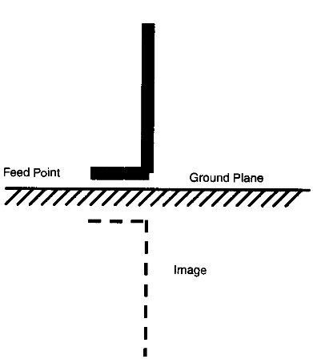
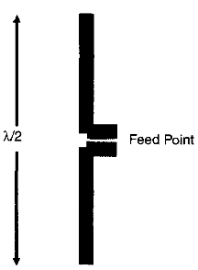
Antennas
The dipole antenna, has a length of half a wavelength, λ/2, and is the smallest self-resonant antenna structure.
The monopole antenna, is similar to a dipole antenna but with half of its length replaced by an "image" consisting of a large ground plane.

Slide 5
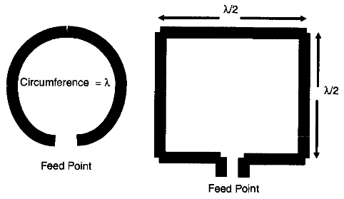
Antennas
The loop antenna, is a self-resonating structure when the circumference is equal to one wavelength.
The loop antenna works primarily through exploiting the changing magnetic field.
The impedance of this antenna is obviously very low and requires an impedance-transforming network to interface to the RF chain.

Slide 6
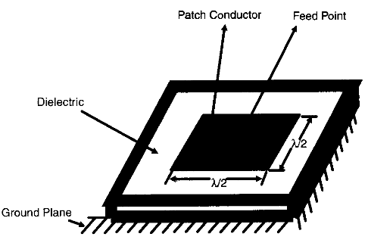
Antennas
A patch antenna, is formed by a conductor mounted on a dielectric substrate that is backed by a conducting ground plane.
A square patch has a length of half a wavelength and a circular patch has a diameter of approximately 0.6 wavelengths.
Because of the ground plane, the radiation is emitted over a half space, similar to that of a monopole.

Slide 7
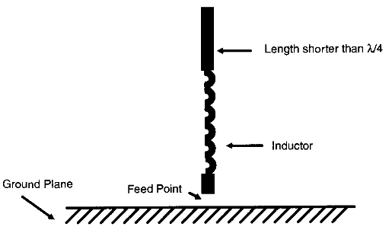
Antennas
Antenna form factor is very important in mobile systems, particularly for hand-held radios, and an excessively long antenna can be a big problem.
The "rubber ducky" antenna is the most commonly used antenna for hand-held radios because of its reduced length.
This antenna is basically a monopole antenna that uses a lumped or distributed inductance to make the resonating length shorter than a quarter wavelength.

Slide 8
Antennas
The inductance is typically a coiled wire that has a flexible, spring-like physical property.
It is useful to note that the human body serves as a ground plane for the antenna
On the other hand, the head can function as a ground plane, blocking the reception of the basestation signal coming from the direction of the head.
various antenna configurations have different polarizations, and the orientation of the radio will reduce the antenna's efficiency if the antenna and wave polarization do not match

Slide 9
Duplexer and Diplexer
Duplexer: It is a 3 port device that allows the transmitter and receiver to use a single antenna.
Diplexer: It is 3 port device that allows 2 different devices to share a common communication channel.
A duplexer is used to separate or isolate transmit and receive signals in a common frequency range that uses a common antenna.
A diplexer performs a similar but different function: it isolates transmitted and received signals that lie in distinct frequency ranges
The duplexer operates as a filter consisting of a ferrite device called a circulator.

Slide 10
Duplexer and Diplexer
Software radios that support multiple modes, such as full-duplex and half-duplex systems, require a duplexer or diplexer that works for both systems, which is a significant design challenge.
In a mobile phone, diplexers are typically low-pass and high-pass filters that allow dual-band operation through one antenna or antenna feed point.
Duplexers are usually dual passband filters that allow simultaneous operation of the receiver and transmitter in a full-duplex system
The diplexer is easier to create than the duplexer.

Slide 11
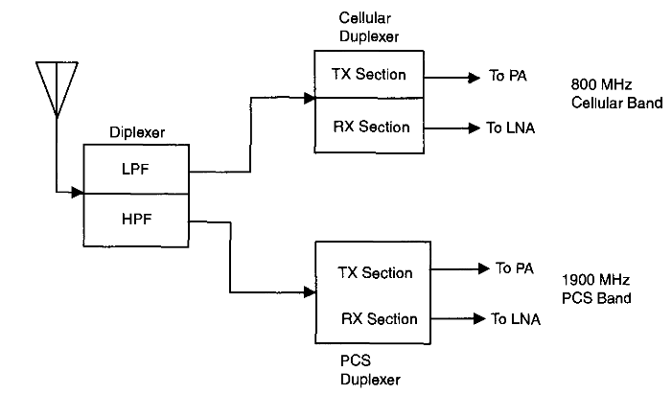
Duplexer and Diplexer in a Dual Mode Cellular Phone

Slide 12
RF Filter
The initial filtering after the duplexer rejects out-of-band interference.
This filter should inject small amounts of noise, have low loss, and provide as much selectivity as feasible without limiting the bandwidth needed to support multiple modes of the software radio.

Slide 13
Low Noise Amplifier
The LNA boosts the signal power level into a range compatible with other components in the circuit
The primary design challenge is to maximize gain without adding excessive noise into the signal.
The noise figure is the primary figure of merit and indicates the ratio of the output SNR to the input SNR.

Slide 14
Image Reject and IF Filters
The image reject filter that is located before the mixers reduces noise and protects the mixer from interference
Noise contributed by this filter (which is an active filter) should be minimized
Filters can consume a significant amount of circuit area

Slide 15
RF Mixer
The RF mixer is used to downconvert the signal and can be a major source of intermodulation Distortion.
Harmonics due to the mixer (possibly enhanced by harmonics created by the LNA) may end up in IF passband.
Increasing the LO power to the mixer is one way to improve linearity and to reduce distortion.
Active RF mixers can also be a source of noise, and this noise characteristic is represented by their noise figure

Slide 16
Local Oscillator
The mixer is driven by an LO whose frequency determines the channel selection
This LO should have a good tuning range and good phase stability to minimize the contribution of phase noise to the noise floor.
Phase noise is an important characteristic of an LO and can be viewed as random disturbances in the phase of an oscillator.
This effect can be modeled in an LO signal
y(t) = K sin(2πf_{c}t + φ(t)) where φ(t) is a small random variable representing the phase noise.

Slide 17
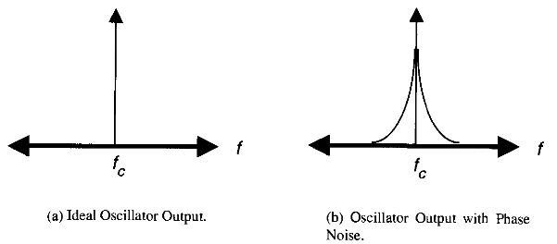
Local Oscillator
In the frequency domain, a signal with and without phase noise is shown in Figure
Multiplying a received signal by a noisy LO is equivalent in the frequency domain of convolving their two spectra, producing a widened resulting signal spectrum compared to that of the ideal LO case.

Slide 18
Local Oscillator
If an adjacent channel interfere is present, its spectrum after mixing will be widened, and thus the interference may now lie in-band with the desired signal.
A high level of phase noise could be a significant source of interference.

Slide 19
Automatic Gain Control
The AGC is primarily used to ensure that the signal has a voltage level that is compatible With ADC.
The AGC should be fast enough to account for changing signal levels without introducing distortion.
The placement of the AGC is made to ensure that minimal noise is injected into the system.
The AGC is necessary to ensure that the signal is not clipped by the ADC, which would create non-linear distortion.
AGC is set to provide some average magnitude value that is below the maximum value of the ADC

Slide 20
Automatic Gain Control
It may be advantageous to implement the AGC as a series of amplifiers strategically placed in the circuit with gain that can be turned on or off via software control to keep the circuit operating at ideal signal power levels.
A combination of RF AGC and IF AGC schemes is used in conjunction to maintain adequate SNR as well as linearity at the input of the receiver.
At very high signal strengths where the noise figure of the receiver is not crucial, the LNA is bypassed to improve the operating linearity point of the receiver.

Slide 21
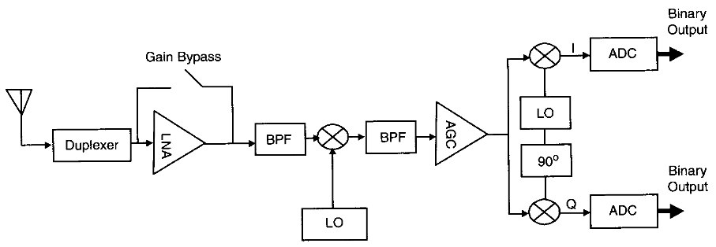
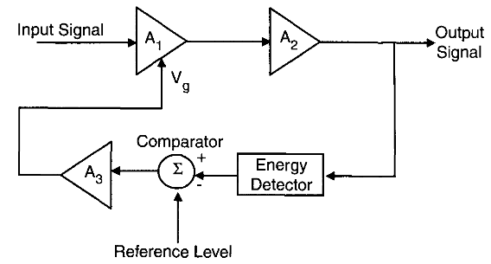
Figure : Cascaded AGC Approach.
Figure : Schematic of an AGC System

Slide 22

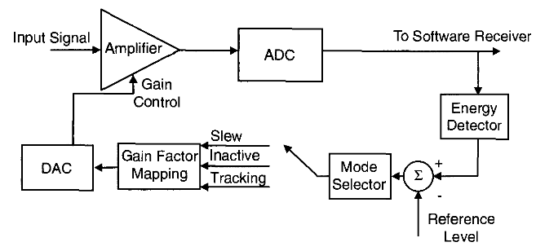
This parameter indicates how the output level changes with a small change in the input level and basically depends on how the amplifier gain A1 changes in response to Vg.
Block Diagram of a Digital AGC System.

Slide 23
Analog to Digital Converter
The ADC is the most difficult component to select and the one that places the most constraints on the system design
If perfect ADCs were available, the TRF architecture would likely be the architecture choice for nearly all wireless systems
A trade-off must be made between real limitations such as sampling rate, dynamic range, ADC resolution, and power consumption
The ADC must sample a real signal at a rate that is at least twice the bandwidth of the signal
Different signaling standards require different amounts of dynamic range
This dynamic range is usually set by the amount of adjacent channel interference the system

Slide 24
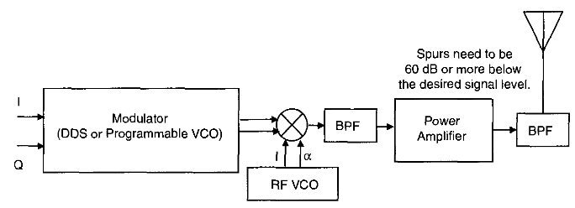
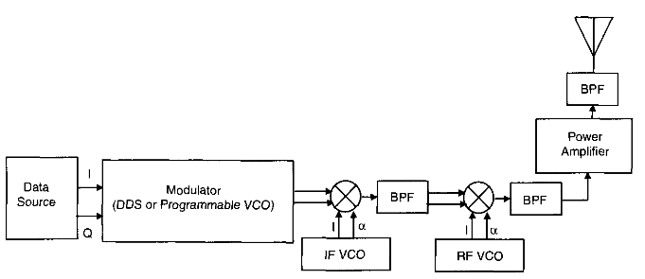
Transmitter Architectures and Their Issues

Slide 25
Flexible RF Systems
Using Microelectromechanical Systems
RF hardware tends to be rigidly fixed for a particular bandwidth and operating frequency
The use of Microelectromechanical Systems (MEMS) in the design of RF components allows a single-chip RF front-end much more flexibility than using traditional design approaches.
Using microfabrication technology, many types of miniaturized mechanical devices, such as very low loss and wide bandwidth switches, variable capacitors and inductors, varactors, high quality factor filters, planar impedance tuners, and reconfigurable antennas, can be used to create a very flexible RF front-end.

Slide 26
MEMS devices are manufactured using batch fabrication techniques, similar to integrated circuits (ICs).
The bringing together of integrated circuit processing and micromachining techniques makes it possible to implement nearly lossless switches that can be used to create a bank of RF front-ends to cover a wide range of bands.
The second characteristic of MEMS is the ability to form filters with a high quality factor, reducing interference levels early in the RF chain and thus reducing the dynamic range requirements on components such as the LNA or ADC.

Slide 27
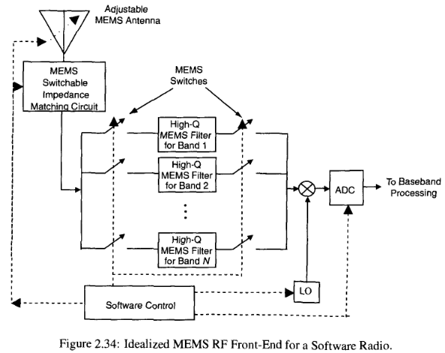

Slide 28
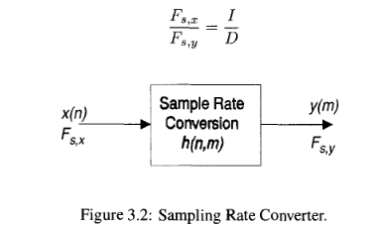
Sample Rate Conversion Principles
A data stream can be downsampled to a lower sampling rate or upsampled to a higher sampling rate.

Slide 29
Decimation
Decimation is the process by which high frequency information is eliminated from a signal to reduce the sampling frequency without resulting in aliasing.

