Slide 1
Unit 3 - Multi Rate Signal Processing and Digital Generation of signals

Slide 2
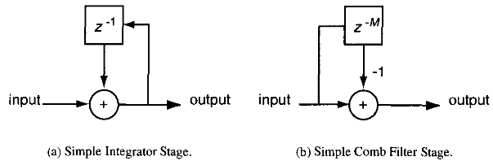
Cascaded Integrator Comb Filter
In software radio systems, sample rate changes can be very large, with changes from many tens of MHz to around 100 kHz.
such a requirement leads to large order and high-rate digital filters, which can easily become a bottleneck in the overall system design.
A cascaded integrator comb (CIC) filter can be used to reduce the computational demands
A CIC filter is a cascade of simple integrators (accumulators) and a cascade of comb filters (delay and subtract from current sample).
The basic building
blocks are shown in Figure.

Slide 3
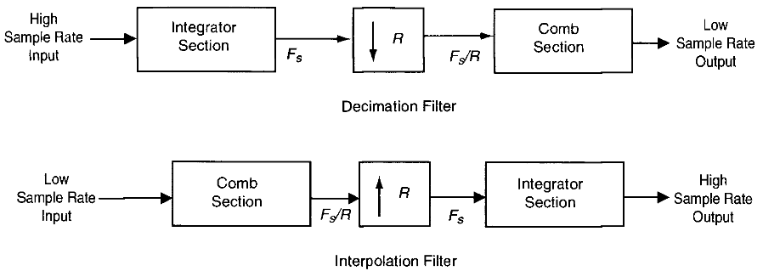
The CIC filter can implement an interpolation or decimation filter that uses only delay and add operations and thus is well-suited for FPGA and ASIC implementation.
Further, the same basic filter structure can be used to handle variable sample rate conversion

Slide 4
    CIC Filter Vs FIR Filter
CIC filters have low pass frequency characteristics, while FIR filters can have low-pass, high-pass, or band-pass frequency characteristics.
CIC filters use only addition and subtraction.FIR filters use addition, subtraction, but most FIR filters also require multiplication.
CIC filters have a specific frequency roll-off, while low pass FIR filters can have an arbitrarily sharp frequency roll-off.
CIC filters are in general much more economical than general FIR filters
In cases where only a small amount of interpolation or decimation are needed, FIR filters generally have the advantage

Slide 5
For large rate changes, a CIC has a significant advantage over a FIR filter with respect to architectural and computational efficiency.
FIR filter can use fixed or floating point math, a CIC filter uses only fixed point math
The range of filter shapes and responses available from a CIC filter is somewhat limited.
Larger amounts of stopband rejection can be achieved by increasing the number of poles. However, doing so requires an increase in bit width in the integrator and comb sections which increases filter complexity.
The shape of the filter response provides even fewer degrees of design freedom. For this reason, many real-world filtering requirements cannot be met by a CIC filter alone

Slide 6
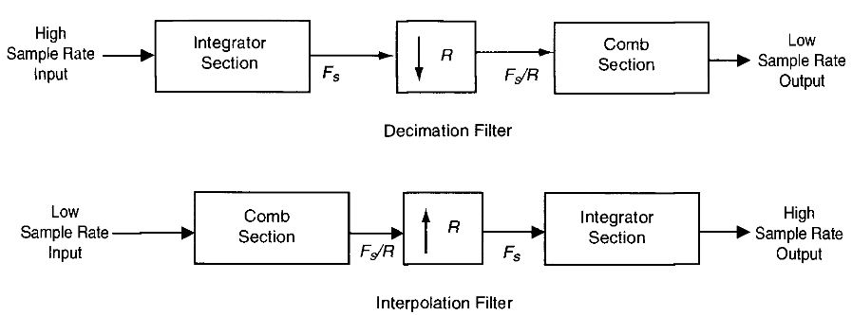
    Decimation and Interpolation Using Comb and Integrator Filters
Basic Structures : CIC Decimation Filter
The CIC implementation of a decimation filter is the cascade of an integrator stage, a decimation procedure, and a comb stage as shown in Figure below

Slide 7

To analyze the CIC filter's response, combining the integrator and comb stages into a single transfer function are important to reduce the complexity of the analysis.
However, to reduce the computational expense of the operation, the implementation of the filter is performed in two separate sections, before and after the decimation.
The integrator section is the cascade of N ideal digital integrator stages operating at the high sampling rate of F3, where the transfer function is defined as

Slide 8

The comb sections consist of N comb stages operating at the low sampling rate of F_{s}/R, where R is the integer-rate change factor.
The comb sections have a differential delay of M samples per stage, where the system function is defined as
M is typically chosen as 1 or 2
The cascade of the integrator and comb sections of the CIC filter requires a decimation process to be implemented between these two filters

Slide 9
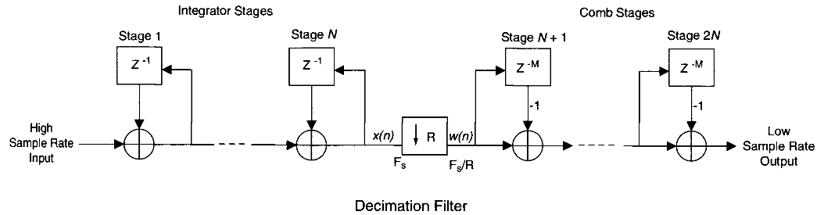
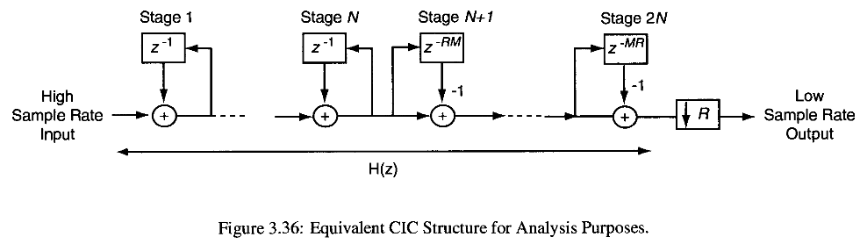

Slide 10


The order of the comb filter and the decimation procedure can be switched without causing any change in the end results of the filtering operation.
The integrator and comb stages of the filter can be combined into a single transfer function, thus simplifying analysis. The transfer function of the cascaded integrator comb filter before decimation is then
and the frequency response (with respect to the higher input sample rate) is

Slide 11


Note that the frequency response H(u>) is with respect to the original sample rate. By letting ω' = ωR, the frequency response with respect to the decimated sample rate is found
Note that a null in the frequency response occurs at 1/M for both the decimated and non-decimated filters, Furthermore, if R is large, then H(ω’) can be approximated as
The gain of the filter is (RM)^{N}, which can become very large, necessitating the need for large registers

Slide 12
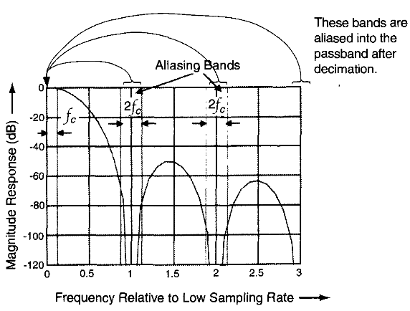
As an example, the frequency response is plotted for N = 4, M = 1, R = 7 for a cutoff frequency f_{c} = 1/8. The input sample rate is 7 and the output sample rate is 1
Note the bands at multiples of 1 Hz will be aliased into the passband region about 0 Hz.
At multiples of 1 Hz, there are nulls in the frequency response and thus aliasing will be minimal in the passband.
The filter is designed to attentuate the signal so that there are acceptable levels of aliasing at the passband edge, fc.

Slide 13
CIC Interpolation Filter
The structure of the interpolation CIC filter uses a comb stage followed by an upsampler and an integrator stage.
The analysis of the interpolator CIC filter follows that of the decimator filter. One difference here is that the purpose of the CIC filter for the interpolator is to suppress replicated images that occur due to zero-insertion, while the CIC filter for decimator is used to suppress aliasing.

Slide 14
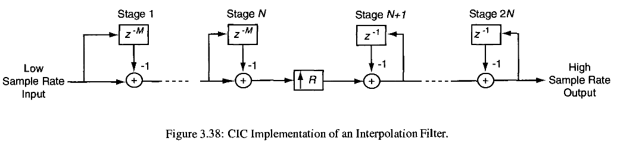
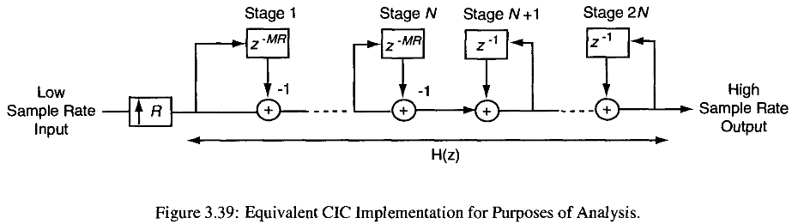

Slide 15
Economics of CIC Filters
The CIC filter presents several advantages over more basic implementations of decimation and interpolation filters:
no multipliers are required,
no storage is required for filter coefficients,
the structure of CIC filters is very regular, consisting of two simple building blocks,
very little external or complicated control is needed

Slide 16
Digital Filter Banks
The application of digital filter banks are to break a wideband signal into multiple bands (channels).
Each of these bands can be processed individually, thereby allowing lower-speed computational techniques to be applied to each of the channels.
This partitioning of a signal using a digital filter bank can be applied to other applications apart from the reduction of computational complexity, such as the conversion of a signal from FDM to TDM or vice versa

Slide 17
In the following discussion, we assume a uniform filter bank, i.e., all the channels have the same bandwidth and sampling rates.
The channel outputs are also assumed to be critically sampled, meaning that the total number of samples per unit time from all the channel outputs together is the same as the number of samples per unit time of the input signal. (No. of output samples of all channels = input samples )
We consider the DFT as a filter bank, and, although it is not very good in terms of stopband responses.

Slide 18
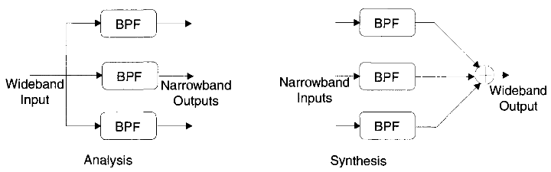
Implementation
The implementation of a digital filter bank follows two basic architectures:
  1. An analyzer for decomposing the input signal into several channels 2. A synthesizer for reconstructing the input by combining the channel signals
(a) Digital Filter Bank Analysis, (b) Synthesis Architecture

Slide 19
In a filter bank analyzer, the input signal is divided into a set of N channels using complex bandpass filters.
The center frequencies of these bandpass filters H_{k}(ω- ω_{k}) are equally spaced with center frequencies ω_{k} = 2πk/N, k=0, 1, 2, 3, . . .N-1.
The output of these filters can be decimated by a factor of N.

Slide 20
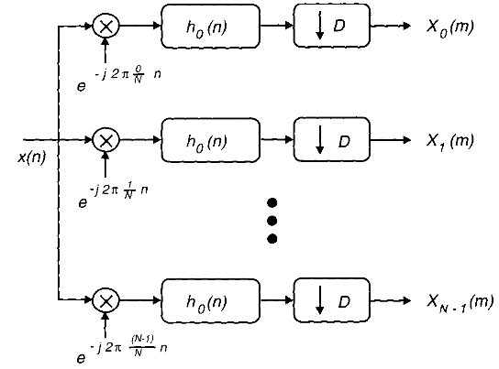

DFT Filter Banks
The DFT is a well-known approach for splitting a signal into several bands.
The input signal, x(n), is first multiplied by the complex sinusoids e^{-jωkn}, k=0,1,2, N - 1, resulting in N complex signals.
These modulated signals are then lowpass filtered by h(n) and downsampled by a factor of N (critically sampled), and thereby effectively converting them to baseband signals.
The channel outputs, X_{k}(m), can be expressed as
N-channel DFT filter bank analyzer

Slide 21


for practical purposes, assume that the filter h(n) has a finite impulse response of length N.

Slide 22
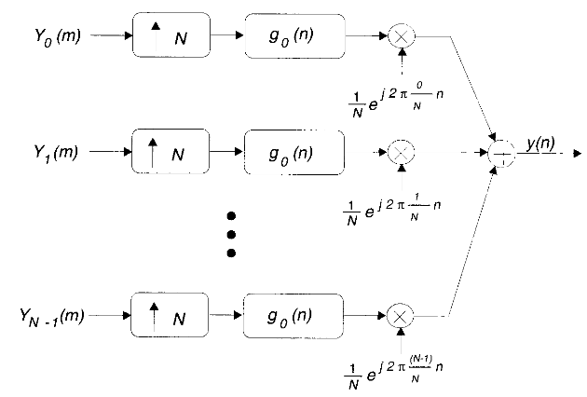
In the DFT filter bank synthesizer, all the N channel signals are interpolated (upsampled and lowpass filtered) first by a factor of N that restores them to their original sampling rate.
Finally, all the channel signals are upconverted and summed to get the synthesizer output.

Slide 23
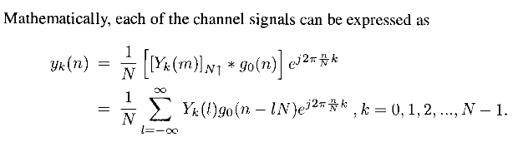

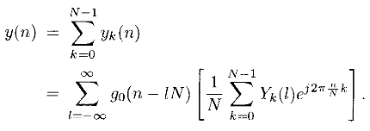
synthesis is achievable by taking the IDFT across channels and interpolating each resulting time sample with the LPF go{n)

Slide 24

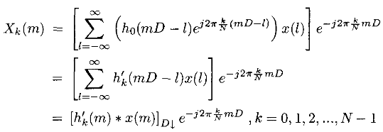
Alternative Architectures
An alternative way of implementing the DFT filter bank can be developed as follows
the basic DFT filter bank analyzer output is given by
This time it is assumed that the signal is not critically sampled, i.e., D ≠ N. Equation (1) can then be written as

Slide 25
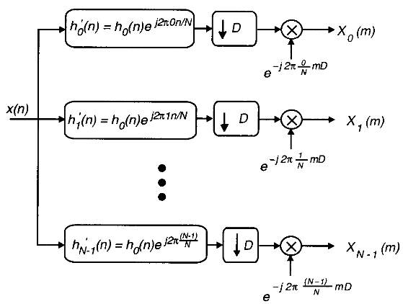
Where,
The alternate structure for the analyzer

Slide 26
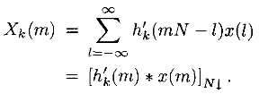

In each channel, the signal is bandpass filtered by h_{k}(n), downsampled by a factor of D, and then downconverted by the complex sinusoid e^{-j2kn/N} ,k = 0,1,2,….. N- 1. In the case of critical sampling, i.e., D = N, Equation (2) becomes
Similarly, an alternative structure can be created for the synthesizer. In the basic DFT filter bank synthesizer

Slide 27
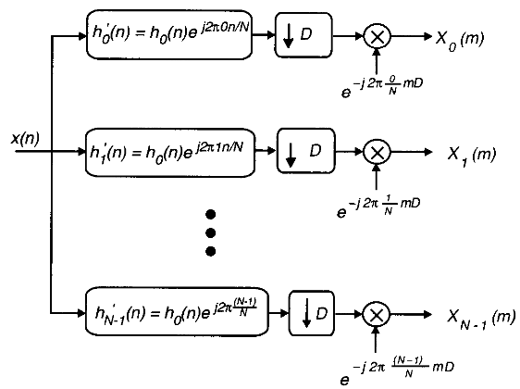
Another way of expressing above Equation is

Slide 28
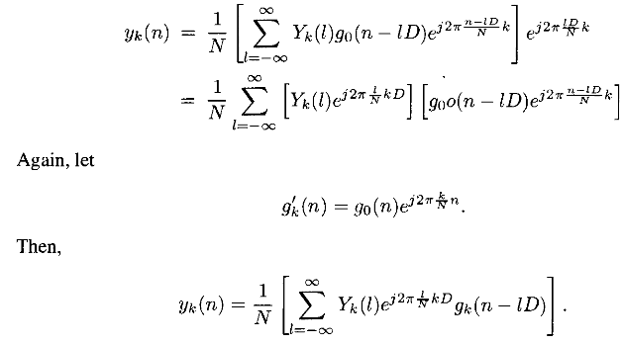


Slide 29
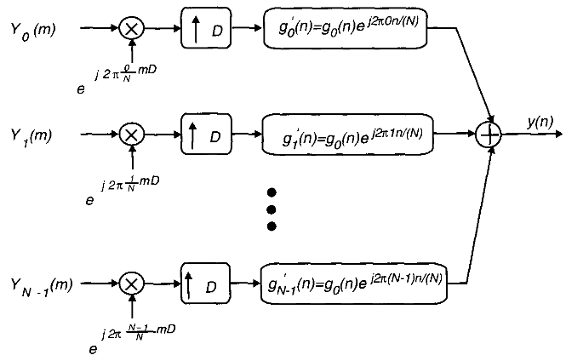

Slide 30
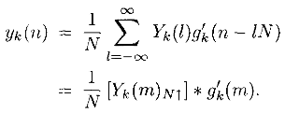
In this alternative implementation, each of the channel input signals is separately multiplied by the complex sinusoid, translating the frequency bands to their original spectral location.
The upconverted signals are then interpolated by a factor of D, converting the sample rate to the original value.
The interpolation filter is the complex BPF, the impulse response of which is given by g'k(n), k = 0,1, 2,N — 1, which selects the desired bandpass image.
For the case of critical sampling, i.e., D = N,

Slide 31
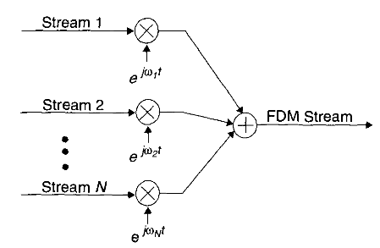
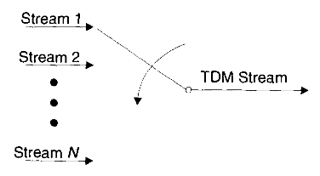

Transmultiplexers
An application of multirate digital signal processing in communications is in the channelization of data streams.
The goal of these techniques is to convert a TDM signal into a FDM signal, conversely, an FDM signal can be converted in a TDM signal.

Slide 32
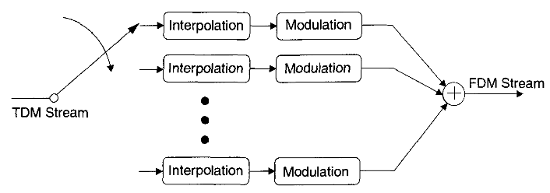
TDM to FDM Conversion (DFT filter bank synthesizer )
A block diagram of a system that performs a TDM to FDM conversion is shown below.
The TDM to FDM conversion converts a single data stream into a channelized version of the original signal.
The IDFT process collects several narrowband signals and generates a single wideband signal that contains all the information received.

Slide 33
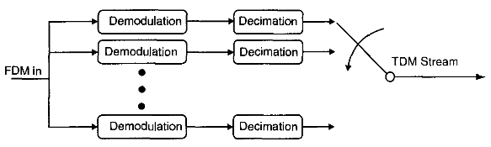
FDM to TDM Conversion (DFT filter bank analyzer )
Block diagram of an FDM to TDM conversion system is shown below.

Slide 34
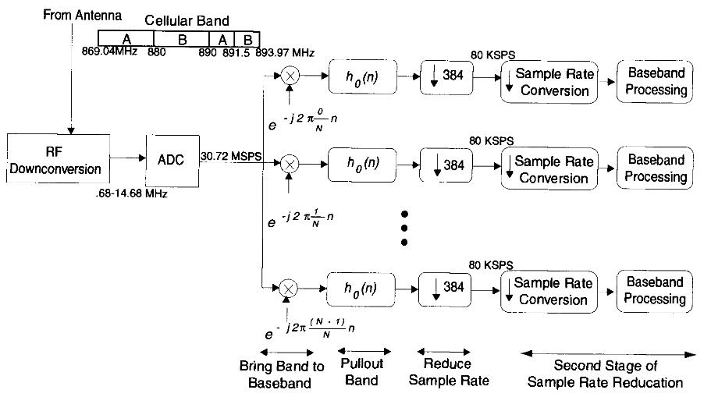


Slide 35
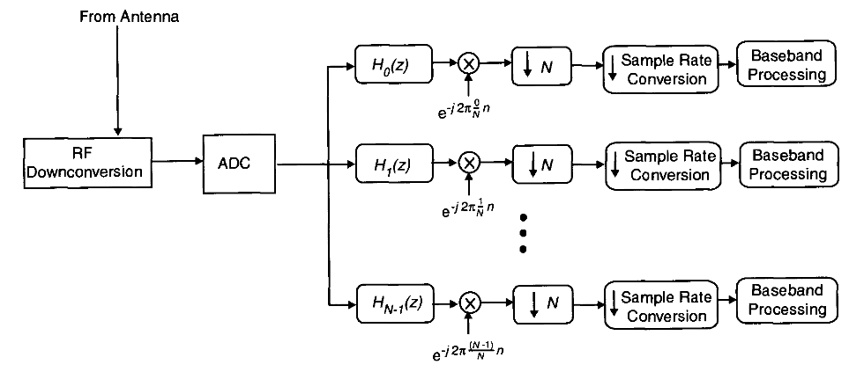

Slide 36
Timing Recovery in Digital Receivers
Using Multirate Digital Filters
Multirate signal processing is very useful for creating flexible timing recovery techniques for radios supporting multiple waveforms.
Multirate digital signal processing timing recovery techniques may also reduce complexity compared to conventional timing recovery techniques that rely on altering the sample rate of the ADC.
A feedback loop is used in conventional techniques to adjust ADC timing, which spans across both analog and digital domains, greatly complicating the overall design.
Multirate digital filters can be used in digital signal processing based receivers to avoid crossing between domains and to allow for simplified timing recovery, providing a more flexible approach to support multiple waveforms

Slide 37
Timing Recovery in a Classical Analog Receiver
In the classic l&Q receiver, shown in Figure 3.59, a PLL is used to control the phase of a VCO.
By altering the phase, the output of the matched filter is sampled at the optimal instance. (Note that this structure is somewhat inflexible since software control of the analog matched filter is difficult to accomplish.)
A more modern approach is shown in Figure 3.60. The signal is sampled prior to the matched filtering operation.
However, the timing recovery requires feedback between the analog and digital domains, which complicates the overall design

Slide 38
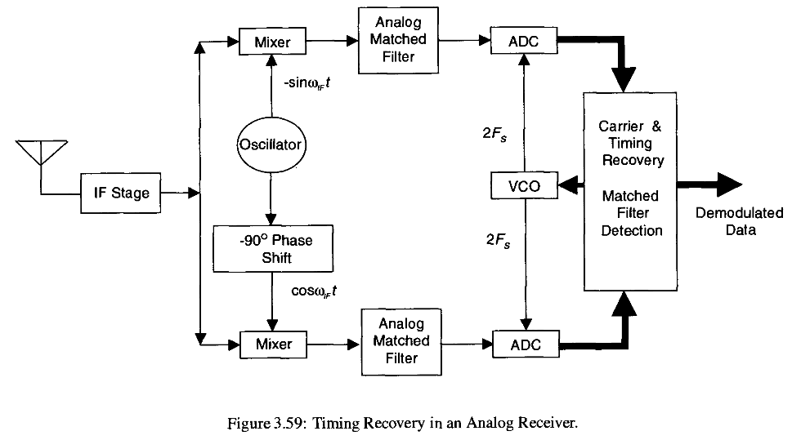

Slide 39
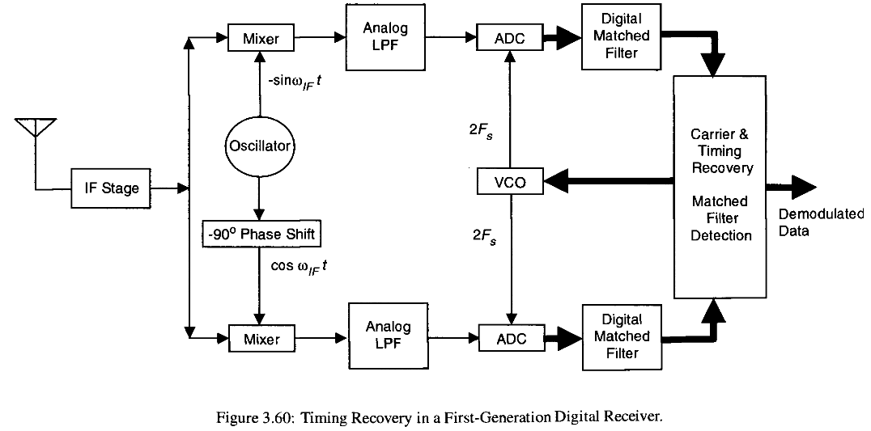

Slide 40
Approaches to Direct Digital Synthesis
There are two basic approaches for generating signals directly from digital hardware
  ROM LUT approach
  Pulse output DDS
In ROM LUT approach, the sampled values of the sine waveform are stored in ROM and are output periodically through a DAC to generate the output waveform.
In second approach, pulse output DDS, a phase accumulator is used to obtain a series of periodic pulses (or a rectangular
or sawtooth waveform) from which other waveforms can be created

Slide 41
Like all digital systems, a direct digital synthesizer is driven by a reference clock signal.
The Nyquist sampling theorem limits the theoretical maximum attainable output lowpass frequency to half the clock frequency f_{clk}/2.

Slide 42
Pulse Output Direct Digital Synthesis
One of the simplest forms of a DDS system is a pulse output DDS (PO DDS) system.
This DDS approach generates pulse, sawtooth, or rectangular waveforms. Other waveforms can be created from these basic waveforms.
The idea is to create the rectangular waveform by cycling through an accumulator as a way to create an adjustable pulse frequency from a stable high-frequency driving clock.
PO DDS consists of an bit adder and register to form an accumulator
A frequency word Δ_{r} is added to the accumulator once every clock period, T_{clk} .

Slide 43

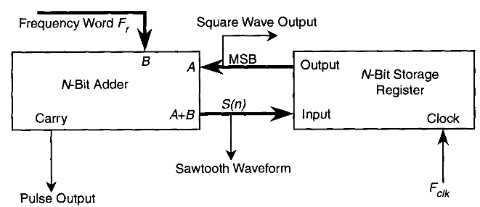


The output of the accumulator, S(n) at time n, is given by

Slide 44
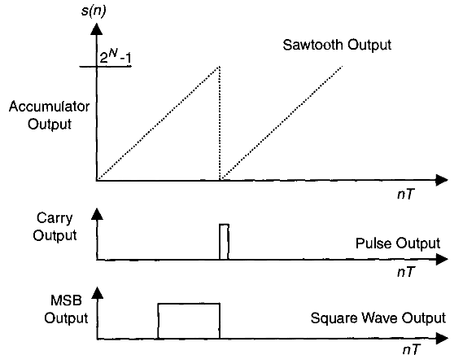
The output of this synthesizer could be the carry output of the accumulator for a pulse output (Figure 2) or the most significant bit (MSB) of the accumulator to represent the approximate square wave output, or S(n), for a sawtooth waveform

Slide 45
ROM Look-Up Table Approach
The ROM LUT approach uses sampled values of a periodic function stored in a ROM.
Every clock cycle, a value of the periodic function stored in the ROM is output through a DAC to generate the synthesized signal.
The output from the DAC, however, is a distorted analog signal due to the sample and hold nature of the waveform.
Therefore, the signal obtained at the output of the DAC is passed through LPFs and amplifiers to obtain the final analog waveform.
Sometimes it is advantageous to perform digital filtering before the digital to analog conversion to compensate for the distortion of the non-ideal analog filters.

Slide 46
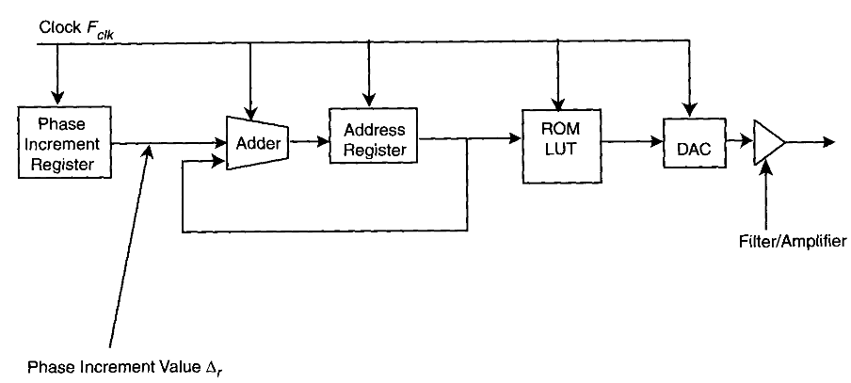
DDS-based function generators are based on a single crystal oscillator, which generates a reference clock frequency.
The structure of a DDS system using a ROM LUT is shown below.

Slide 47
The adder and register function as an accumulator and increment the output value by Δr at each clock cycle.
For example, if the first adder output is zero and the phase
increment Δ r is 17, then the second output would be 17, the third would be 34, the fourth 51, etc.
The output of the accumulator takes the form of an address used by a ROM LUT that contains the waveform samples.
The number of clock cycles needed to step through the entire ROM LUT defines the time period of the waveform.
The waveform period is determined by Δr.
The LUT holds the digital representation of the desired waveform, which is made up of digital words that define the amplitude of the waveform as a function of phase.

Slide 48
The address generated by the adder represents the phase value of the waveform.
For example, if the ROM LUT has 512 addresses, address 0 would correspond to the phase of the waveform equal to 0 degrees and address 511 would correspond to the phase of the waveform equal to (511/512)*360°.
The address generator sequentially reads the table of digital values out of the memory and passes them to a DAC to generate the output waveform.
The DAC changes each of these digital words into an analog voltage, which is fed through filters to reduce the distortion and amplifiers to produce an analog signal.
The period of the output waveform is based on the phase increment value Δr and the frequency of the clock signal F_{clk}.

Slide 49

Phase Truncation Distortion
The size of the ROM needed can be a major design issue and sometimes it is necessary to limit the address size before going into the random access memory (RAM).
This process is essentially truncating the phase of the signal.
Example:
To output a particular frequency, the proper phase increment value must be loaded into the accumulator. The original address is increased by the phase increment and is used to index the ROM LUT.
According to the Nyquist sampling criterion, the maximum value lowpass output frequency, F_{out}, is F_{clk}/2, although it is customary to limit Δ_{r} to F_{clk}/4 to accommodate non-ideal analog filters. Given that the smallest change in Δ_{r} is 1, the frequency resolution is found from Equation

Slide 50
For example, if the maximum output frequency is 2.5 MHz, with a tuning step of 1 Hz, F_{clk} should be 10 MHz. The accumulator should have sufficient width given by 2^{N}.
Solving for the smallest accumulator size gives N = 24, which means that the size of a LUT should be 2²⁴ or 16 MB.
Typically eight bits may be used to represent each sample. Having this size of memory on a board is costly.
The number of ROM bytes required can be reduced by storing only one-fourth the period of the sine wave and repeating it with the necessary sign inversion.
However, the size of the memory remains 4 MB, which is still very large.

Slide 51
To circumvent the problem of having a large amount of memory, not all of the N bits of the phase accumulator are used to address the ROM. Instead fewer bits, say W, are used to address the ROM while retaining the number of bits used in the accumulator. This approach is called phase truncation.
Often, on a particular clock pulse, the accumulator output does not advance, so the ROM causes the DAC to deliver the same voltage as on the previous clock cycle. Thus the phase is held back by 2π/2^{W} radians before continuing to creep forward as before.
The variation of the phase at the output of the DDS with phase truncation is explained in Table below.
Here a three-bit DDS accumulator (N = 3) is used, but only two of the MSBs (W = 2) of the accumulator are used to address a 2x8 ROM.

Slide 52
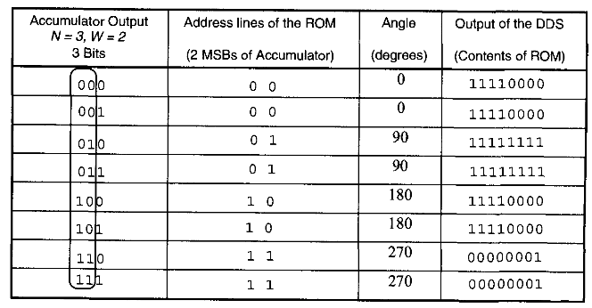
Table shows the output of the accumulator, the input to the ROM address lines, and the output of the ROM.
The addresses and the contents of the ROM LUT are also shown in Table.

Slide 53
An example of a rudimentary DDS system using phase truncation follows:
The system has an accumulator of length five bits, of which three bits are used to address an 8x8 ROM.
The only function of the address latch is to latch the addresses at the ROM over a complete clock cycle.
The three MSBs of the accumulator held at the latch are capable of addressing 2³ or 8 memory locations. Hence an 8x8 ROM is used to store the values of the periodic function
For convenience, sine function values are shown in the memory.
At every clock cycle, the output of the accumulator corresponds to a unique address in the ROM.
The value stored at this address is then output to the DAC. The output of the DAC is then passed through reconstruction filters and amplifiers

Slide 54
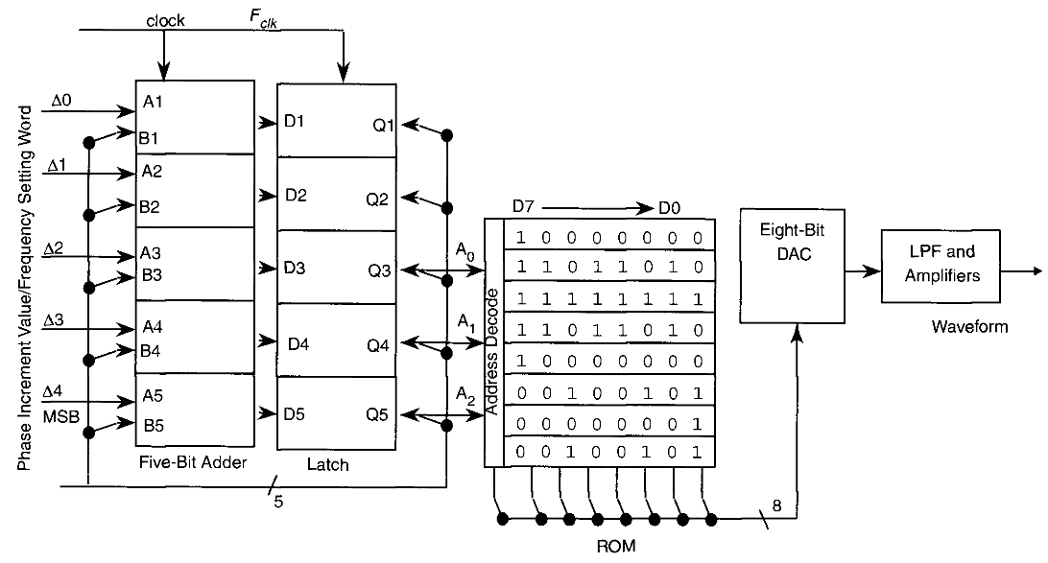

Slide 55
The accumulator generates a maximum of 2⁵ or 32 unique addresses. However, since only three MSBs are used, only 2³ or 8 unique addresses are created. Thus the values stored in the ROM correspond to one complete cycle.
So, the eight values in the ROM need to represent the amplitudes of a sine wave at 45° intervals.
The amplitude values stored in the ROM range from 1 for the negative peak of the waveform to 2 5 5 for the positive peak. The DAC assumes an offset binary representation where the value 12 8 corresponds to the mean level of the waveform
In Table 4.3, the output of the accumulator, the input to the ROM, and the output of the direct digital synthesizer when Δ_{r} = 1 are shown at each clock cycle for one complete period.
Assuming the beginning state where the latch content is all 0s, the ROM address lines will all be 0, so the ROM will output 10000000.

Slide 56
The value of 10000000 (D7-D0) is stored in the first ROM location as seen in Table 4.3. This causes the DAC to output 0 V, corresponding to the value of a sine wave at 0°.
Four clock cycles later, the accumulator contents are incremented by four since Δr = 1.
For the first four clock cycles, the output of the ROM is 10000000. The value at the output of the adder will be 00100 (binary for 4) after four clock cycles.
The three MSBs of the adder's output addressing the ROM are 001. A0 is now 1, so the ROM will output 11011010, which is the value stored in the second memory location in the ROM. This corresponds to the offset binary representation of the value of a sine wave at +45°, and accordingly, the DAC output for 45° becomes 1 V.
After thirty-two clock cycles, the accumulator is full, and the DAC has delivered a complete cycle of a stepwise approximation to a sine wave.

Slide 57
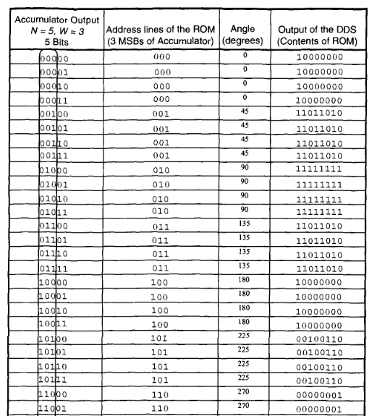

Slide 58
If the frequency setting word Δ_{r} is changed to 00010 (2 in decimal), the whole process will complete one output cycle in half as many clock periods.
The higher the value of the frequency setting word (Δ_{r}), the fewer the clock cycles needed to cycle through the ROM once and hence the higher the output frequency.
The highest value of Δ_{r} is, however, limited by the Nyquist theorem.

