Slide 1
Software Defined Radio
UNIT -II

Slide 2
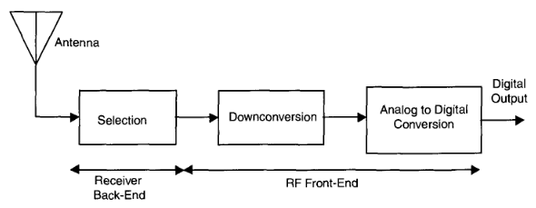
The Purpose of the RF Front-End
The purpose of the receiver is to reject undesired signals and condition the desired signal for digital signal processing.
The receiver takes the signal from the antenna, filters it to remove undesired signals, and then converts the signal to a center frequency with an amplitude compatible with the analog to digital conversion process.
Processing Steps in the Receiver RF Front-End

Slide 3
Processing Steps in the Receiver RF Front-End
Reject as many undesired signals as possible.
With minimal distortion, convert the desired signal's center frequency to a range compatible with the ADC.
The process of mixing or frequency translation may lead to undesirable non-linear distortion and introduction of additive noise.
With minimal distortion, amplify the desired signal to the level required by the ADC.
Minimize additive noise.
Achieve a dynamic range that is compatible with that of the ADC.
Dynamic range is defined as the difference in power between the weakest detectable signal and the strongest signal.

Slide 4
Processing Steps in the Receiver RF Front-End
The RF front-end must separate a desired signal, typically in the picowatt range (—160 to -100 dBW)
the RF front-end also sets the system signal-to-noise ratio (SNR) and should be designed to add minimal noise.
Thus the overall system must have a considerable dynamic range to accommodate both the high-power background signals and the lowest-power desired signal.
The wider the bandwidth of the receiver, the more potential for interference and noise, and thus, the more difficult it is to achieve high dynamic range.

Slide 5
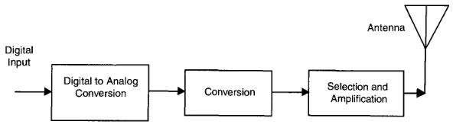
Processing Steps in the Transmitter RF Front-End
The purpose of the transmitter RF section is to convert the digital representation of the analog signal into a radiated analog signal.
The process is nearly reverse that of the receiver and includes converting a digital signal, upconverting the analog signal to the desired RF center frequency , amplifying the signal to the appropriate power level, and limiting the signal's bandwidth before it is radiated.

Slide 6
2. Dynamic Range: The Principal Challenge of Receiver Design
Dynamic range is the key design challenge in building an RF front-end since it provides a measure of the highest and lowest-level signals that can be simultaneously accommodated by the radio.
Dynamic range is limited at the bottom of the range by noise that enters the system through thermal effects of the components or through non-idealities of the ADC, such as quantization noise or sampling aperture jitter.
Low-level signals can be masked by this noise

Slide 7
Dynamic Range: The Principal Challenge of Receiver Design
Dynamic range is limited at the high-end by interference.
The source of this interference could be co-channel, adjacent channel, or self-induced by the transceiver
High levels of interference may cause the receiver to become more non-linear and introduce cross-products, which may inhibit the detection of low-level signals or reduce the desired signal bit error rate (BER)
Attenuating the high-level signals before they drive the receiver into a non-linear operating region is insufficient since low-level desired signals that are also present will be attenuated until masked by system induced noise and thus will fall below the sensitivity of the receiver.

Slide 8
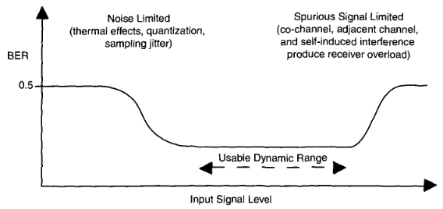
Non-linear distortion can be characterized as intermodulation, cross-modulation, and reciprocal mixing.
Intermodulation distortion creates signal energy at the sum and difference frequencies due to products of all signals present.
Cross modulation occurs when the modulation of the stronger signal is imparted onto the weaker desired signal.
Reciprocal mixing is the cross-product of an adjacent channel signal and a noisy oscillator signal and results in a higher noise floor in the region of the desired signal.

Slide 9
Proper selection of components and good circuit design techniques, particularly in the active components, can improve the dynamic range of the RF front-end.
Providing good initial selectivity at the RF front-end can reduce the nterference levels.
Direct current (DC) bias in the signal can consume the dynamic range. This bias is possibly produced by self-mixing in the mixer circuits (the local oscillator signal is picked up at the other mixer input and produces a DC output)

Slide 10
RF Receiver Front-End Topologies
A number of different RF front-end topologies are appropriate for software radios.
Each has its own advantages and disadvantages.
The most common types of RF front-ends are dual conversion, single conversion, and tuned radio frequency receivers.
Characteristics of the Topologies
Receiver topology depends on a number of parameters
Sensitivity defines the weakest signal level that a receiver can detect and is usually determined by the various noise sources in the receiver.

Slide 11
Stability indicates the lack of change in the receiver gain and operating frequency with temperature, time, voltage, etc
Dynamic range is the difference in power between the weakest signal that the receiver can detect and the strongest signal that can be supported (either in-band or out-of band) On the receiver without detrimental effects
Spurious response is a receiver's freedom from interference due to internally generated spurious signals or to their interaction with external signals

Slide 12
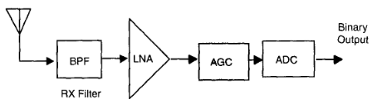
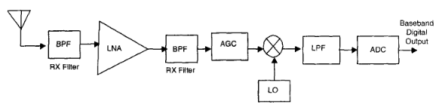
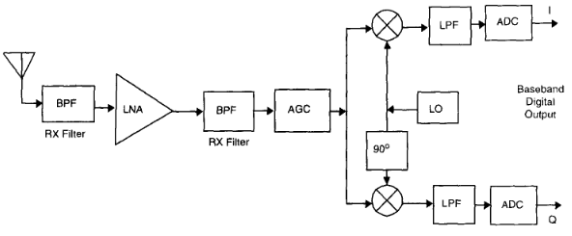
Figure 2.4: TRF Digital Signal Processing Receiver
Figure 2.5:
(a) Single Conversion Receiver for Binary Phase Shift Keying (BPSK) and Amplitude Modulation (AM),
(b) Single Conversion for Frequency and Phase Modulated
Signals

Slide 13
TRF Digital Signal Processing Receiver
The tuned radio frequency (TRF) receiver, consists of an antenna connected to an RF BPF. The BPF selects the signal and the LNA with the automatic gain control (AGC) raises the signal level for compatibility with the ADC.
BPF bandwidth relative to the carrier frequency can be quite narrow, while in absolute bandwidth, it may be quite broad band.
The primary difficulty in creating a practical TRF receiver is the limitation of the ADC, which must handle high-frequency signals.

Slide 14
TRF Digital Signal Processing Receiver
In addition to the given the bandwidth and roll-off limitations of the RF filter, the sampling rate of the ADC must be very high to avoid significant aliasing.
High power consumption is required with high sampling rate conversion
The ADC must accommodate multiple signals over the wide bandwidth of the RF filter
In practice, the RF filter can select only a general band of interest; subsequent filtering within the DSP is required to extract the desired channel.
The AGC adjusts its gain to accommodate varying signal levels to utilize the full range of the ADC without overloading it

Slide 15
Single Conversion Receiver for BPSK and AM
A very popular topology for low-power application is the single conversion receiver which uses a single mixing stage to convert the signal to baseband or near baseband.
This receiver has one stage of downconversion.
In the case of a phase or frequency modulated signal, I&Q downconversion is required.
since only one mixer stage (possibly I&Q) is used in the single conversion receiver, the receiver potentially offers good power consumption characteristics.

Slide 16
Single Conversion Receiver for BPSK and AM
LO leakage has the potential of creating leakage across input ports
Isolation between the LO and input to the mixer or other components is very desirable but difficult to achieve
An alternating current (AC) coupling capacitor
helps but may remove important DC information in the signal

Slide 17
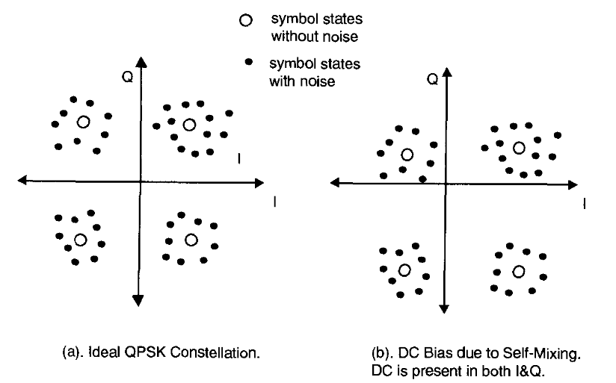
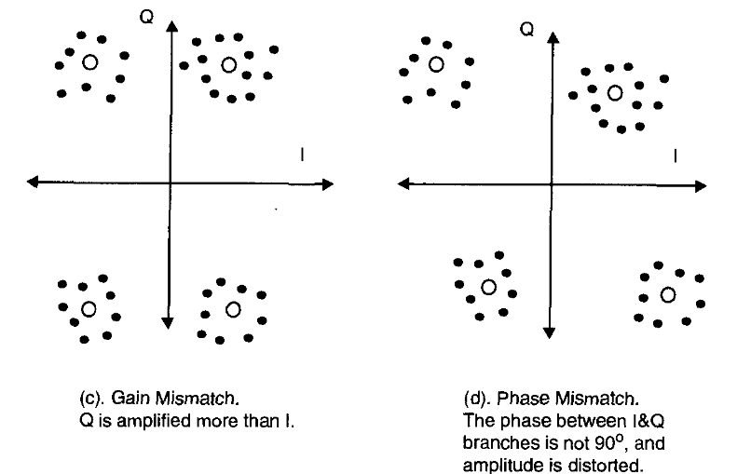
Single Conversion for Frequency and Phase Modulated Signals
A more effective though more costly approach is to track the DC error after digitization and feed back a correcting bias signal using a DAC and subtractor.
A non-ideal I&Q downconversion may result if the phase and amplitude of the branches are not matched and cause a warping of the received signal constellation diagram for the case of a quadrature phase shift keying (QPSK) signal.

Slide 18
Heterodyne Receiver
The most common RF front-end for radios is the heterodyne receiver. This receiver is commonly used in analog radios.
A heterodyne receiver works by frequency translating the incoming signal to an IF that is fixed and independent of the desired signal's center frequency.
When this IF frequency is lower than the center frequency of the received signal's carrier frequency and higher than the bandwidth of the desired signal, the receiver is called a superheterodyne receiver.
The desired signal that is now frequency translated to a fixed IF can be more easily filtered, amplified, and demodulated.

Slide 19
Heterodyne Receiver
At each mixer stage, not only is the signal downconverted, but also a portion of the band at ω1, the image frequency, is upconverted, which places it on top of the frequency translated desired signal.
For instance, a 68 MHz LO (ω>LO) will downconvert the desired signal by 68 MHz, but the adjacent band, located 136 MHz below the desired signal, will be upconverted to the same frequency range (ω_{IF}, the intermediate frequency) in which the desired signal now lies.
In general, trade-offs exist in the selection of the IF frequency, the image filter, and the post-mixer filter

Slide 20
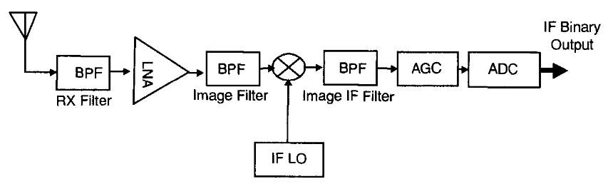
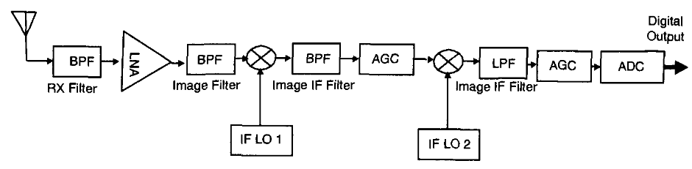
Heterodyne Receiver

Slide 21
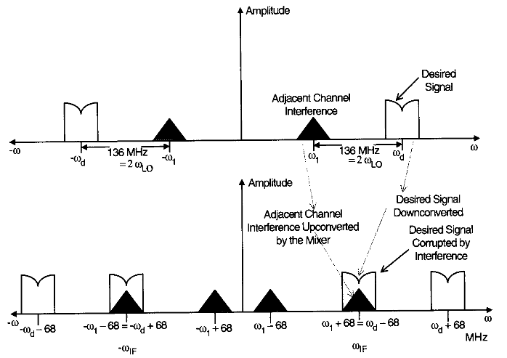
Image Frequency Problem of Heterodyne Receivers

Slide 22
Importance of the Components to Overall Performance
Antennas
The antenna is perhaps the weakest link in the overall design, and its importance in the design process is usually important.
For a software radio, which is designed to support multiple modes and multiple bands, the antenna choice becomes an even more crucial issue
multimode radios that cover the cellular band at 900 MHz and 2 GHz are difficult to support with a single antenna
In handsets, the form factor of the antenna is very important and the potential body coupling may help or hurt the antenna performance.

Slide 23
Antennas
For handset design, it is important to minimize radiation directed toward the head.
Exploitation of diversity or smart antennas can be performed at the handset or at a base station.
Diversity may be achieved by using multiple receiver chains and spatially separated antennas, antennas with different gain patterns or polarization characteristics.
Several antenna types are commonly used for mobile terminals, including the dipole, monopole, loop, and patch antennas

Slide 24
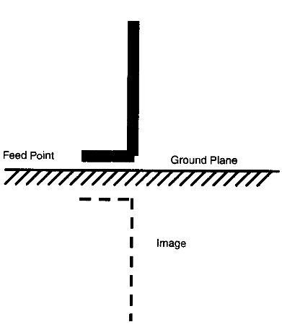
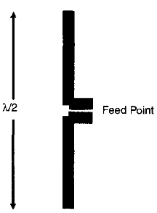
Antennas
The dipole antenna, has a length of half a wavelength, λ/2, and is the smallest self-resonant antenna structure.
The monopole antenna, is similar to a dipole antenna but with half of its length replaced by an "image" consisting of a large ground plane.

Slide 25
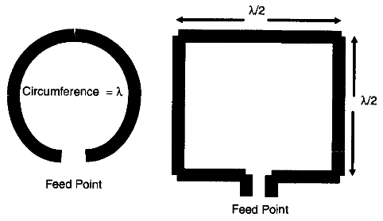
Antennas
The loop antenna, is a self-resonating structure when the circumference is equal to one wavelength.
The loop antenna works primarily through exploiting the changing magnetic field.
The impedance of this antenna is obviously very low and requires an impedance-transforming network to interface to the RF chain.

Slide 26
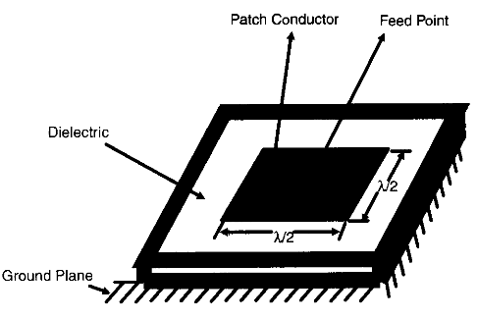
Antennas
A patch antenna, is formed by a conductor mounted on a dielectric substrate that is backed by a conducting ground plane.
A square patch has a length of half a wavelength and a circular patch has a diameter of approximately 0.6 wavelengths.
Because of the ground plane, the radiation is emitted over a half space, similar to that of a monopole.

Slide 27
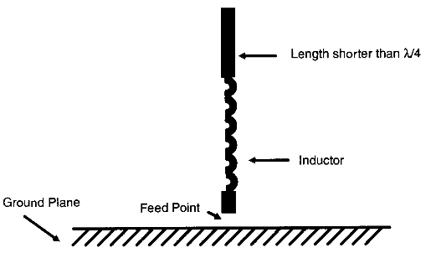
Antennas
Antenna form factor is very important in mobile systems, particularly for hand-held radios, and an excessively long antenna can be a big problem.
The "rubber ducky" antenna is the most commonly used antenna for hand-held radios because of its reduced length.
This antenna is basically a monopole antenna that uses a lumped or distributed inductance to make the resonating length shorter than a quarter wavelength.

Slide 28
Antennas
The inductance is typically a coiled wire that has a flexible, spring-like physical property.
It is useful to note that the human body serves as a ground plane for the antenna
On the other hand, the head can function as a ground plane, blocking the reception of the basestation signal coming from the direction of the head.
various antenna configurations have different polarizations, and the orientation of the radio will reduce the antenna's efficiency if the antenna and wave polarization do not match

