Slide 1
Software Defined Radio
UNIT -1

Slide 2
UNIT- I
INTRODUCTION & CASE STUDIES
Introduction to software Radio concepts:
  Need for software Radios
  Definition of software Radio
  Characteristics and Benefits
  Design Principles
Case studies:
  SPEAK easy
  JTRS
  SDR-3000

Slide 3
Wireless Communication System
Transport
TCP/UDP
Network
IP
Baseband
Processing
Analog
Front-end
LINK
PPP
MAC
Upper Protocol Layers
Physical Layer (PHY)
Application
bits
Packets
“Air”

Slide 4
Anatomy of Cellular Phone

Slide 5
Protocol on Wireless Platform
Source
coding
Audio
AMR/QCELP
Video
MPEG
GPP
(Software)
DSP/
Accelerator
Application
Processor
Transport
GPP
(Software)
Baseband
Processor
Upper
layers
Network
LINK
Physical
layer
MAC
ASIC
(Hardware)
PHY

Slide 6
Software Defined Radio (SDR)
Use software routines instead of ASICs for the physical layer operations of wireless communication system
ASICs
(PHY)
Software
Routines
Programmable
Hardware
Both Analog Frontend and Digital Baseband are the scope of SDR

Slide 7
Levels of SDR
Tier | Name | Description
Tier 0 | Hardware Radio (HR) | Implemented using hardware components. Cannot be modified
Tier 1 | Software Controlled Radio (SCR) | Only control functions are implemented in software: inter-connects, power levels, etc.
Tier 2 | Software Defined Radio (SDR) | Software control of a variety of modulation techniques, wide-band or narrow-band operation, security functions, etc.
Tier 3 | Ideal Software Radio (ISR) | Programmability extends to the entire system with analog conversion only at the antenna.
Tier 4 | Ultimate Software Radio (USR) | Defined for comparison purposes only
<source:http://www.sdrforum.org>

Slide 8
Introduction to software Radio concepts
Need for software Radios:
With the emergence of new standards and protocols,
wireless communication is developing at a furious pace.
Integrated seamless global coverage requires that the radio support 2 distinct features.
Global roaming or seamless coverage across geographical regions.
  Multimode phones that can switch between different cellular standards like IS-95 and GSM
Interfacing with different systems and standards to provide seamless services at a fixed location.
  ability to interface with other services like Bluetooth or IEEE 802.11 networks
Cont..

Slide 9
Need for software Radios:
The rate of technology innovation is accelerating, and predicting technological change and its ramifications to business is especially problematic.
As a result, to keep their systems up to date, wireless systems manufacturers and service providers must respond to changes as they occur by upgrading systems to incorporate the latest innovations or to fix bugs as they are discovered
Existing technologies for voice, video, and data use different packet structures, data types, and signal processing techniques
Cont..

Slide 10
Need for software Radios:
Integrated services can be obtained with either a single device capable of delivering various services or with a radio that can communicate with devices providing complementary services.
The supporting technologies and networks that the radio might have to use can vary with the physical location of the user.
To successfully communicate with different systems, the radio has to communicate and decode the signals of devices using different air-interfaces.
To successfully communicate with different systems, the radio has to communicate and decode the signals of devices using different air-interfaces.
Cont..

Slide 11
Need for software Radios:
To manage changes in networking protocols, services, and environments, mobile devices supporting reconfigurable hardware also need to seamlessly support multiple protocols, such as IP (Internet Protocol) and MExE (Mobile Execution Environment).
Such radios can be implemented efficiently using software radio architectures in which the radio reconfigures itself based on the system it will be interfacing with and the functionalities it will be supporting
Cont..

Slide 12
Need for software Radios:
Second-generation (2G) wireless technology consists of a handful of incompatible standards, and the goal behind the development of third-generation (3G) standards is compatibility among these standards within and between different generations' standards
Even if cellular standards globally converge, 3G systems require multimode operation and automatic mode selection
With fourth-generation (4G) and possibly 3G systems, the user's application will likely have the ability to control the quality of service and obtain a higher QoS for a higher cost.
Cont..

Slide 13
Why we need SDR ?
Seamless wireless connection – End User
  Widely different wireless protocols
    TDMA : GSM, AMPS
    CDMA : IS-95, CDMA2000, W-CDMA, IEEE 802.11b
    OFDM : IEEE 802.11a/g/n, WiMAX
  Needs a terminal that can support multiple wireless protocols
Easy infrastructure upgrade – Service Provider
  Wireless protocols evolve continuously
    Ex) W-CDMA → W-CDMA + HSDPA
Time to market – Manufacturer
  Reduce hardware development time and cost

Slide 14
Why SDR is challenging ?
Analog Frontend
  Must be tunable across a range of carrier frequencies and bandwidths.
Digital Baseband
  Super computer level computation power.
    > 50 Gops per subscriber
  Tight power budget.
    200 ~ 300 mW (@terminal)
  High level of programmability.
    Combination of heterogeneous signal processing algorithms.

Slide 15
What is Software Radio?
The term software radio was coined by Joe Mitola in 1991 to refer to the class of reprogrammable or reconfigurable radios.
The SDR Forum defines the ultimate software radio (USR) as a radio that accepts fully programmable traffic and control information and supports a broad range of frequencies, air-interfaces, and applications software.
The user can switch from one air-interface format to another in milliseconds, use the Global Positioning System (GPS) for location, store money using smartcard technology, or watch a local broadcast station or receive a satellite transmission

Slide 16
What is Software Radio?
A radio that defines in software its modulation, error correction, and encryption processes, exhibits some control over the RF hardware, and can be reprogrammed is clearly a software radio.
A good working definition of a software radio is “a radio that is substantially defined in software and whose physical layir behavior can be significantly altered through changes to its software”.
A soft radio denotes a completely configurable radio that can be programmed in software to reconfigure the physical hardware

Slide 17
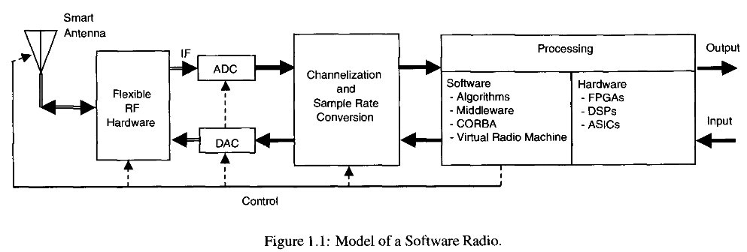
Characteristics and Benefits of a Software Radio
Field Programmable Gate Arrays (FPGAs),
Application Specific Integrated Circuits (ASICs)
Common Object Request Broker Architecture (CORBA)
Cont..

Slide 18
Benefits of a Software Radio
Multifunctionality
Global mobility
Compactness and power efficiency
Ease of manufacture
Ease of upgrades

Slide 19
Design Principles of Software Radio
The generic design procedure for software radios are,
Systems Engineering
RF chain planning
ADC and DAC conversion selection
Software Architecture selection
Digital Signal Processing H/W architecture
selection
Radio Validation
Cont..

Slide 20
Design Principles of Software Radio
Systems Engineering
  Understand the constraints and requirements of communication link and network protocol allows the allocation of sufficient resource to establish the service.
  Constraints – Range, transmit power, modulation type, Data rate.
Cont..

Slide 21
Design Principles of Software Radio
RF chain planning
  The ideal RF chain for the software radio should incorporate simultaneous flexibility in selection of power gain, bandwidth, center frequency, sensitivity, and dynamic range.
Cont..

Slide 22
Design Principles of Software Radio
ADC and DAC conversion selection
The AD conversion and DA conversion for the ideal software radio is difficult to achieve.
The selection requires trading power consumption, dynamic range, and bandwidth (sample rate).
AD conversion and DA conversion selection is closely tied to the RF requirements for dynamic range, frequency translation and channelization requirement.
Multirate digital signal processing can be used to improve the flexibility of the digitization.
Cont..

Slide 23
Design Principles of Software Radio
Software Architecture selection
The architecture should allow for hardware independence through the appropriate use of middleware.
The software needs to be aware of the capabilities of the hardware (both DSP and RF hardware) at both ends of the communications link to ensure compatibility and to make maximum use of the hardware resources .
The software radio will operate in an existing data infrastructure, it must interface quickly and efficiently with this Infrastructure
Cont..

Slide 24
Design Principles of Software Radio
The software radio needs to control issues such as attribute naming, error management, and addressing, regardless of the protocol used in the infrastructure.
The software architecture should consider latency and timing for the whole protocol stack
Digital Signal Processing H/W architecture selection
The core digital signal processing hardware can be implemented through microprocessors, FPGAs, and/or ASICs.
Cont..

Slide 25
Design Principles of Software Radio
Digital Signal Processing H/W architecture selection
It is essential to ensure not only that the communicating units operate correctly, but also that a glitch does not cause system-level failures.
Interference caused by a software radio mobile unit to adjacent bands is an example of how a software radio could cause a system-level failure.
Structuring the software to link various modules with their limitations and deficiencies can help in testing compatibility of software modules.

Slide 26
Case 1: SPEAKeasy
SPEAKeasy, is a s/w radio architecture is the joint project done by the branches of US military.
Initially research was estabilished as a part of AIR FORCE TAJPS processor (Tactical AntiJam Programmable Signal Processor)which sought to create a programmable MODEM that would support future evolution of waveforms.
During Desert Storm operation, other military branches were felt difficult to communicate with allies.
Allies military branches took an interest in TAJPSP and collectively developed SPEAKeasy program.

Slide 27
Case 1: SPEAKeasy
This SPEAKeasy programme expanded their goals of TAJPSP to the creation of software defined MBMMR (MultiBand MultiMission Radio).
SPEAKeasy was the beginning of a long term strategy by the military to advanced S/W radio technology.
Military planned to develop and implement a S/W radio architecture with commercial partners and then to later support the migration of the technology to the commercial domain.
As part of this strategy, SPEAKeasy was broken into Two phases.

Slide 28
Case 1: SPEAKeasy
In phase I, special attention is paid in creating a S/W reconfigurable MODEM.
In phase II, attention were paid in creating S/W radio and to formalize complete SW radio architecture.

Slide 29
SPEAKeasy Phase-I (1992-95)
The SPEAKeasy phase I was intended to show that S/W radio had the potential to
Alleviate the military's interoperability issues,
Simplify the process of incorporating new technology,
Provide more advanced security functions,
Simplify information security (INFOSEC) implementations
Add flexibility without significantly increasing power consumption,
Demonstrate that the use of reprogrammable hardware in the place of dedicated hardware would incur no major performance penalties.
Cont..

Slide 30
Phase-I Architecture
The architecture implements a four-channel half-duplex transceiver with the bulk of the processing being performed in digital signal processing
The various hardware components are housed inside a Versa Module Europa (VME) chassis
The architecture supports reconfiguration through reprogramming the quad C40 subsystem and the INFOSEC Subsystem
To handle high data rate signals, a segmented, high-speed bus is implemented on the backplane of the chassis.
Control and monitoring of the radio is performed from a
Sun SPARC workstation
Cont..

Slide 31
Phase-I Architecture
To provide multiband capability, the radio was defined to operate from 2 MHz to 2 GHz.
Since maintaining performance and linearity over this wide range of frequencies in a single channel using real world components is a difficult, the original frequency range was segmented into three bands:
  low band from 2 MHz to 30 MHz,
  Mid band from 30 to 400 MHz, and
  high band from 400 MHz to 2 GHz
These three bands were then implemented as independent RF channels.
Cont..

Slide 32
Phase-I Architecture
To provide the processing power for the modem, a multichip module (MCM) was designed
To The MCM consists of four Texas Instruments C40s, a PLD, and 5 MB of memory, of which 1 MB acts as a shared global memory for the four processors.
Each of the four DSPs handles an individual radio signal.
The development of the Cryptographic Reduced Instruction Set (CYPRIS) chip was another key result of Phase I.
Cont..

Slide 33
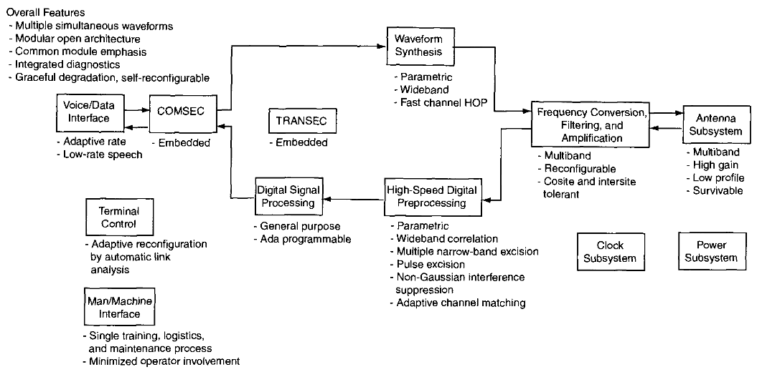
Phase-I Dataflow
Cont..

Slide 34
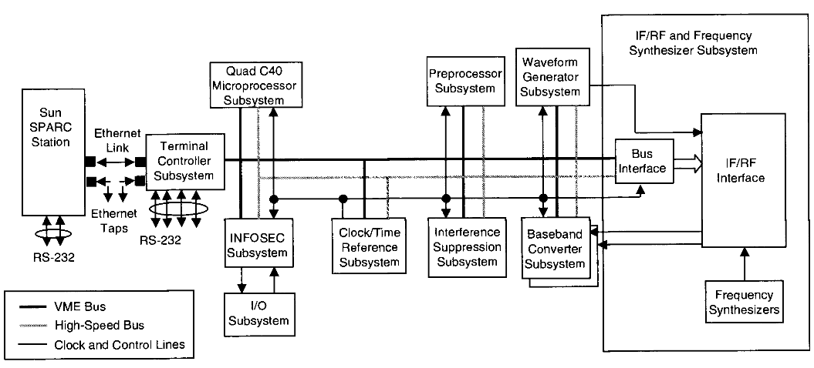
Phase-I Architecture
Cont..

Slide 35
SPEAKeasy Phase-II
Instead of focussing on MCM and CYPRIS aspects, Phase II focused on the entire radio and the software than phase I.
The primary goal of the Phase II architecture were,
  implement a reconfigurable architecture,
  implement an open architecture,
  achieve cross-channel connectivity
secondary goals were to
  incorporate more commercial off-the-shelf (COTS) components,
  reduce the form factor to a size deployable in the field,
  incorporate reconfigurable hardware,
  improve the CYPRIS chip's context-switching time

Slide 36
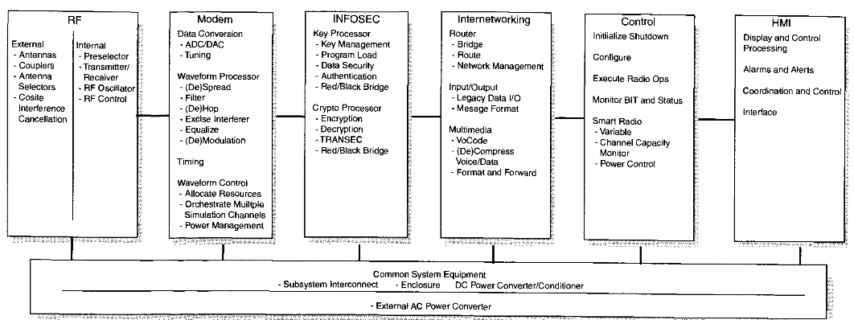
The RF module supports 4 half-duplex channels, ideally operating from 2 MHz to 2 GHz, and is divided into internal and external components
The Modem module performs data conversion, waveform processing over four independent channels, and resource allocation
Control module monitors the radio and performs system-level control opera­
tions
The INFOSEC module contains both Key and Crypto processors
HMI module provides an interface for displaying the status of the radio as well as providing a control interface

Slide 37
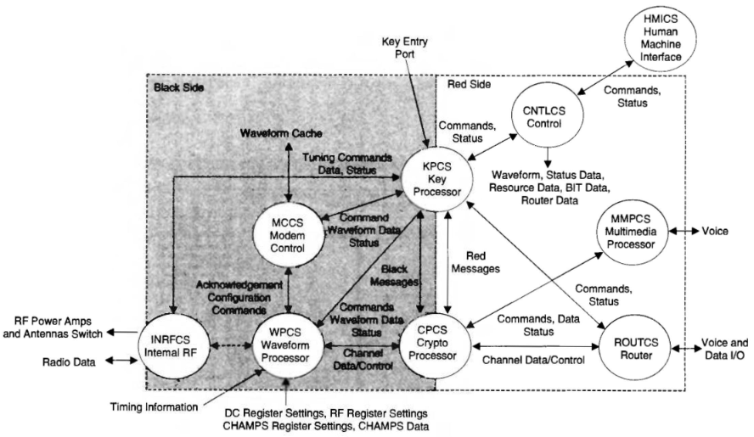
SPEAKeasy Phase-II Control Software and Dataflow

Slide 38
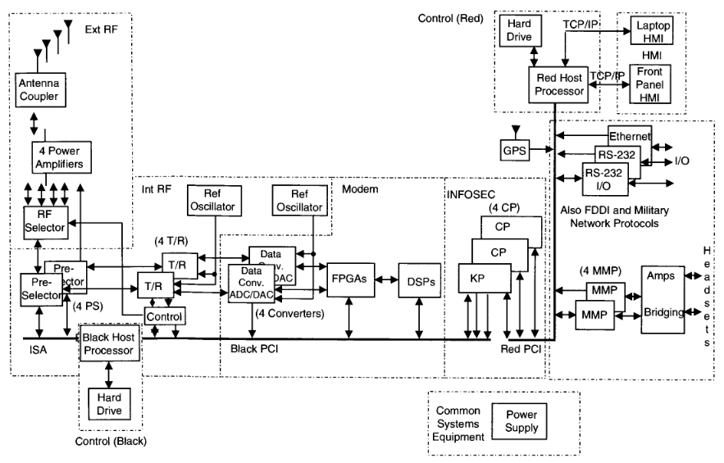
SPEAKeasy Phase-II Architecture
ISA - Instruction Set Architecture
CHAMPS – Configurable Hardware
Algorithm-Mappable Processors
FDDI - Fiber Distributed Data Interface
AIM - Advanced INFOSEC Machine
MMP - Multichassis Multilink Point to Point
Protocol

Slide 39
Joint Tactical Radio System - JTRS
Joint Tactical Radio System (JTRS) aimed to replace existing radios in the American military with a single set of software-defined radios.
Evolving from SPEAKeasy and PMCS (Programmable Modular Communication System
JTRS envisions a radio that will
  support operating frequencies ranging from 2 MHz to 2 GHz.
  be reconfigurable through waveform software,
  support voice, video, and data applications,
  be scalable in both software and hardware,
  leverage COTS components for affordability,
  be interoperable with different waveforms, with legacy equipment, and with radios designed for different domains.

Slide 40
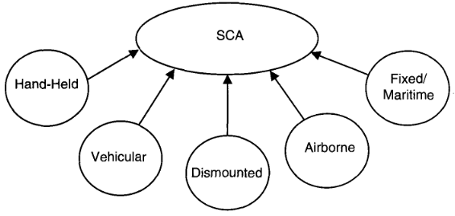
JTRS – Unique Domain
JTRS radio uses the same baseline architecture to ensure interoperability across domains
Baseline architecture can be viewed as a parent class and the domain radios as child classes derived from the baseline architecture
The baseline (parent) architecture of the JTRS family is the SCA

Slide 41
Goals of the SCA
Function as a MBMMR
Be interoperable with all domains
Be compatible with legacy systems
Support the insertion of new technologies
Support advanced networking features
Use primarily COTS components

Slide 42
SCA Architecture
Two new software radio architecture concepts are extensively leveraged in the design of the SCA:
  Building the framework around an open systems architecture and
  Constructing the remaining pieces utilizing object-oriented methodologies.
Other concepts developed in SPEAKeasy and PMCS are also employed in the SCA
SPEAKeasy had previously employed an open software architecture.
The SCA expands the open software architecture to an open systems architecture.
All layers, hardware and software, are independent and can be altered without impacting any other layer.

Slide 43
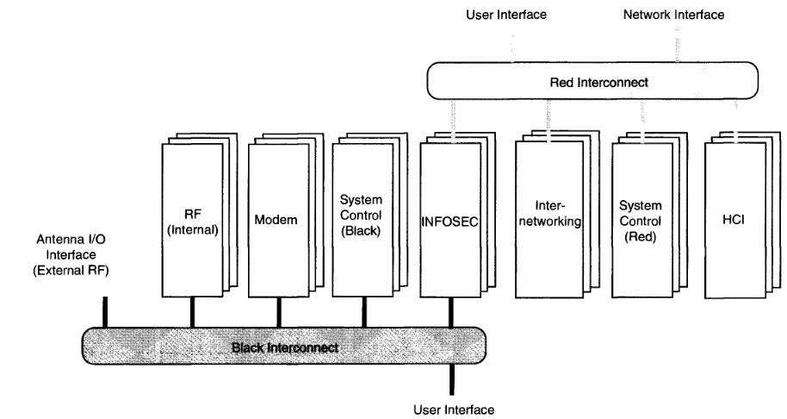
PMCS Reference Model

Slide 44
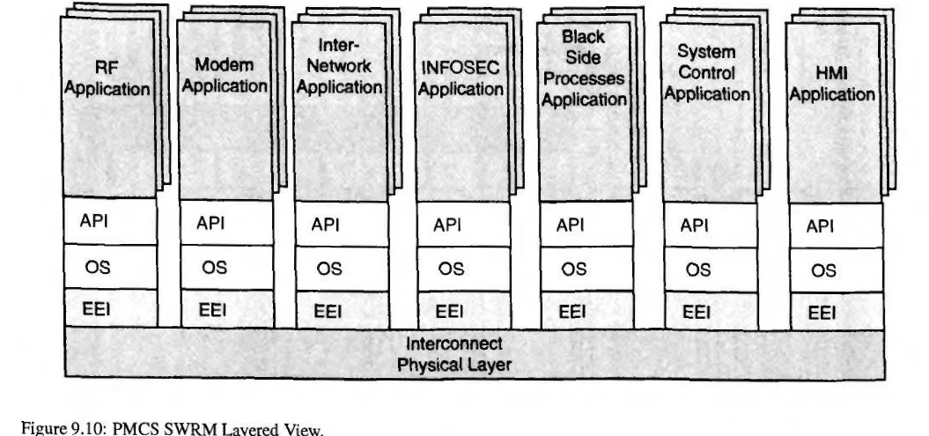
API – Application Interface
EEI – External Environment Interface
SWRM – Software Reference Module

Slide 45
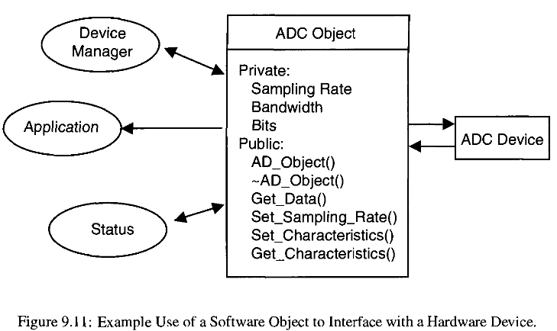

Slide 46
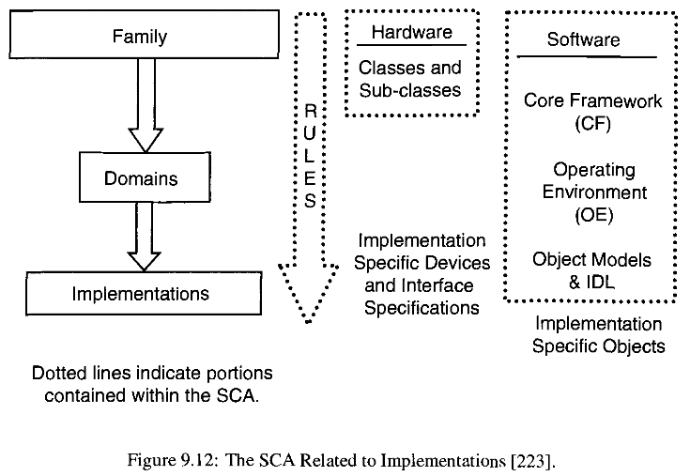

Slide 47
SCR related to implementation:
The basic SCA architecture consists of a software framework, a hardware framework, and rules that govern the hardware and software implementations.
The software framework defines the software structure and the interaction between software components.
The software framework is applicable to every domain's implementation.
The hardware definition of the SCA is limited to only the hardware classes and subclasses.
The rules address such issues as interfaces, form factors,
and software development languages as they relate to specific implementations.

Slide 48
