Slide 1
UNIT 3
Antenna array
- Phased array, Adaptive array

Slide 2
Phased array
Meaning:
  Array of many elements with the phase of each element being variable.
  It provides control of the beam direction and pattern shape including side lobes.

Slide 3
Objectives of phased array
1. To accomplish beam steering without mechanical & inertial problems of rotating the entire array.
2. To provide beam control at a fixed frequency or at number of frequencies within a certain BW in a frequency independent manner.

Slide 4
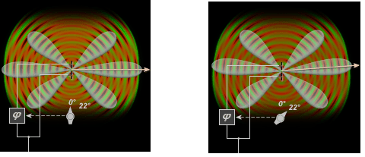
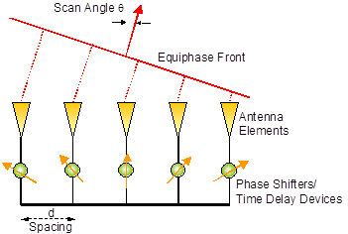
The shape and direction of pattern is determined by relative phases amplitudes applied to each radiating element.
2 elements fed with same phase
2 elements fed with different phase

Slide 5
Beam steering mechanisms
Mechanical switches
Diode (PIN type)
Phase shifters
Insertion of cables

Slide 6
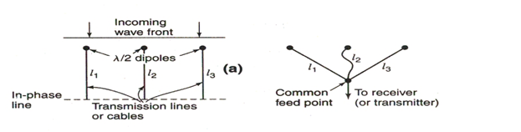
Array of three λ/2 dipoles with incoming wave broadside

Slide 7
An incoming wave arriving broadside will induce voltages in the transmission lines in the same phase if
The voltages will be in phase at in-phase line.
By bringing all the cables to a common point, the array operate as a broadside array.

Slide 8
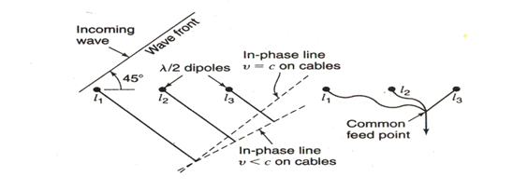
Consider a wave arriving at an angle of 45˚ from broadside.

Slide 9
If v = c, in-phase line is parallel to the incoming wave front.
If , the lengths l₂ and l₃ must be increased.
If cables of these lengths are joined, the array will have its beam 45˚ from broadside.

Slide 10
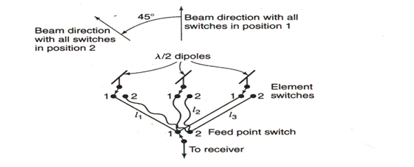
By installing a switch at each antenna element and one at the common point, the beam can be shifted from broadside to 45˚. These switches are mechanically ganged together.
Switch 1 position: 0˚ phase
Switch 2 position: 45˚ phase

Slide 11
Instead of mechanical switches, electronic switches (using PIN diode) can also be used.
Advantages of electronic switches:
1. Extremely fast
2. Occupy very small space
3. Lower cost
4. Available at IC form

Slide 12
Instead of switches,
phase shifters can be used.
Advantages of phase shifters:
1. Low loss
2. Lower cost
3. Ability to achieve flat phase over wide BW
4. Easier to assemble
5. Higher power handling & linearity
Cables of λ/4, λ/2, 3λ/4 can also be used.

Slide 13
Feeding mechanisms
Corporate feed
Line feed
Coupler feed

Slide 14
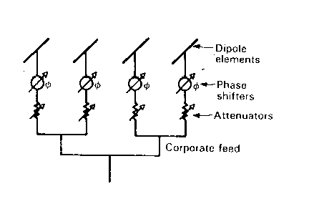
Corporate feed
Phase shifter & attenuator is connected at each element

Slide 15
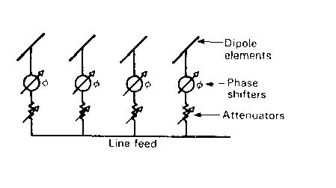
Line feed
Phase shifters introduces opposite phase changes, so that end fire array can be formed.

Slide 16
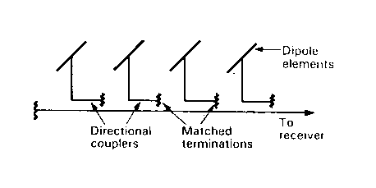
Coupler feed
Phasing is accomplished by physically sliding the directional couplers along the line

Slide 17
Advantages
High gain with low side lobes
Ability to permit the beam to jump from one target to the next in a few microseconds
Ability to provide an agile beam under computer control
Arbitrarily modes of surveillance and tracking
Multifunction operation by emitting several beams simultaneously
Fault of single components reduces the capability and beam sharpness, but the system remains operational

Slide 18
Disadvantages
The coverage is limited to a 120 degree sector in azimuth and elevation
Deformation of the beam while the deflection
Low frequency agility
Very complex structure (processor, phase shifters)
Still high costs

Slide 19
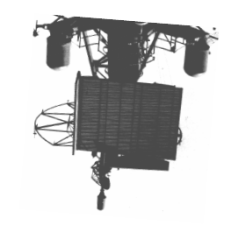
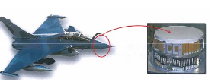
Applications of phased array
Ground based multi function radar for military use.
2. Air borne radar for surveillance

Slide 20
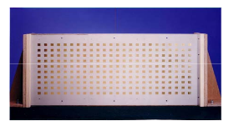
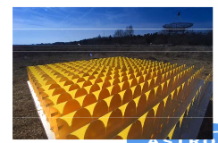
3. Space borne SAR and communications for remote sensing
4. Radio astronomy

Slide 21
Adaptive array (Smart antenna)
  An array can become active and react intelligently to its environment by steering its beam towards a desired signal, while simultaneously steering a null toward an undesired interfering signal.
  Advantages:
  This maximizes SNR of the desired signal.
  Provides higher resolution
  Lower side lobes

Slide 22
Antenna array with a digital signal processing capability to transmit and receive in an adaptive and spatially sensitive manner.
“Smart” ---->> digital signal processing facility.
These antennas are sometimes called as Digital Beam Forming (DBF) antennas.

Slide 23
Objectives
To maximize the antenna gain in the desired direction
To minimize the gain in directions of interferers

Slide 24
2 element adaptive array
Let the spacing between the elements = λ / 2
Signal frequency = f_{s}
With elements operating in phase, the beam is broadside
Each element is equipped with its own
Mixer
VCO
Intermediate frequency amplifier
Phase detector
An oscillator (f₀) is connected to each phase detector

Slide 25
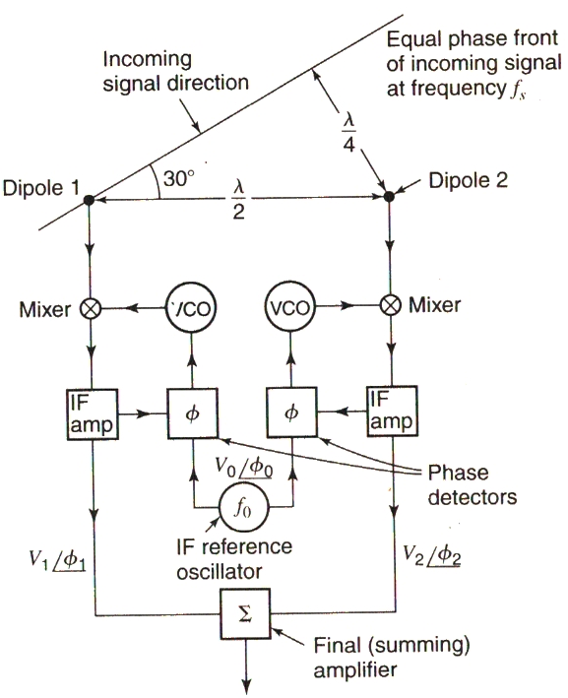
2 element adaptive array
If signal is 30˚ from broadside, the wave arriving at element 2 travels farther than to element 1.
Thus the phase of the signal is retarded by 90˚ at element 2.

Slide 26
Phase detector
Compares the phase of the downshifted signal with the phase of the reference oscillator
Produces a voltage proportional to the phase difference
This voltage advances or retards the phase of the VCO output to reduce phase difference to zero.
Thus signal from element 1 & 2 are locked in phase,

Slide 27
With equal gain,
Summing amplifier proportional to 2V₁(2V₂)
Maximizes the response of the array

Slide 28
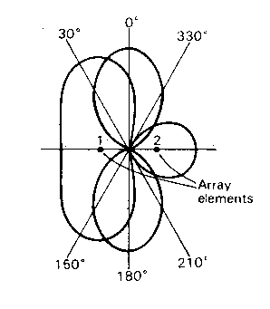
The beam will be in the 0˚ direction for a signal from the 0˚ direction.
The beam is at 30˚ for a signal from that direction.
For signal at 30˚, the nulls at 210 & 330 will suppress the interference.

Slide 29
Advantages
      Higher Capacity
      Higher Coverage
      Higher bit rate
      Improved link quality
      Spectral efficiency
      Mobility

Slide 30
Disadvantages
Complex
More Expensive
Larger Size
Location

Slide 31
Applications
Cellular and wireless networks
Radar
Electronic warfare (EWF) as a countermeasure to electronic jamming
Satellite systems

Slide 32
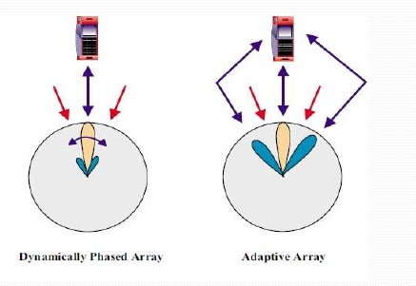
Differences between phased & adaptive array
Phased array reduces the probability of interference with the narrower beam
Adaptive array adjust the beam pattern to suppress interference

Slide 33
Array Analysis:
Here we investigate the radiation patterns for a given antenna array configuration.
Array Synthesis:
Here we design the array configurations to achieve a desired radiation pattern.

Slide 34
Antenna synthesis
4.1 Basic principle for antenna synthesis
4.2 Line source synthesis (Fourier transform, woodward-lanson sampling)
4.3 Linear array synthesis (Fourier series, woodward-lanson sampling)
4.4 Low sidelobe synthesis (Dolph-Chebyshev, Taylor)

