Slide 1
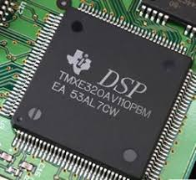
UNIT 5 - DIGITAL HARDWARE AND
SOFTWARE CHOICES

Slide 2
1.DSP Processors
A digital signal processor (DSP) is a specialized microprocessor (or a SIP block), with its architecture optimized for the operational needs of digital signal processing
DSPs are also optimized for specific applications like wireline communications, wireless communications, or general control applications.
It is important to choose the right DSP for a particular application by considering its architecture, speed, multiprocessor capabilities, MAC units, instruction set, power consumption, and cost.

Slide 3
1.1 DSP Core
A DSP typically consists of an
  arithmetic logic unit (ALU),
  accumulator(s),
  MAC unit(s), and
  data and address buses.
MAC performs multiplication and accumulation process
A MAC operation is common to most DSP algorithms including the FIR filter and is generally integrated into the main arithmetic processing unit in a DSP rather than placed on a coprocessor.
The MAC instruction can be expressed as
  a <— a + b * c

Slide 4
1.2 DSP Architectures
von Neumann Architecture
Harvard Architecture
Uniscalar Architecture
Single Instruction Multiple Data
von Neumann Architecture
In von Neumann concept, the primary computing elements are, the ALU, the control unit, the memory, Registers and the I/O.
Von Neumann architecture is based on the stored-program computer concept, where instruction data and program data are stored in the same memory. This design is still used in most computers produced today.

Slide 5
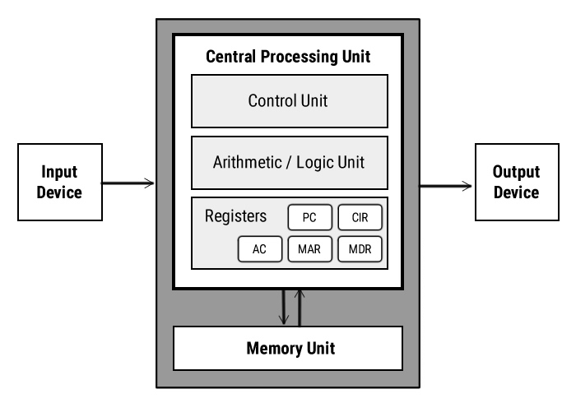

Slide 6
Central Processing Unit (CPU)
The Central Processing Unit (CPU) is the electronic circuit responsible for executing the instructions of a computer program.
It is sometimes referred to as the microprocessor or processor.
The CPU contains the ALU, CU and a variety of registers.
Registers
Registers are high speed storage areas in the CPU. All data must be stored in a register before it can be processed.
MAR Memory Address Register Holds the memory location of data that needs to be accessed
MDR Memory Data Register Holds data that is being transferred to or from memory
AC Accumulator Where intermediate arithmetic and logic results are stored
PC Program Counter Contains the address of the next instruction to be executed
CIR Current Instruction Register Contains the current instruction during processing

Slide 7
Arithmetic and Logic Unit (ALU)
The ALU allows arithmetic (add, subtract etc) and logic (AND, OR, NOT etc) operations to be carried out.
Control Unit (CU)
The control unit controls the operation of the computer’s ALU, memory and input/output devices. The control unit also provides the timing and control signals required by other computer components.
Buses
Buses are the means by which data is transmitted from one part of a computer to another, connecting all major internal components to the CPU and memory.
A standard CPU system bus is comprised of a control bus, data bus and address bus.

Slide 8
Address Bus Carries the addresses of data (but not the data) between the processor and memory
Data Bus Carries data between the processor, the memory unit and the input/output devices
Control Bus Carries control signals/commands from the CPU (and status signals from other devices) in order to control and coordinate all the activities within the computer
Memory Unit
The memory unit consists of RAM, sometimes referred to as primary or main memory. Unlike a hard drive (secondary memory), this memory is fast and also directly accessible by the CPU.
RAM is split into partitions. Each partition consists of an address and its contents (both in binary form).
The address will uniquely identify every location in the memory.
Loading data from permanent memory (hard drive), into the faster and directly accessible temporary memory (RAM), allows the CPU to operate much quicker.

Slide 9
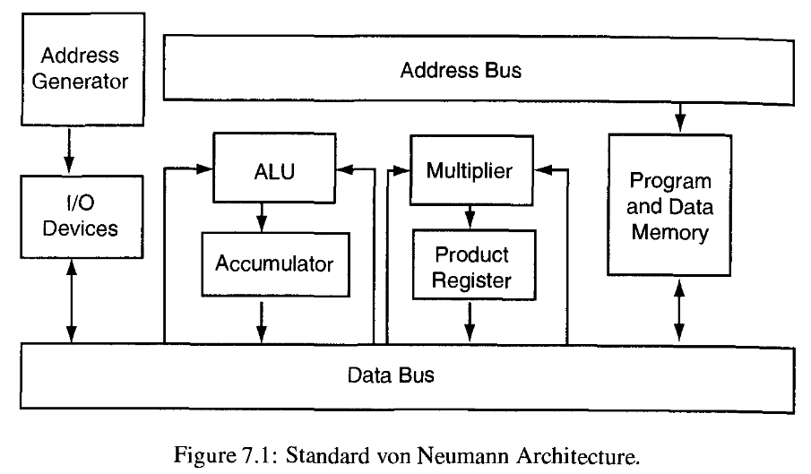

Slide 10
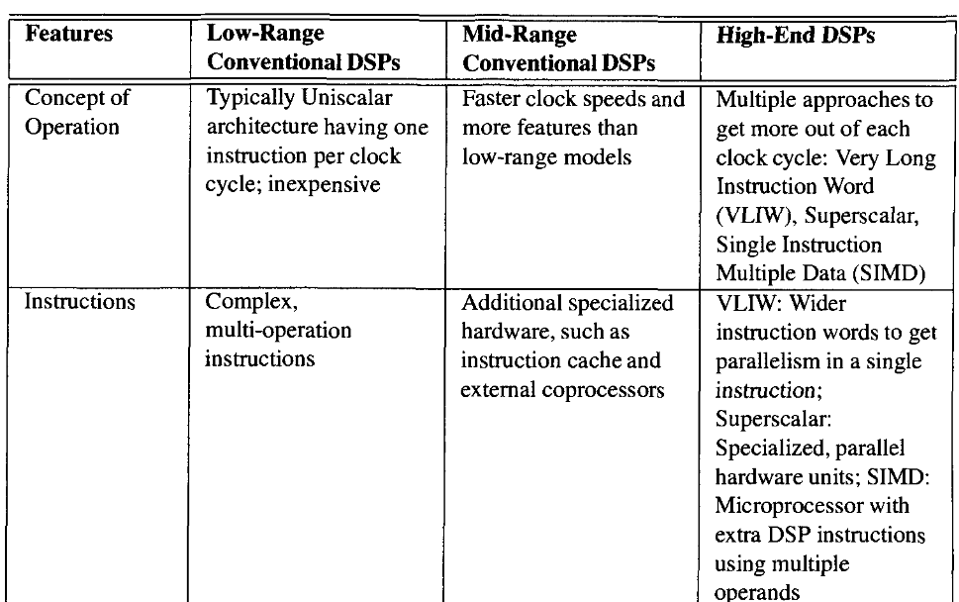

Slide 11
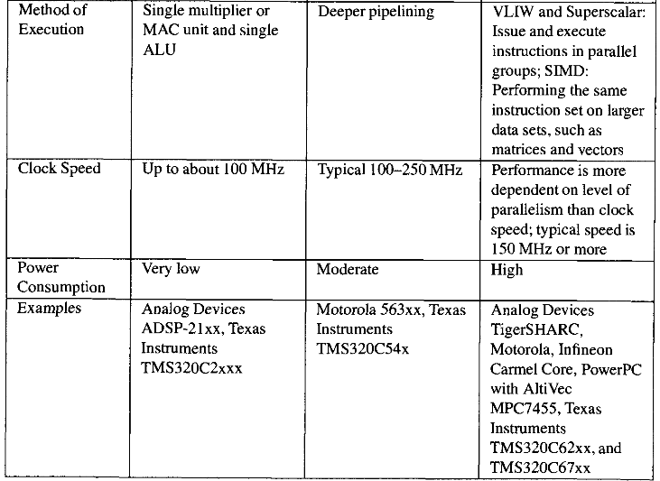

Slide 12
For a DSP, having a single memory slows the performance.
The DSP needs at least three accesses to memory at the same time to be efficient. Typically, the instruction and two operands are used in an arithmetic operation, and then the result is stored.
(The DSP needs at least four memory accesses if the result storage for a previous calculation occurs at the same time as the instruction/operand accesses for the current calculation.)
Sequential memory addressing can also be a limiting factor.
Finally, data tables and HLL data typing allow the meaning of the data to be stored with the data.

Slide 13
Harvard Architecture
The Harvard architecture features separate memory areas for instructions and operands.
The basic Harvard architecture contains one program (instruction) memory and one data memory, each with its own bus.
Variants include multiple program memories and buses as well as multiple operand memories and buses.
Because the architecture has multiple memory areas and buses, pipelining can be used for faster program execution speed.
Strict Harvard architecture is used by some DSPs, but most use a modified Harvard architecture.
In the modified Harvard architectures used by Texas Instruments, separate program and data memory spaces are maintained but communication between the two memory spaces is permissible.
This feature allows operands to be accessed over an instruction bus and vice versa.

Slide 14
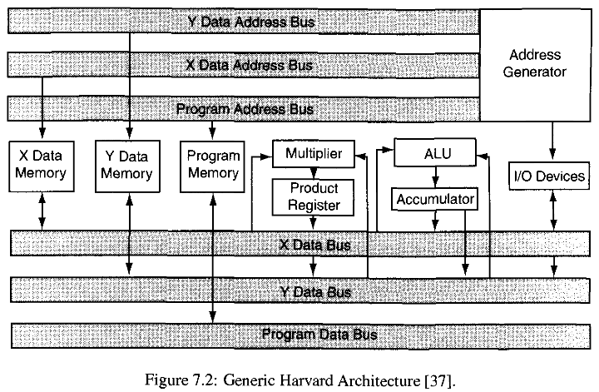

Slide 15
Program and data memory can be further categorized as on-chip and off-chip.
DSP chips have on-chip memory to facilitate embedded applications and fast memory access.
Small programs can be implemented economically without the addition of external memory.
Off-chip memory is often added to provide more program and/or data space, allowing more flexibility and ease of use for the programmer.
However, off-chip memory can be slower to access than on-chip memory

Slide 16
Uniscalar Architecture
The Harvard architecture is generally applied to a uniscalar processing core architecture.
The uniscalar architecture provides a small number of processing elements: typically no more than one multiplier and one ALU.
This architecture allows, at maximum, execution of one instruction per cycle.
In this way, the maximum DSP processing speed is limited to the maximum clock rate of the chip.
Other DSP architectures allow faster processing speed, but the uniscalar provides good code density and has the lowest power consumption and price.
The uniscalar DSP is more suitable for lower-speed, lower-power, and lower-cost Applications.
Texas Instruments TMS320C549 is an example of a uniscalar DSP.
The C549, optimized for low-power wireless applications, provides a maximum of 120 MIPS at a clock speed of 120 MHz

Slide 17
Single Instruction Multiple Data
The Single Instruction Multiple Data (SIMD) architecture is exactly what its name suggests: a single instruction is simulataneously performed on different data elements.
The SIMD architecture is often known as a vector processing architecture because of the inherent data parallelism.
A SIMD processor performs well where the same calculation can be performed across vector data; this works well for repetitive computations on real-time data streams.
SIMD can be an instruction set extension to a general purpose processor.
This is true for the Motorola MPC7455, which is the general purpose PowerPC architecture with their SIMD instruction extension called AltiVec.
The MPC7455 provides up to 2280 MIPS at 1 GHz

Slide 18
Very Long Instruction Word Architecture
The VLIW architecture provides more processing elements that can be used in parallel.
The extra-long instruction word allows the multiple processing elements to be programmed in parallel
Typically four to eight instructions are executed per clock cycle.
The code generation tool maximizes the number of instructions executed in one clock cycle by grouping together those instructions that can be executed in parallel
Maximum performance is achieved when all processing elements are continuously used in parallel.
One example of the VLIW architecture is the Texas Instruments TMS320C62x

Slide 19
With eight processing elements (two multipliers and six ALUs), the C62x has a maximum processing speed of eight instructions per cycle.
The maximum clock rate of the C62x is 300 MHz, so its maximum throughput is 2400 MIPS.
Obviously, the VLIW architecture can significantly increase DSP processing speed, but VLIW processors have larger memory requirements due to the long instruction word.
Since the scheduling is performed in software, programming is more difficult than that for a uniscalar DSP.
The VLIW DSP is more easily programmed in an HLL, such as C,
rather than assembly language.
With more execution units running in parallel, the VLIW dissipates more power and generally costs more than a uniscalar processor.

Slide 20
Superscalar Architecture
The superscalar architecture provides multiple processing elements that can be used in parallel, similar to the VLIW architecture.
The difference is that the parallelism (scheduling) is set up mostly in hardware, making the superscalar DSP easier to program than the VLIW
Hardware design of the DSP with superscalar architecture is more difficult since an efficient layout of processing elements and data flow must be designed into the chip.
Both power consumption and speed are somewhere between those for a uniscalar DSP and those for a VLIW DSP
Since the scheduling is done in hardware, temporarily unused portions of the hardware can be easily powered off (by the hardware) to lower consumption

Slide 21
Since the parallelizing operation is done during runtime, it is difficult to predict the execution time.
One example of a superscalar DSP is LSI Logic Corporation's ZSP600 core.
Hybrid Architectures
Some of the newer DSPs are being constructed using a combination of VLIW and superscalar architectures; the DSP can benefit from increased speed, parallelism, and configurability with lower power consumption.
Infineon Technologies' Carmel DSP Core lOxx [177,178] is an example of this combination-style architecture,
The Carmel can execute up to fifteen parallel operations per cycle, with a clock speed of 250 MHz, providing a processing speed of up to 3500 million operations per second (MOPS).

Slide 22
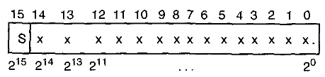
1.3 Numeric Representation
A DSP chip implements either fixed point or floating point.
Fixed Point
In fixed point, a number may be represented as an integer, as a fraction between —1 and 1, or as a combination of integer and fraction.
If the desired number cannot be exactly represented in this manner, that number will be rounded-off and/or truncated to fit in a fixed point word of available precision.
Sixteen-Bit Two's Complement Representation Fixed Point

Slide 23
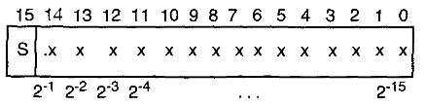
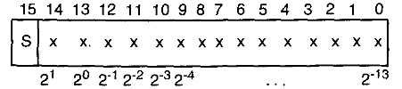
Fixed point DSPs are very popular in high-volume, low-power applications.
They are fast and inexpensive and are generally used in commercial applications, such as wireless communications
Sixteen-Bit Signed Fractional Fixed Point (Q15 Representation).
Sixteen-Bit Signed Integer/Fractional Fixed Point (Q13 Representation)

Slide 24
Generally fixed point DSPs consume less power and cost less because of a smaller die size.
operated at faster speeds because of their relatively simple architecture
today's fixed point DSPs use a sixteen-bit word
Fixed point arithmetic requires that programmers pay attention to numeric precision and scaling.
Overflows can result from finite word length multiplication, and underflows can result from truncation and rounding
There are several ways of dealing with overflow
1. leaving one or two bits of headroom
2. Accumulators are usually longer than data storage word size

Slide 25
Floating Point
A binary floating point number is represented as follows: N = mantissa * 2 ^Exponent
The mantissa is generally a fraction: (—1 < mantissa < 1)
The exponent is an integer indicating the number of places that the binary point of the mantissa must be shifted left or right to obtain the value represented
Floating point numeric representation provides greater dynamic range than fixed point representation of the same word length.
Because of this large dynamic range, numeric truncation and rounding are less necessary and less obvious with floating point. As a result, floating point DSPs are easier to program than fixed point DSPs
Floating point DSPs are usually more expensive.
The increased cost results from having more complex circuitry, which results in a larger silicon die

Slide 26
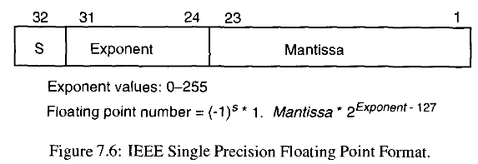
Format Conversions
Some floating point DSPs have certain native fixed point instructions, allowing fixed point processing.
Conversely, it is possible to create a floating point format in software on a given fixed point DSP.
The software floating point format take more time because the native fixed point format must be converted to the floating point format each time.
The format or precision conversion is performed implicitly (automatically) by the compiler, which is typical in the C language

Slide 27

1.4 Addressing
Addressing refers to defining the location of instruction operands
One or more dedicated address generation units enable faster overall performance
DSP can handle a wide variety of addressing modes.
This allows the location of operands to be determined by several different methods, not all of which are available on all DSPs.
Six general categories of addressing are immediate, direct, indirect, memory-mapped, circular (modulo), and bit-reversed.
Immediate Addressing
Immediate addressing uses a constant value, from either a register or the output of an operation

Slide 28
This instruction sets up a repeated execution of the next instruction /V times where ./V is determined by the hexadecimal value of plus 1.
Direct Addressing
Direct addressing uses either the stack pointer (SP) or the data page pointer (DP) in combination with address information specified along with the instruction.
The SP points to a "stack" of memory locations that are used for temporary storage.
The C language environment normally uses direct addressing with reference to the SP and all the details are handled automatically by the compiler.
Although the DSP assembly language programmer can use direct addressing with reference to the stack pointer, most often the programmer chooses to use direct addressing with reference to the DP.

Slide 29
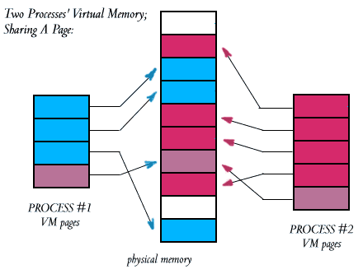
Memory is segmented into pages, which are simply divisions of contiguous RAM memory.
The current page of memory is marked by the data page pointer, which is used as a reference location to directly access that memory.

Slide 30

Indirect Addressing
Indirect addressing exists in many forms and can often allow access to multiple memory locations at the same time.
Indirect addressing uses a register to provide a base address; offsets to this base address can then be calculated.
These offsets can be generated from either information in another register or information specified within the instruction.
In above example, The instruction results in the contents of the address specified in AR3 being added to the contents of accumulator A.
After this add operation, the address specified in AR3 is incremented by one to point to the next memory word.

Slide 31

Memory-Mapped Addressing
Memory-mapped addressing uses direct or indirect addressing to access special areas of memory allocated for registers, I/O, peripherals, and other important functions.
For example, Texas Instruments TMS320C54x has CPU memory-mapped registers between locations 0000-001D (hex).
Figure 7.9 shows an example of memory-mapped addressing.
This instruction places the value 5 into the interrupt mask register (IMR), which is memory-mapped to location 0000.

Slide 32

Circular Addressing
Circular (modulo) addressing uses indirect addressing to create a circular buffer.
Separate registers provide base address, buffer length, and optionally an increment value.
The address update operation performed in hardware is effectively
New Address = Buffer Base Address + Increment modulo (Buffer Length).
Figure 7.10 shows an example of modulo addressing with a circular buffer.
This is similar to the indirect addressing example in Figure 7.8, except that modulo addressing is used as indicated by %.

Slide 33
If the address specified in AR3 points to a location in a circular buffer, the increment operation is modified to include the modulo operation defined above.
When AR3 points to the last location in the circular buffer and is then incremented, the modulo operation will return AR3 pointing to the circular buffer base address.
Circular addressing is useful when performing an FIR filtering operation.
In this case, a dot product is performed: y = w^{H}x . Here, circular buffers can be used for both w and x.
In this case, a repeat block MAC unit can be set up with indirect addressing to automatically increment pointers to the circular buffers.
When the repeat block is complete, the indirect addressing pointers will again be pointing to the first locations of both w and x for the next
filtering iteration.

Slide 34

Bit-Reversed Addressing
Bit-reversed addressing is specifically for increasing speed and decreasing memory utilization of FFT algorithms.
The addressing of either the input or the output of an FFT, depending on the particular algorithm used, is in bit-reversed form.
With bit-reversed addressing, the software does not need to copy either the input data or output results to or from standard linear addresses, thereby saving time and memory resources.
Bit-reversed addressing uses indirect addressing with separate registers to provide a base address and an increment value equal to one-half the FFT size.

Slide 35
Here, the address in AR3 is the base address, and 0B represents the use of AR0 as the bit reversed increment register. If this is an eight-point FFT, AR0 is loaded with the value 4 before performing the bit reverse operation.
7.3.5 Pipelining
Pipelining is setting up and executing in parallel the various stages of instruction processing.
The key to a pipelined architecture is simultaneous instruction/operand fetch, which is allowed by the Harvard architectures multiple program and data buses.
New instructions can be fetched while operands are being fetched for the previous instruction

Slide 36
Example : A three-stage pipeline
Here, the instruction pipeline is implemented in three stages: fetch, decode, and execute.
Each stage takes one clock cycle to execute.
In the fetch stage, a new instruction is fetched from program memory and the program counter is incremented to point to the next address location.
In the decode stage, the fetched instruction is decoded and the operands are fetched.
In the execution stage, reading, writing, or another ALU operation is performed as defined by the instruction.
Processing of an instruction is complete at this stage.

Slide 37
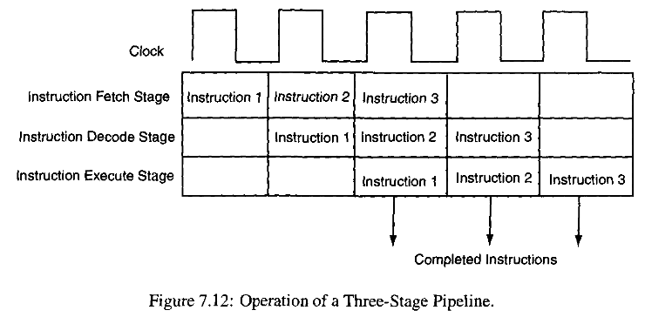
The pipeline allows the second instruction fetch stage during the first instruction decode stage.
Similarly, the third instruction fetch stage occurs in the third clock cycle, during the first instruction execute stage and the second instruction decode stage.

Slide 38

In an ideal situation, the pipeline is always full and pipeline utilization is at its maximum.
Once the pipeline is initially filled up, i.e., after two clock cycles, there is one instruction in the execution stage every clock cycle.
The maximum throughput is one instruction per cycle once the pipeline is full.
The performance gain achieved by using a pipeline is measured in terms of the speedup, which is defined as
In practice, the pipeline can be stalled if an instruction takes more than one clock cycle to complete a stage in the pipeline.
This could happen if a slow external memory is accessed or if a complex instruction needs more than one cycle to execute.
A stall also occurs when instructions cannot be fetched, decoded, and executed in sequential order

Slide 39
1.6 Multi-Processing
Multi-processing provides one solution to the need for processing speed.
If an algorithm can be partitioned for processing into smaller modules, these modules can be implemented on separate processors for faster throughput.
There are a number of multi-processor configurations: pipeline linear, hypercube (2D and 3D arrays), ring, and tree.
The data flow through these different configurations can be categorized as either pipeline or star.
With a pipeline data flow, the data is set up to be transferred from one processor to the next, down the line of processors.
With a star data flow, one processor controls all data transfers and generally passes data to others to be processed and returned.

Slide 40
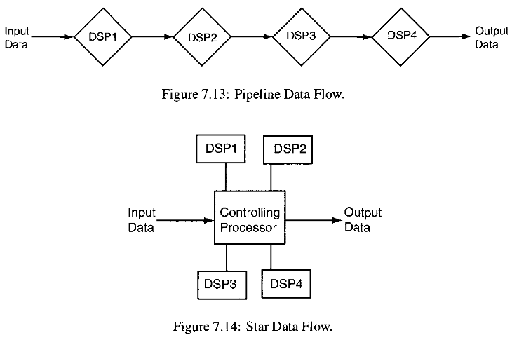
Data flow is affected by the design of the interprocessor communication (IPC) system on the target board(s)
The IPC mechanisms implemented on the target board(s) are the designated communication link(s) between processors.

Slide 41
This communication occurs via shared memory or dedicated high­speed interprocessor communication ports using DMA.
A shared memory architecture can provide all the IPC necessary in some systems.
shared memory architecture may be too limiting unless caching is used.
When dedicated communication lines are present, the system memory architecture can be entirely distributed.
All IPC can take place via the dedicated lines.
There are some situations where a combination of shared memory and distributed memory is appropriate.
Generally, shared memory tends to be more effective for shorter IPC messages, while dedicated high-speed communication lines tend to be more effective for larger IPC messages.

Slide 42
1.8 Multi-Processing Using a Real-Time Operating System
The real-time operating system (RTOS) can be very helpful for implementing multiprocessor systems.
The RTOS can provide dynamic threads, task switching, semaphores, and other high-level software features.
These RTOS features allow creation of and communication between multiple tasks running on one or more processors
The cost of using an RTOS is the extra time required to perform these operations, which takes away from algorithm processing time.
Another option is to use a general purpose processor in combination with the DSP(s).
The general purpose processor can run an operating system and application code to provide overall control of the DSP(s) as well as outside communication

Slide 43
When the application being developed requires multiple processors with common memory or if it requires multiple threads or tasks, an RTOS can greatly simplify the development cycle.
An RTOS is a tool that also allows a greater number of developers to generate applications.
Furthermore, the RTOS makes the software easier to maintain and enhances the portability of the software.
Before selecting an RTOS, the designer must decide whether there is a need for "hard” real-time operation.
An RTOS with hard real-time operation guarantees the programmer a specific execution time for each function.
Many RTOS versions are on the market. SPOX is one example of a DSP RTOS that is available for multiple DSPs.
SPOX contains four main components: the kernel, host communications, math and signal processing library, and a debugger interface.

Slide 44
DSP/BIOS, is another example of a DSP RTOS, which is available for Texas Instruments C5x and C6x DSP processors.
DSP/BIOS contains a real-time kernel, real-time analysis tools, and device configuration tools.
DSP/BIOS provides for real-time data exchange (RTDX), which allows real-time data transfers from the target to the host computer.
DSP OS is an example of a real-time kernel for specific Motorola and Analog Devices processors.
It was designed specifically for fast execution speed and very small kernel RAM usage.
OSE is an RTOS that is available for many DSPs as well as various general purpose processors.
OSE consists of a target kernel, a soft kernel (for simulation), debugging and analysis plug-ins, and a link handler for intertask communication

Slide 45
The Software Design Cycle
DSP software development process is similar for all types of DSPs. Development usually requires host and target devices.
The host device is a computer that interfaces with the DSP and the programmer.
Most often the host is the same computer that the programmer uses to develop and build the code.
The target device refers to the DSP device, board, module, or system that runs the DSP code developed.

Slide 46
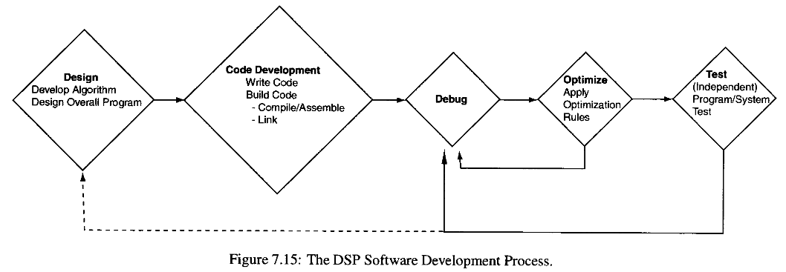

Slide 47
Case Study: TMS320C54x Series DSPs
The TMS320C54x devices are a family of sixteen-bit fixed point uniscalar processors.
The C54x DSP core was designed for digital wireless applications.
The C54x family uses a modified Harvard architecture with one program memory bus and three data memory buses.
On-chip peripherals are different for each variant but generally include two serial ports, one timer, a wait state generator, and a PLL for clock frequency multiplication.
One of the DSPs in the C54x family, the C549 has the following features:
  120 MHz (up to 120 MIPS) operation,
  Forty-bit ALU with either single thirty-two-bit or dual sixteen-bit configuration,
  one forty-bit adder and two forty-bit accumulators, eight auxiliary registers,
  32 KW on-chip Data RAM, 16 KW on-chip Program ROM,

Slide 48
extended addressing mode for up to 8M sixteen-bit external program space,
six-channel DMA controller,
Two buffered serial ports (BSPs) with 2 KW buffer,
Eight-bit host port interface (HPI),
TDM serial port,
sixteen-bit on-chip timer
PLL clock generator (internal oscillator or external clock source),
Viterbi accelerator,
single-cycle normalization and exponential encoding (for floating point arithmetic),
Three power-down modes,
2.5 V low-voltage operation,

Slide 49
1.4 Field Programmable Gate Arrays
A field-programmable gate array (FPGA) is an integrated circuit designed to be configured by a customer or a designer after manufacturing – hence “ field programmable".
The FPGA configuration is generally specified using a hardware description language (HDL), similar to that used for an application-specific integrated circuit (ASIC).
FPGAs (Field Programmable Gate Arrays) are amazing devices that now allow the average person to create their very own digital circuits.
By itself an FPGA does nothing. It is up to the designer to create a configuration file, often called a bit file, for the FPGA. Once loaded the FPGA will behave like the digital circuit designed!
One of the reasons FPGAs are so awesome is that unlike an ASIC (Application Specific Integrated Circuit) the circuit design is not set and you can reconfigure an FPGA as many times as you like.

Slide 50
FPGA vs Microcontroller
With a microcontroller, like an Arduino, the chip is already designed for you. You simply write some software, usually in C or C++, and compile it to a hex file that you load onto the microcontroller.
The microcontroller stores the program in flash memory and will store it until it is erased or replaced.
With microcontrollers you have control over the software.
FPGAs are different. You are the one designing the circuit.
There is no processor to run software on, we can configure an FPGA to be something as simple as an and gate, or something as complex as a multi-core processor.
We create our design using HDL (Hardware Description Language).
The two most popular HDLs are Verilog and VHDL.

Slide 51
We then synthesize your HDL into a bit file which we can use to configure the FPGA.
A slight downside to FPGAs is that they store their configuration in RAM, not flash, meaning that once they lose power they lose their configuration.
They must be configured every time power is applied.
With FPGAs we have control over the hardware.

Slide 52
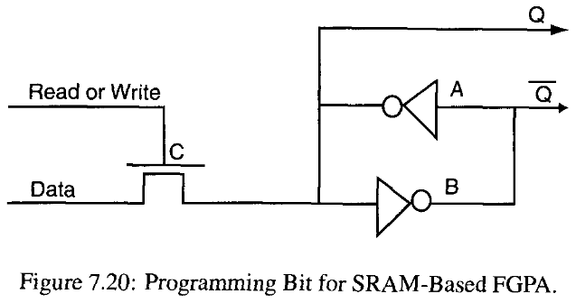
Operation of an SRAM-Based FPGA Cell
A pair of cross-coupled inverters sustain whatever value is programmed into them.
A single n-transistor gate (C) is provided for either writing a value or reading a value.
The ratio of sizes between the transistor (C) and the upper inverter (A) is set to allow values sent through the n-transistor to overpower the inverter's output.

Slide 53
If the gate of the n-transistor (C) is set to 1, then the switch is closed and the data value is transmitted to the cross-coupled inverters that retain the value.
The gate of the n-transistor (C) is set to 0 for the read back mode.
The read back feature is used during debugging to determine the current state of the system.
The actual control of the FPGA is handled by the Q and Q’ outputs.
One simple application of an SRAM bit is to have the Q terminal connected to the gate of an n-transistor.
If a 1 is assigned to the programming bit, the transistor is closed
and the values can pass between the source and the drain.
If a ‘0’ is assigned, the transistor is opened and the values cannot pass.
Thus, this construct operates similarly to an anti-fuse though it requires much more area.

Slide 54
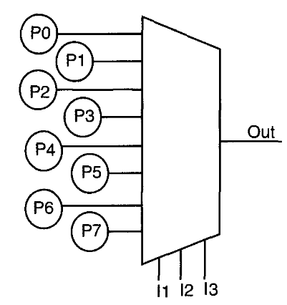

One of the most useful SRAM-based structures is the LUT.
By connecting 2^{N} programming bits to a multiplexer. Where PQ • • • P7 denote the programming bits.

Slide 55
FPGA Architectures
FPGAs contain a matrix of logic elements (cells) that can be interconnected in any desired configuration to implement a given algorithm.
There are various configurations in which FPGA cells can be arranged
two popular architectures used:
1. The Xilinx 4000 Logic Cell Array and
2. The cellular array style CLi FPGA
Xilinx 4000 FPGA:
In the Xilinx 4000 FPGA, the logic cells are embedded grid-like on the chip.
This arrangement is ideal for long distance communication as long as most connections between input and output are relatively short.
The cellular array is configured specifically for fast local communications.

Slide 56
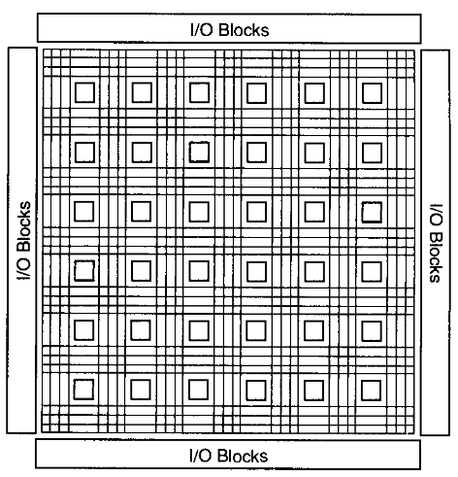
This configuration features a small amount of routing resources running horizontally and vertically between the cells, limiting communication to short distances on the chip.
Xilinx 4000 Logic Cell Array
The Xilinx 4000 series FPGA is an IslandStyle FPGA with logic cells embedded in a general routing structure that permits arbitrary point to point communication.
The logic blocks are surrounded by horizontal and vertical routing channels.
The only requirement for good routing structure is that the source and destination be relatively close together.

Slide 57
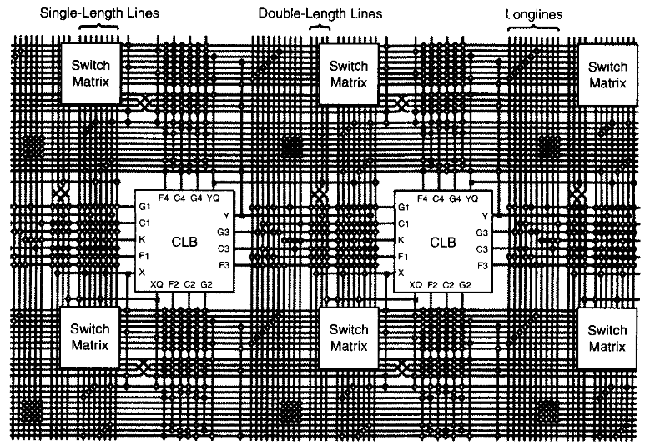
Details of the routing structure are shown in Figure 7.23.
Each of the inputs of the cell (F1-F4, G1-G4, C1-C4, K) comes from one of a set of tracks adjacent to that cell. The outputs are similar (X, XQ, Y, YQ), but they have the choice of both horizontal and vertical tracks
CLB: configurable logic block

Slide 58
The routing structure is made up of three different length lines:
single-length, double-length, and long lines.
Single-length lines travel the height of a single cell, where they then enter a switch matrix.
The switch matrix allows this signal to travel out vertically and/or horizontally. Thus single-length lines can be cascaded together to travel longer distances.
Double-length lines are similar to single-length lines except that they travel the height of two cells before entering a switch matrix.
Finally, long lines go half the chip height without entering the switch matrix. This way, routes of very long distances can be accommodated efficiently.
The Xilinx 4000 series logic cell is made up of three LUTs, two programmable flipflops, and multiple programmable multiplexers

Slide 59
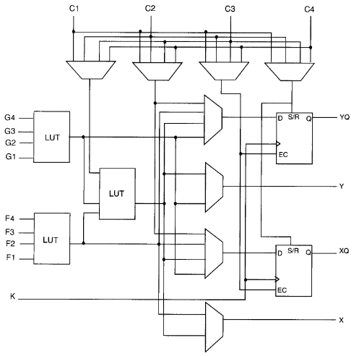

Slide 60
The LUTs allow arbitrary combinational functions of its inputs to be created.
Thus the structure shown can perform any function of five inputs (using all three LUTs with F and G inputs identical), any two functions of four inputs, or some functions of up to nine inputs (using all three LUTs, with F and G inputs different).
SRAM controlled multiplexers then route these signals out of the X and Y outputs (Figure 7.23) as well as to the two flip-flops.
The inputs at the top (Cl - C4) provide enable, set, or reset signals to the flip-flops; a direct connection to the flip-flop inputs; and the third input to the three-input LUT.
This structure yields a powerful method of implementing arbitrary, complex digital logic.

