Slide 1


AYMEN DHEYAA KHALEEL
aymendheyaa@siswa.ukm.edu.my
1

Slide 2

1.
2.
3.
Introduction on microstrip patch antenna (MPA)
Design MPA theoretically
Introduction on CST MICROWAVE STUDIO
4. Simulation
MPA
using
CST
MICROWAVE
STUDIO
2

Slide 3



3

Slide 4
■ In general Microstrip patch antennas are also known
“PRINTED ANTENNAS ”.
as
■ Operates on microwave frequencies (
f
>
1GHz).
■ Invented by Bob
Munson in 1972.
■ Became
popular
starting
in
the
1970s
4

Slide 5
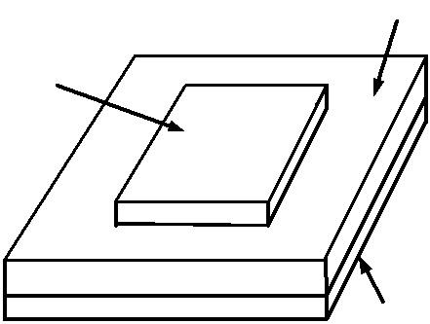
Basically, the Microstrip
consists of :
Patch
Antenna
Dielectric
substrate
Antenna
■ Metal “Patch”.
■ Dielectric Substrate.
■ Ground Plane.
Patch
Ground plane
5

Slide 6
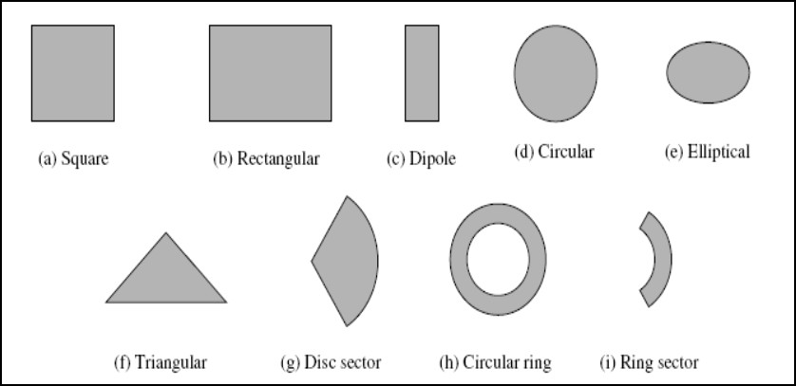
■ The patch can take different shapes , such as rectangular,
circular,
triangular,
or
U-shaped
,
E-shaped,
etc.
6

Slide 7
Advantages of Microstrip Antennas:
■ Easy to fabricate.
■ Low cost , Less size.
■ Can be integrated with microwave circuits.
■ Easy
■ Easy
to
to
feed (coaxial cable,
microstrip
line,
etc.)
.
use
in
an
array.
7

Slide 8
Disadvantages of
Microstrip
Antennas
■ Low gain.
■ Low efficiency.
■ Narrow
bandwidth.
8

Slide 9
Applications
■ in mobile satellite communication
■ Wireless LAN’S.
■ GPS system.
system.
■ Missiles
…….
etc.
9

Slide 10
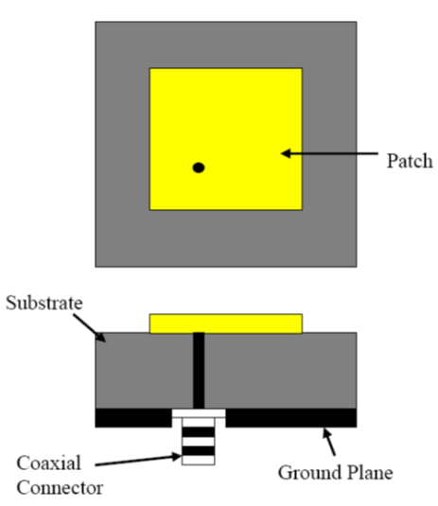
Feedings
Microstrip patch antenna feeds with different
mechanism
feedings, the four
most
popular are
:-
■ Coaxial
Cable
10

Slide 11
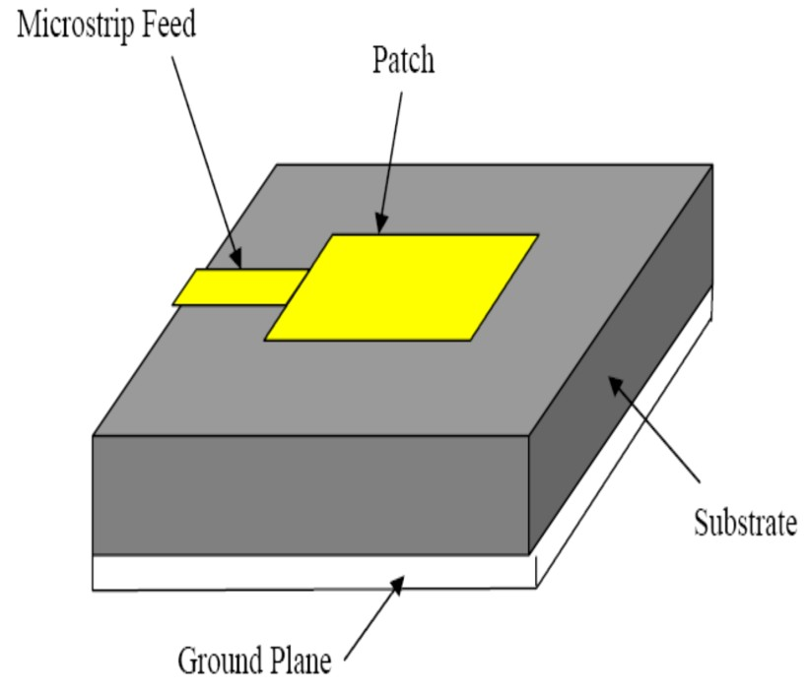
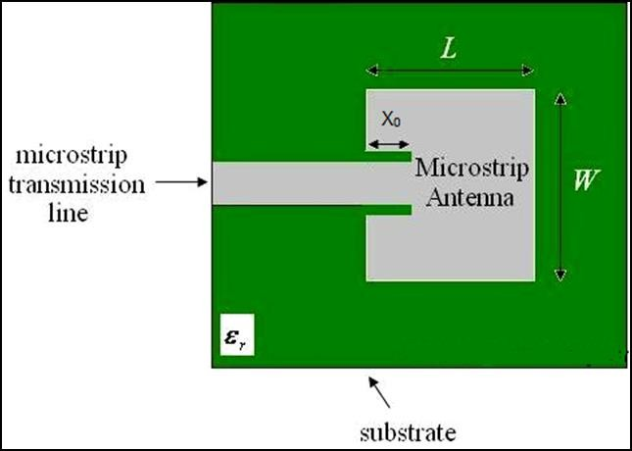
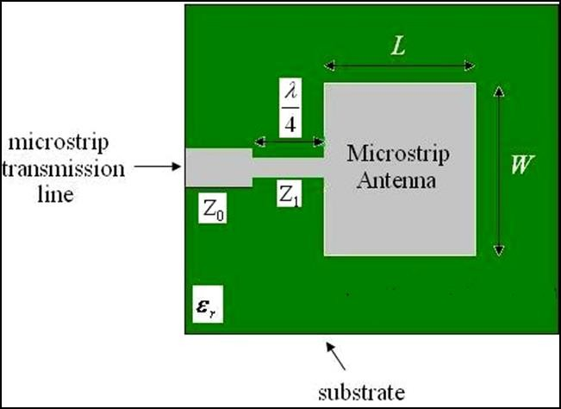
■ Microstrip
Line
inset-fed
11
quarter-wavelength feed

Slide 12
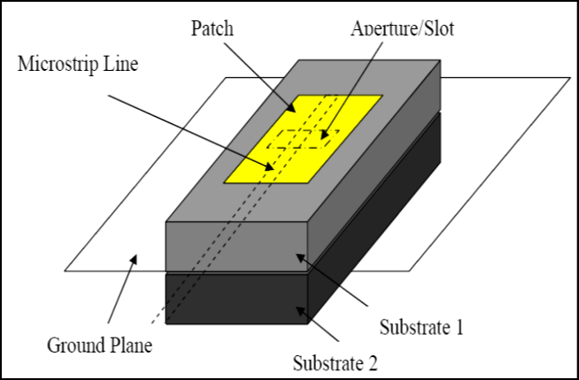
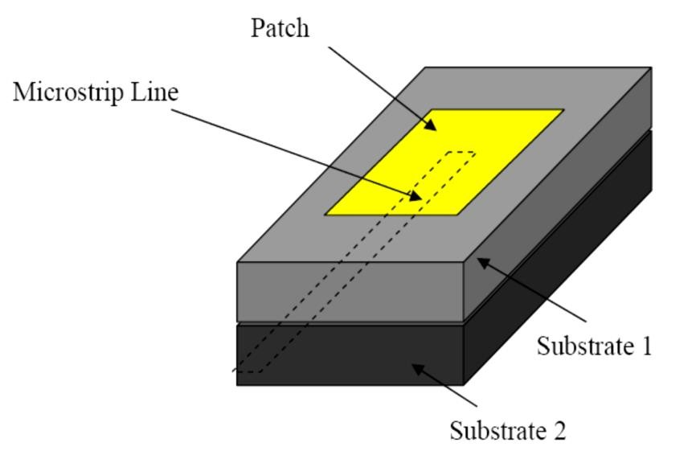
■ Aperture coupled (slot) Feed
■ Proximity
coupled
Feed
12

Slide 13





13

Slide 14
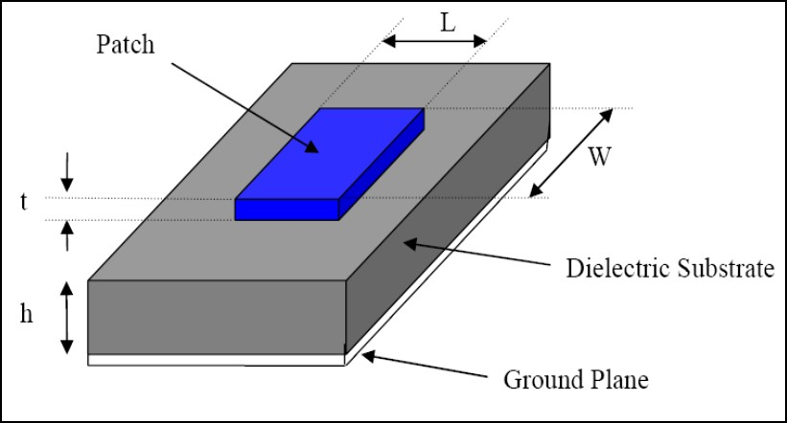
To design a Rectangular patch antenna.
There are four essential parameters which are
■ The operating frequency (f˳).
■ Dielectric constant of substrate (ε_{r}).
important
to
know:-
■ The
■ The
height
height
of
of
the
the
dielectric substrate
(h).
conductor
(t).
The other parameters:
■ The
■ The
■ The
width of the patch (W)
length of the patch (L)
width and length of the
Ground₁₄plane
and the substrate (Wg)(Lg).

Slide 15
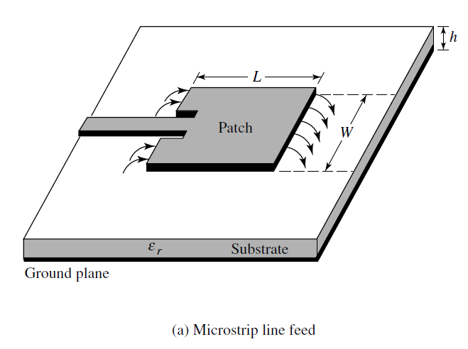
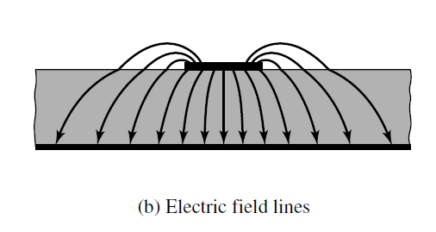
There are a a lot of methods for analysis microstrip patch antenna:
■ The Transmission Line model.
■ The Cavity model.
■ Method of Moments (MoM).
The
Transmission
Line
model
is
the
easiest
of
all
15

Slide 16

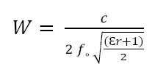
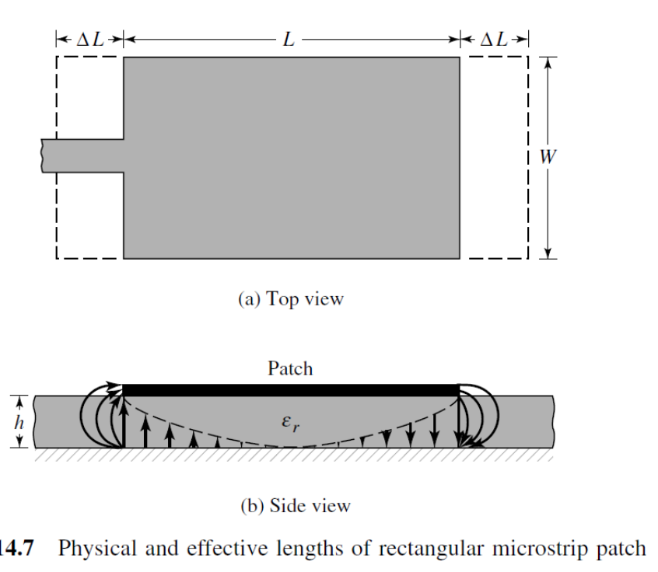


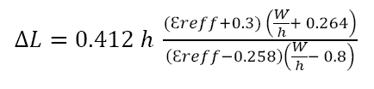

The Transmission Line equations
■ To
Find Width (W)
■ To
find
the
effective
dielectric
constant
■ To
find
the
effective
length
■ To
find
the fringing
length (∆L)
■ To
find
the actual length L and the width
��𝑔 = 2 ∗ 𝐿 16
and length of the Ground
𝑊𝑔 = 2 ∗ 𝑊

Slide 17
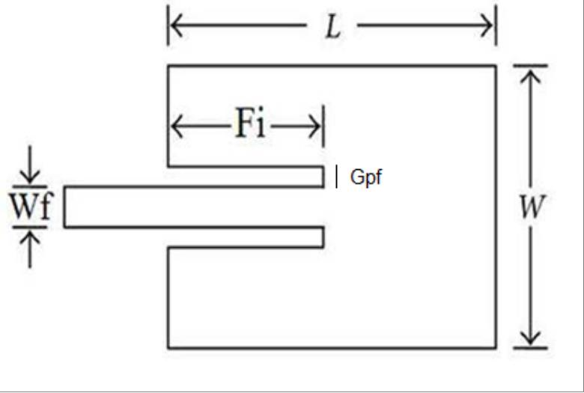
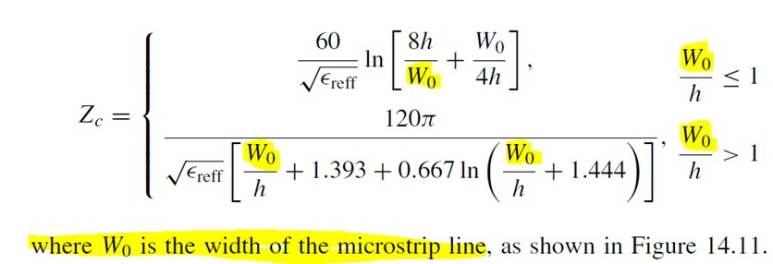
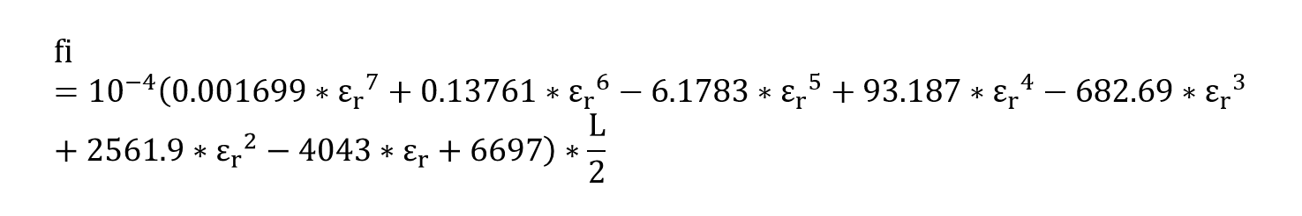
To design the microstrip feed line (inset-fed)
■ The
■ The
input impedance is usually 50 Ω.
width
of
Microstrip
feed
line
(Wf).
■ The
length of inset (Fi)
■ the gap between the patch and the inset-fed
17
(Gpf) usualy 1 mm.

Slide 18
Example:-
To
the
for
design
a
microstrip patch
antenna
with
microstrip feed line (inset-fed)
work
on
WiFi
2.4 GHz.
■ The operating frequency (f˳) = 2.4 GHz.
FR4 material have:-
■ Dielectric constant of substrate (ε_{r}) = 4.3.
■ The height of the dielectric substrate (h) = 1.6 mm.
■ The height of the conductor (t) = 0.035 mm.
18

Slide 19





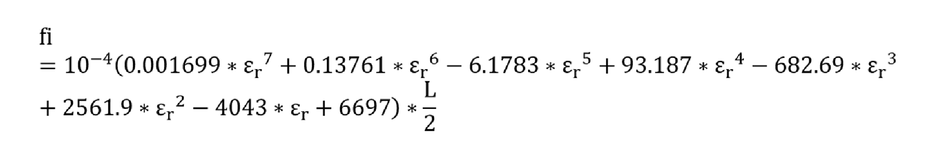
To calculate
the
W,
L
of
the
patch
by
using
the
equations:-
��𝑔 = 2 ∗ 𝐿
𝑊𝑔 = 2 ∗ 𝑊
■ C = 299792458
■ f˳ = 2.4 GHz or
or
3* 10^8 m/se
2.4*10^9 Hz
■ FR4 ► εr = 4.3, h=1.6 mm, t= 0.035 mm
19
■ W≈ 38 mm, L≈ 29 mm , Fi≈8.85 mm

Slide 20

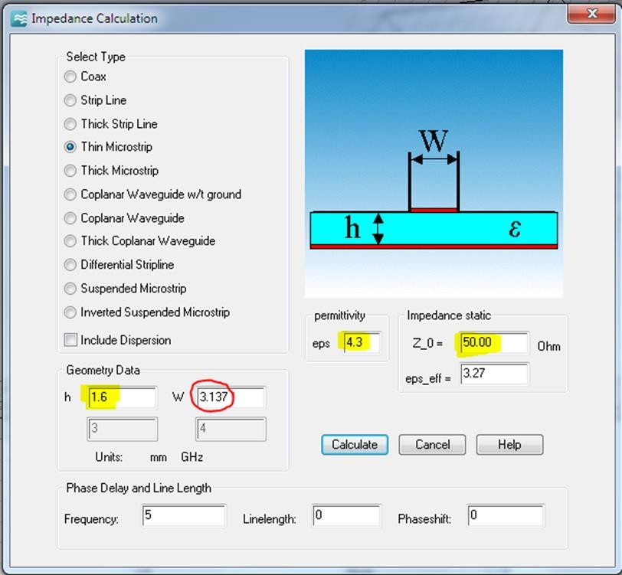
To calculate
The
feed
line
width
Wf
Or using transmission
or CST
line
software
■ Wf≈3.137 mm
20

Slide 21
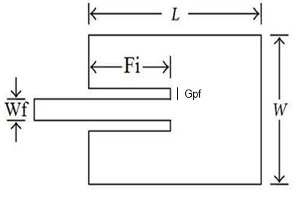
The
Parameters
Parameters
mm
W
38
L
29
Fi
8.85
Wf
3.137
Gpf
1
Lg
2*L
Wg
2*W
ht
0.035
hs
1.6
21

Slide 22

22

Slide 23


https://www.cst.com/
23

Slide 24

https://www.cst.com/
24

Slide 25







CST MICROWAVE STUDIO® is a specialized tool for the fast and accurate 3D EM simulation of high frequency problems. Along with a broad application range, it offers considerable product-to-market advantages: shorter development cycles; virtual prototyping before physical trials; optimization instead of experimentation.
CST EM STUDIO® is an easy-to-use tool for the analysis and design of static and low frequency structures. Applications include: actuators, brakes, EMC, generators, measurement, motors, sensors and shielding.
CST PARTICLE STUDIO® is a specialized tool for the fast and accurate design and analysis of 3D electron guns. This new software is based on the multi-purpose electromagnetic solvers of the CST STUDIO family and incorporates their powerful modelling capabilities in addition to successful algorithms of the MAFIA-TS simulators.
C ST MPHY SIC S STUDIO ™ is a tool to analyze thermal and structural mechanics problems.
C ST DESI GN STUDIO ™ represents a universal platform to manage the entire design process of a complex system beginning with a first layout and closing with the final solution. By constructing elementary sub-systems, the user can analyze the behavior of the complete system in small segments.
C ST PC B STUDIO ™ is a tool for the investigation of Signal and Power Integrity and the simulation of
EMC and EMI effects on Printed Circuit Boards (PCB).
C ST C ABL E STUDIO ™ is a tool for the analysis of SI, EMC and EMI effects in cable systems including single wires, twisted pairs as well as complex cable harnesses.
C ST MIC RO STR I PES™ is a powerful 3D electromagnetic simulation tool, used extensively for solving challenging radiation problems including complex antenna structures, installed performance, EMC/EMI/E3 issues. ₂₅

Slide 26


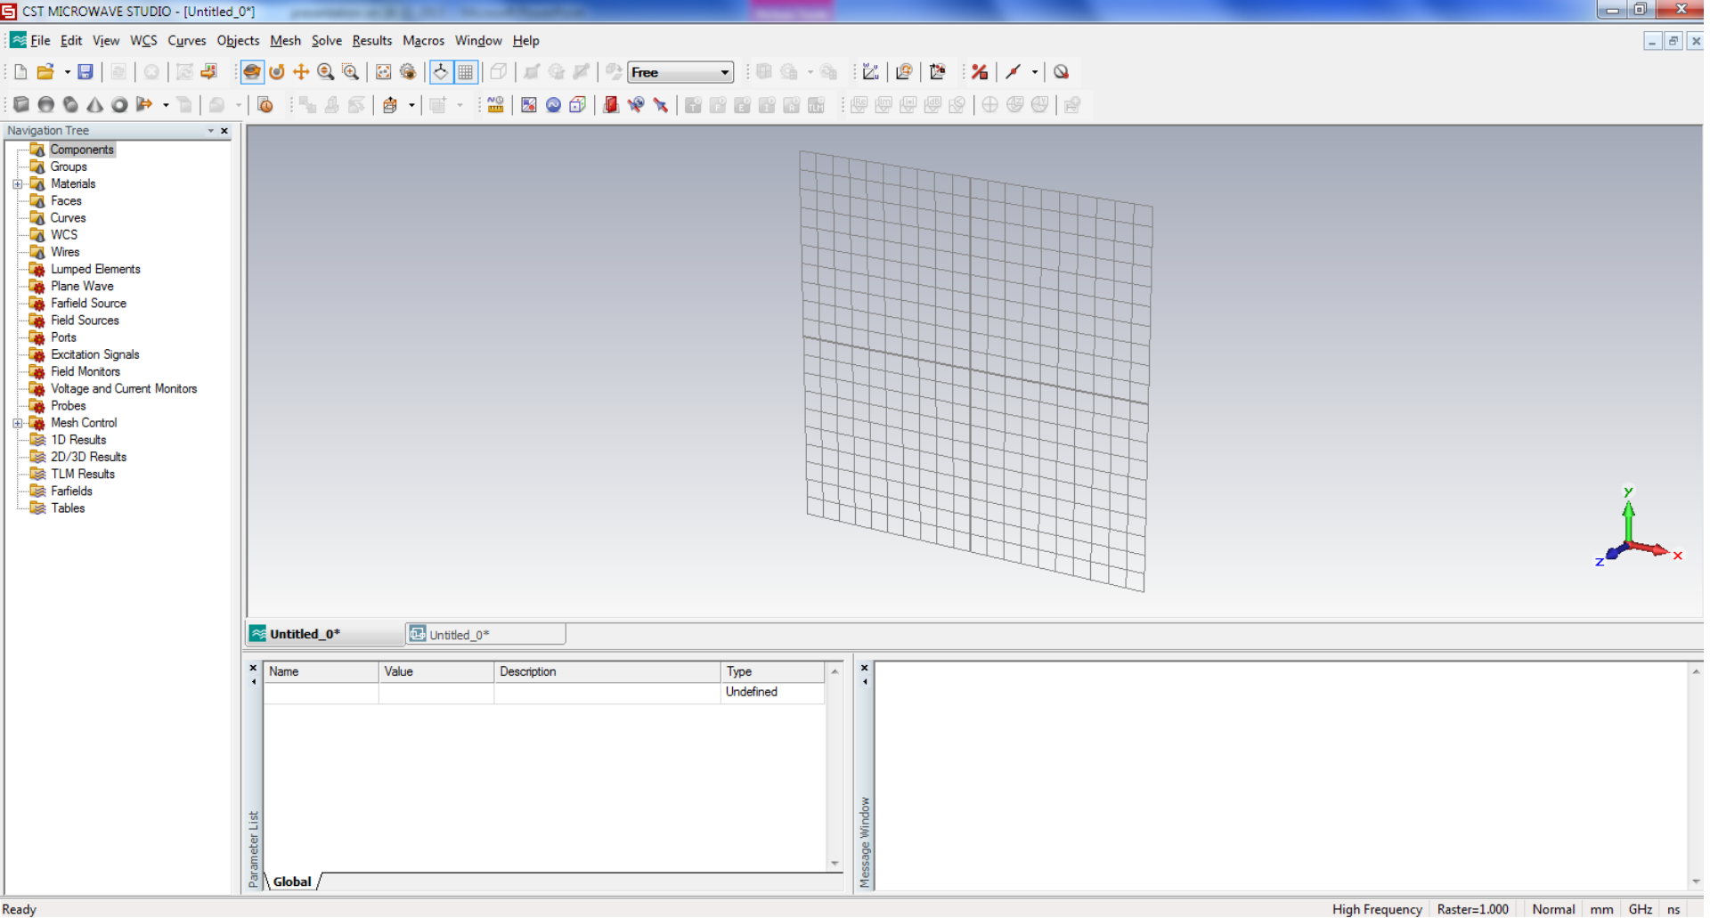
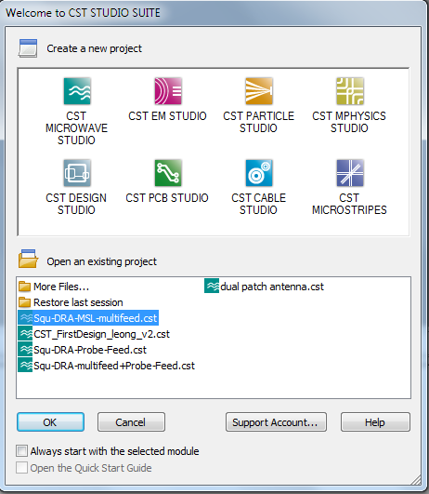
26

Slide 27
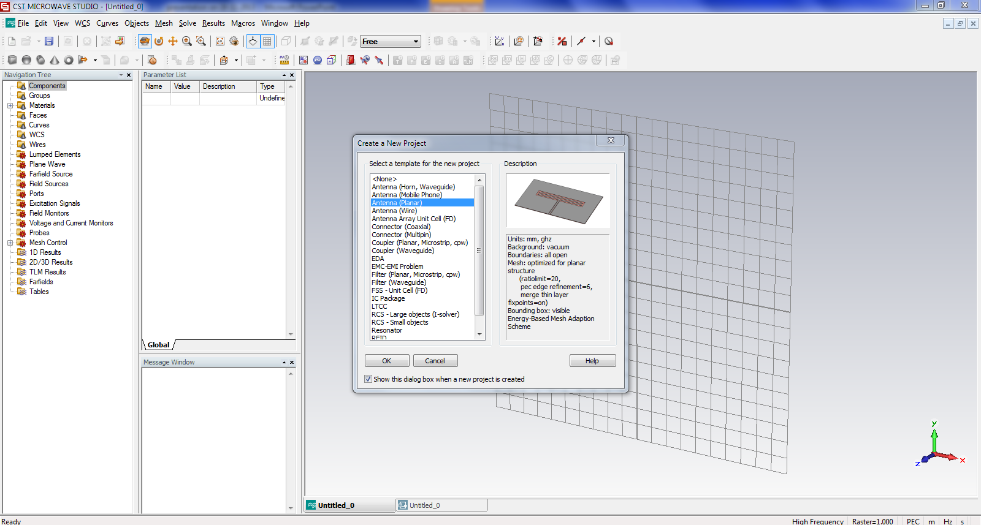
Create
a
new
project
27

Slide 28
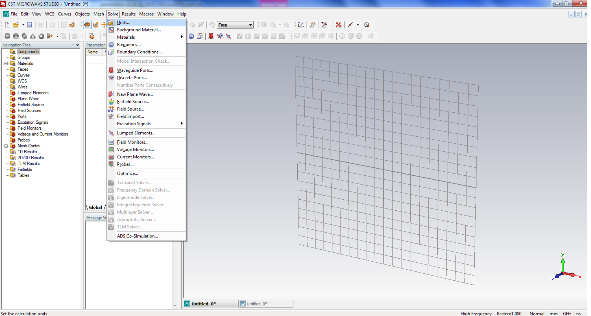
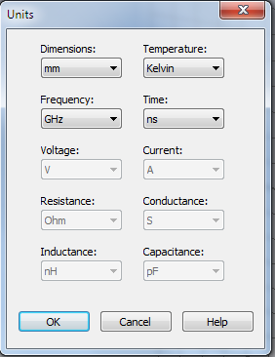
To
Determine
units
28

Slide 29
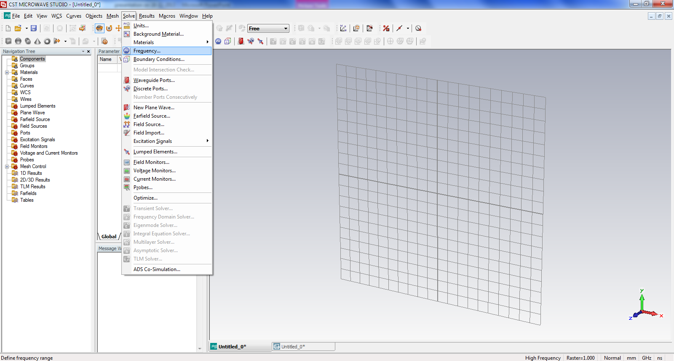
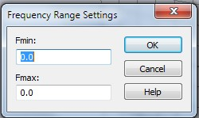
To
the
frequency
range
29

Slide 30





30

Slide 31
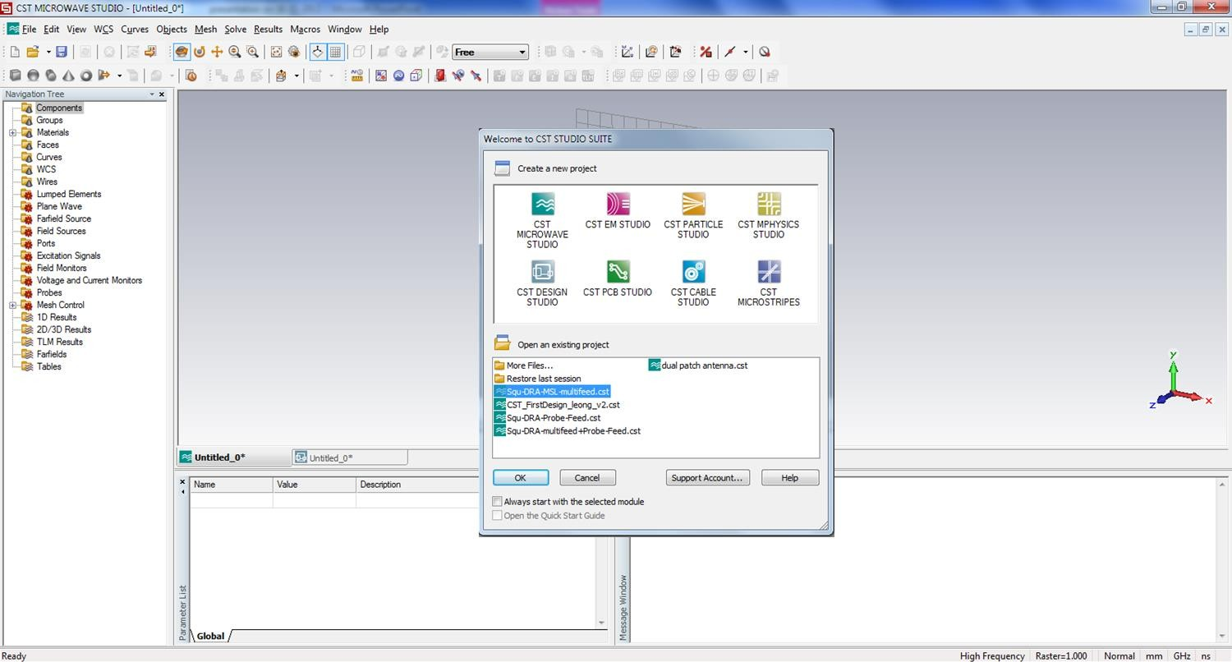
■ Chose
CST
Microwave
studio
31

Slide 32
■ Chose
Antenna
(Planar)
32

Slide 33
The Parameters
For design a microstrip patch antenna with the
microstrip
WiFi.
feed
line
(inset-fed)
work
on
2.4
GHz
for
Parameters
mm
W
38
L
29
Fi
8.85
Wf
3.137
Gpf
1
Lg
2*L
Wg
2*W
ht
0.035
hs
1.6
The frequency
range betwe³e³ n 1.8 to 3

Slide 34
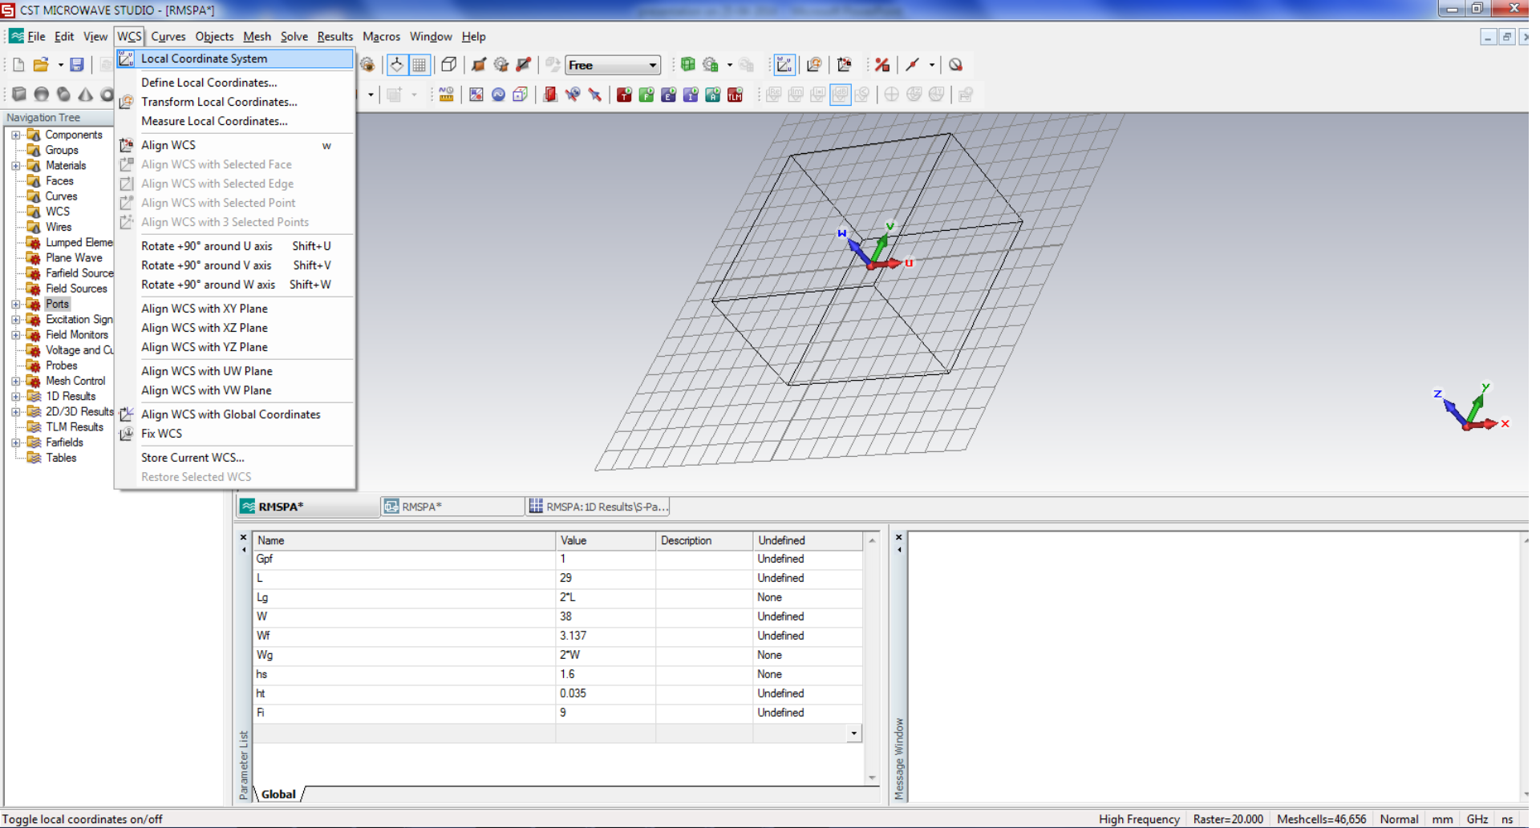
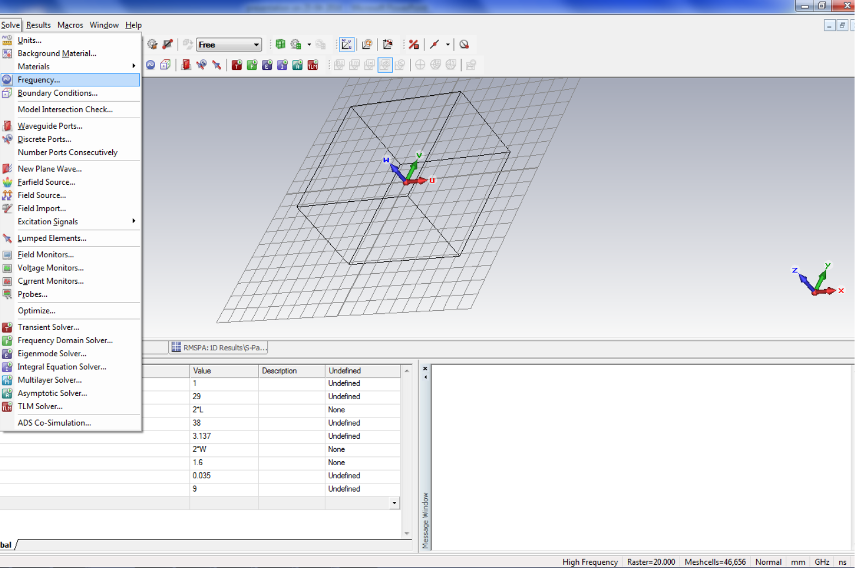
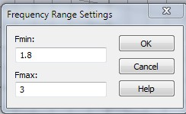
■ local coordinate system
■ Determine
the
frequency
Range
and put
the
parameters
34

Slide 35
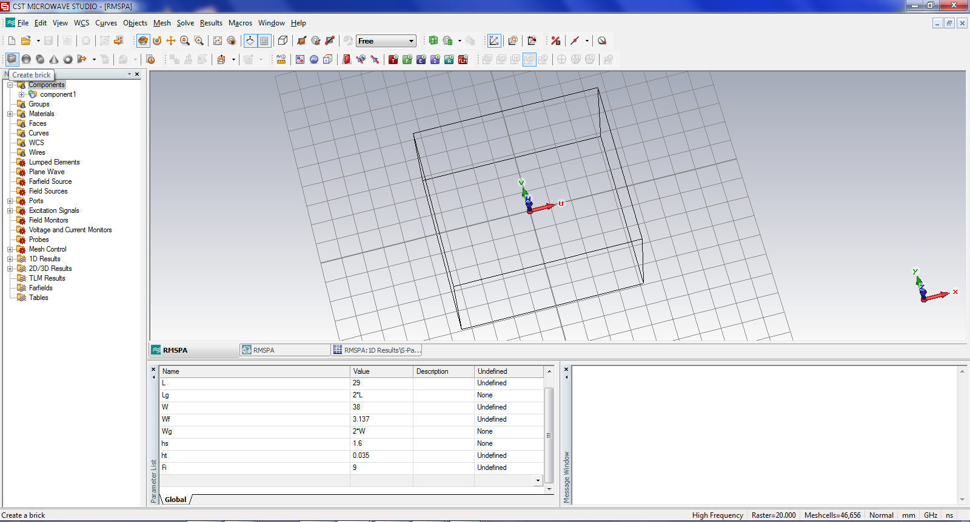
■ Press
create
brick
then
press
Esc
from
the
keyboard
35

Slide 36
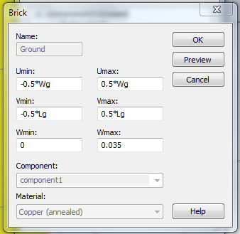
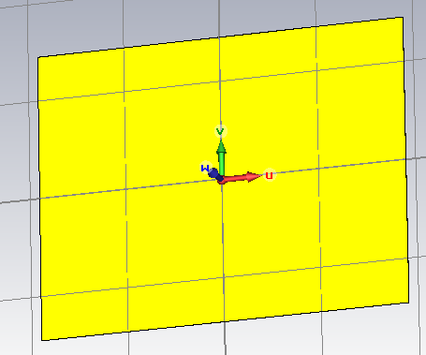
■ Create
ground
plane
36

Slide 37
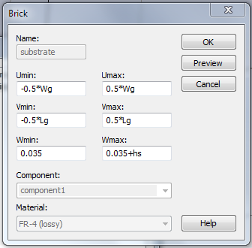
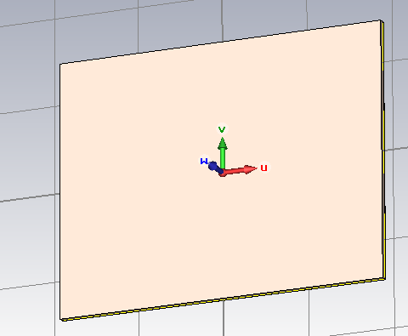
■ Create
the
substrate
37

Slide 38
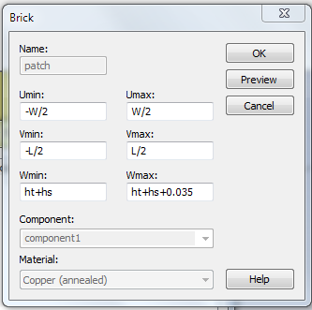
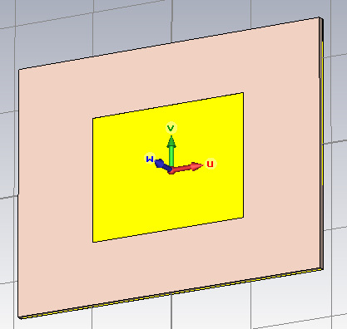
■ Create
the
patch
38

Slide 39
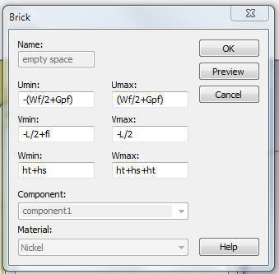
■ Create
the
empty
space
39

Slide 40
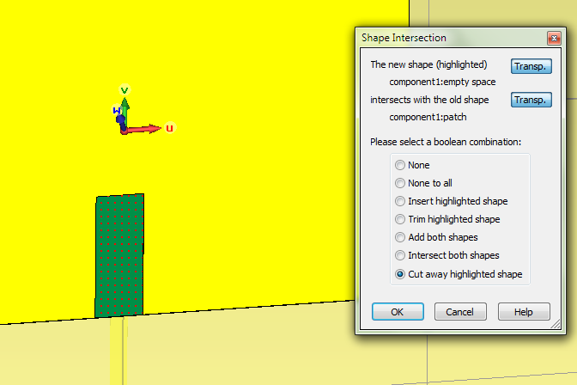
■ Cut
away
the
empty
space
40

Slide 41
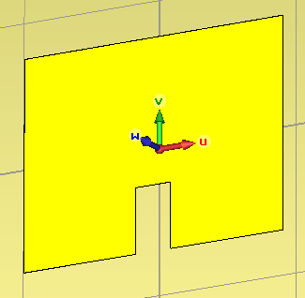
■ Create
the
empty
space
41

Slide 42
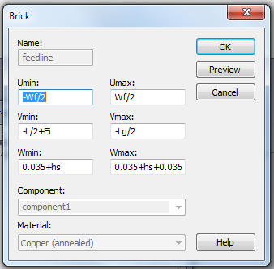
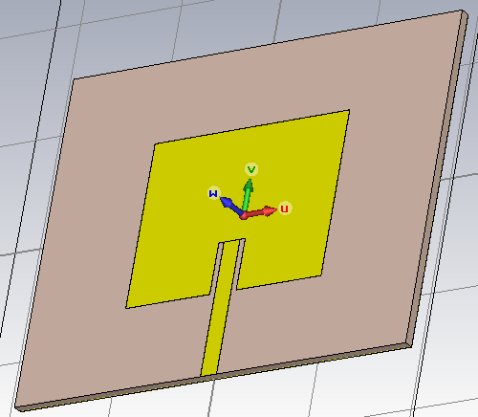
■ Create
the
feed
line
42

Slide 43
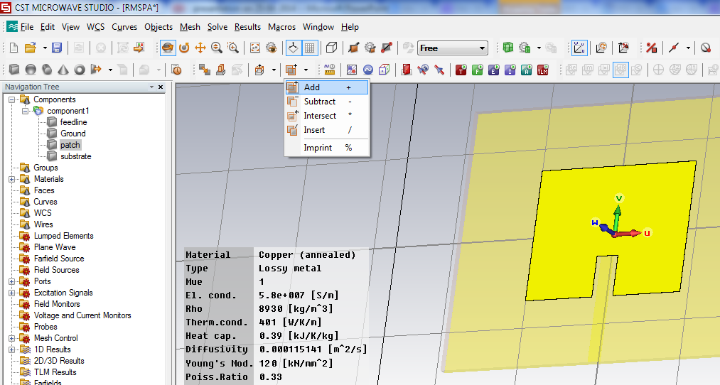
■ The patch and feed line into
one object
Press
to
patch
then
add
then
feedline
then
press
Enter
43

Slide 44
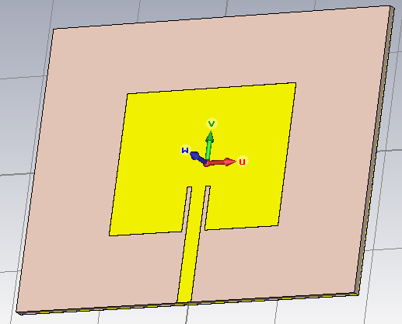
■ The
antenna
44

Slide 45
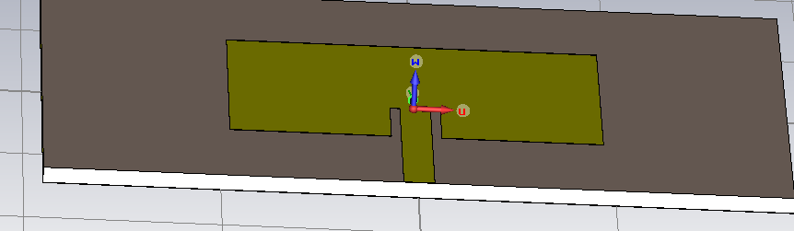
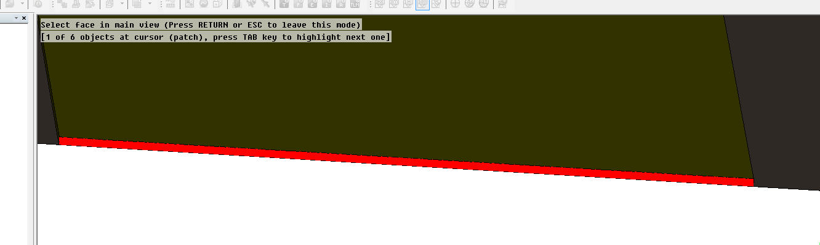
■ The
Port
■ Press
F
from
in
the
keyboard
and
click
to
45

Slide 46
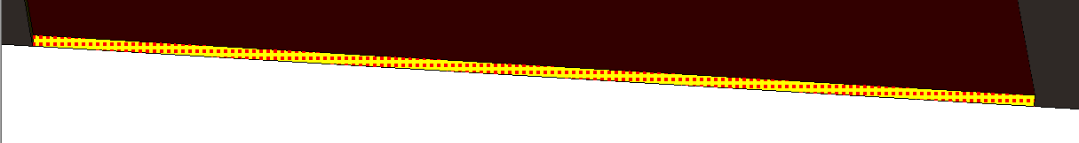
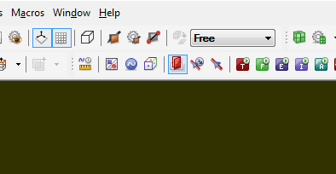
■ Then
■ click
on
waveguide
port
46

Slide 47
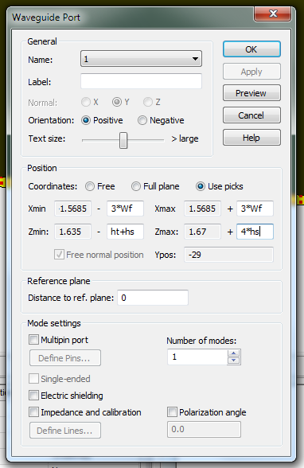
■ waveguide
port
47

Slide 48

■ The
antenna
is
ready
to
simulated
48

Slide 49


■ Field
monitors
49

Slide 50

■ Use
Transient
solver
50

Slide 51

■ start
51

Slide 52

■ The
Result
52

Slide 53

■ The
bandwidth
=
54.9
MHz
53

Slide 54

■ Fairfield
Radiation
pattern
54

Slide 55

■ C. A. Balanis. 1997. Antenna Theory, Analysis and Design. John Wiley and Sons, New
York.
■ Garg, Ramesh. 2001 “Microstrip antenna design handbook”, Artech House
■ Ramesh, M and Yip KB, "Design Formula for Inset Fed Microstrip Patch Antenna", Journal of Microwave and Optoelectronics, Vol.3, No.3, December 2003.
■ G. Devakirubai D et al., “Design and comparative study of pin feed and line feed microstrip patch antenna for x-band applications,” International Journal of Applied Information Systems, vol. 1, pp. 21–25, 2012.
55

Slide 56

■ Design and simulate a dual-band antenna for
LTE
applications. (LTE band 3 and LTE
■ Write a report detailing your work.
■ Last date 18/12/2016.
band
7)
Send it to
aymendheyaa@siswa.ukm.edu.my
56

Slide 57


57

