Slide 1
CU5191
ADVANCED RADIATION SYSTEMS
UNIT 1

Slide 2
UNIT 1 - ANTENNA FUNAMENTALS
Wave equations, Radiation pattern, HPBW, FNBW, Gain and Directivity, Polarization, equivalent circuit,
Radiation resistance, Radiation integrals, Radiation from surface and line current distributions – Dipole, Monopole, Loop antenna, Antenna parameters, Image theory; Induction, Reciprocity theorem, Balance to unbalance transformer, Introduction to numerical techniques.

Slide 3
RADIATION PATTERN
Cont..
Definition:
Antenna Radiation Pattern or Antenna Pattern is defined as “a mathematical function or a graphical representation of the radiation properties of an antenna as a function of space coordinates”
Radiation pattern is determined in the far field region.
It is represented as a function of directional coordinates.
Radiation properties include Power flux density, Radiation intensity, Field Strength, Directivity and Polarisation.

Slide 4
RADIATION PATTERN
Cont..
Types:
    Field Pattern
    Power Pattern
If the radiation from the antenna is expressed in terms of the field strength (E or H) then the pattern is called as Field pattern.
If the radiation from the antenna is expressed in terms of power per unit area then the pattern is called as Power pattern.
Often field and power patterns are normalized w.r.to their maximum value, yielding normalized field and power patterns.

Slide 5
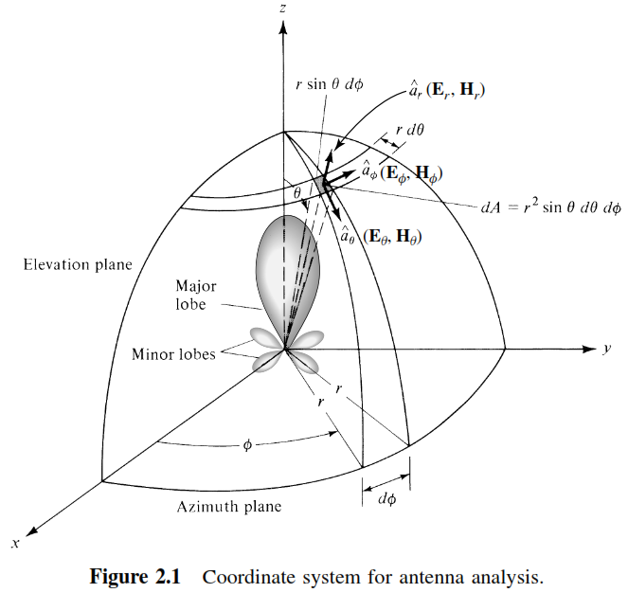
RADIATION PATTERN
Cont..

Slide 6
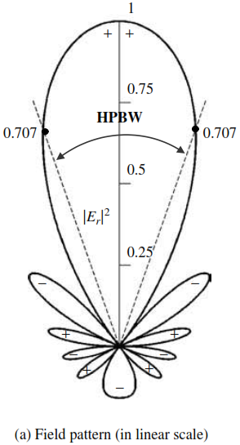
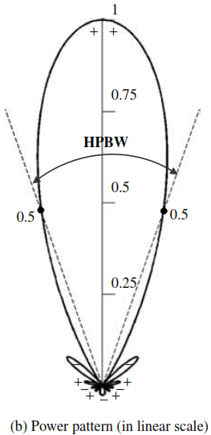
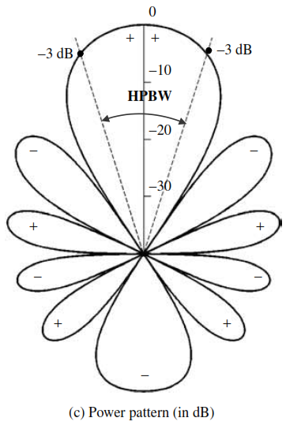
RADIATION PATTERN
Cont..

Slide 7
RADIATION PATTERN
Cont..
The ‘+’ and ‘-’ signs in the lobes indicate the relative polarization of the various lobes which changes as the nulls are crossed.
All the 3 patterns yields the same angular separation between the 2 half power points, 38.64 ° on their respective patterns referred to as HPBW.

Slide 8
RADIATION PATTERN
Cont..
Various parts of a Radiation pattern are referred to as Lobes.
Lobes
Major Lobe Minor Lobe
(Or)
Main Lobe Back Lobe Side Lobe
Major Lobe: It is defined as “The radiation lobe containing the direction of maximum radiation”. It is also known as Main Beam.
Minor Lobe: All lobes except the major lobe is called as Minor Lobe

Slide 9
RADIATION PATTERN
Cont..
Side Lobe: A Radiation lobe adjacent to the major lobe is called as Side Lobe.
Back Lobe: A Radiation lobe whose axis makes an angle of approximately 180° w.r.to the beam of an antenna is called as Back lobe.
  Usually it refers to a minor lobe that occupies the hemisphere in a direction opposite to that of the major lobe.

Slide 10
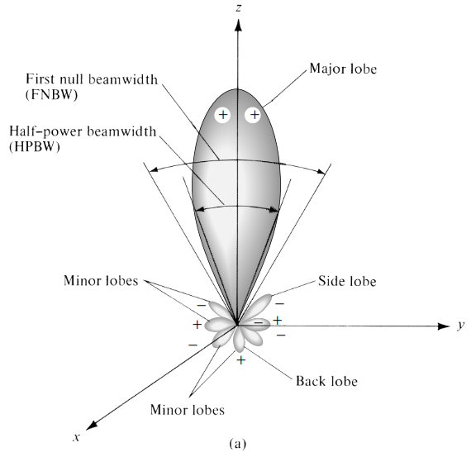
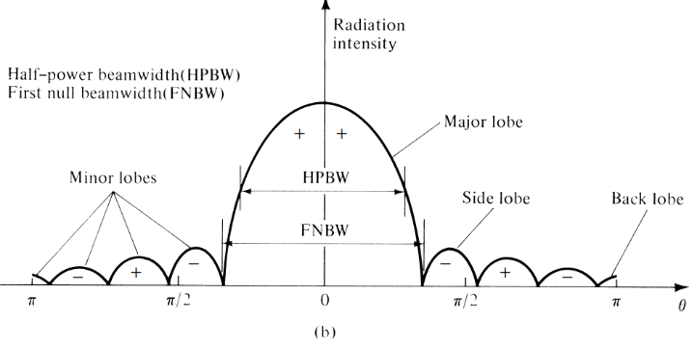
RADIATION PATTERN
Cont..
Radiation lobes and beamwidths of an antenna pattern
Linear plot of power pattern and its associated lobes and beamwidths.

Slide 11
RADIATION PATTERN
Cont..
Antenna Beamwidth: The angular width of the Radiation pattern is called as Beamwidth. There are 2 types of Beamwidth.
1. HPBW (Half Power Beam Width)
2. FNBW (First Null Beam Width)
HPBW: It is defined as “ The angular width measured in the radiation pattern (major Lobe) between the points where the power is half of its maximum value”. It is also called as -3dB Beamwidth.
  P(θ, φ) at Half power points =
  E(θ, φ) at Half power points =

Slide 12
RADIATION PATTERN
Cont..
FNBW: It is defined as “ The angular width measured in the radiation pattern between 2 first nulls”.
  First null does not contain any radiation.
  First null occurs between major lobe and first side lobe.
  P(θ, φ) at First null points = 0
  E(θ, φ) at First null points = 0
10dB Beamwidth: It is the angle between the 2 direction on either side of the main lobe peak along which the power density is 10dB below the maximum value.

Slide 13
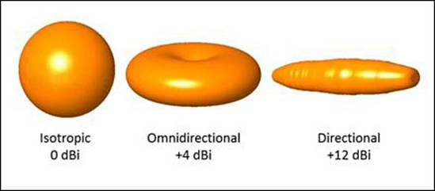
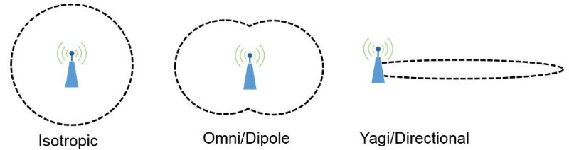
RADIATION PATTERN
Cont..
Isotropic, Directional and Omnidirectional Patterns:
Isotropic Antenna: It is defined as “ a hypothetical lossless antenna having equal radiation in all directions”.
Directional Antenna: A directional antenna is one “ having the property of radiating or receiving electromagnetic waves more effectively in some directions than in others”.
Omnidirectional Antenna: “An antenna which has non directional pattern in a given plane and a directional pattern in any orthogonal plane” is called as Omnidirectional Antenna.

Slide 14
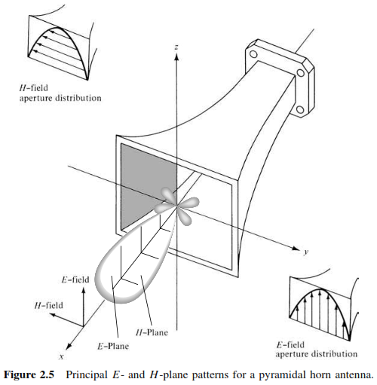
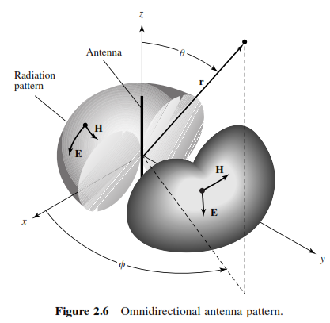
RADIATION PATTERN
Cont..
Principal Pattern:
For linearly polarized antenna, performance is described in terms of its principal E and H plane.
E – Plane: It is defined as “ the plane containing the electric field vector and the direction of maximum radiation”.
H – Plane: It is defined as “the plane containing the magnetic field vector and the direction of maximum radiation”.

Slide 15
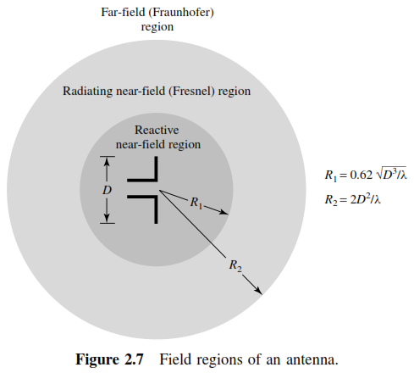
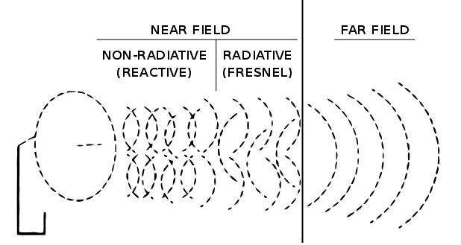
RADIATION PATTERN
Cont..
Field Regions:
Reactive near-ﬁeld region is deﬁned as “that portion of the near-ﬁeld region immediately surrounding the antenna wherein the reactive ﬁeld predominates.”
For most antennas, the outer boundary of this region is commonly taken to exist at a distance R<0.62(D³/λ)^{1/2} from the antenna surface

Slide 16
RADIATION PATTERN
Cont..
Radiating near-ﬁeld (Fresnel) region is deﬁned as “that region of the ﬁeld of an antenna between the reactive near-ﬁeld region and the far-ﬁeld region wherein radiation ﬁelds predominate and wherein the angular ﬁeld distribution is dependent upon the distance from the antenna.
The radiating near-ﬁeld region is sometimes referred to as the Fresnel region on the basis of analogy to optical terminology
Far-ﬁeld (Fraunhofer) region is deﬁned as “that region of the ﬁeld of an antenna where the angular ﬁeld distribution is essentially independent of the distance from the antenna.
If the antenna has a maximum overall dimension D, the far-ﬁeld region is commonly taken to exist at distances greater than 2D²/λ from the antenna.

Slide 17
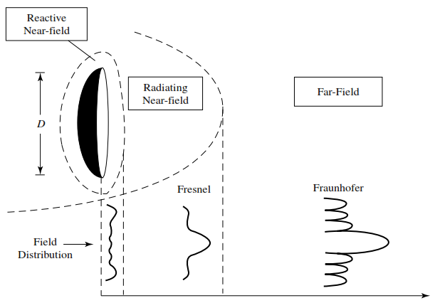
RADIATION PATTERN
Cont..
In the figure it is apparent that in the reactive near ﬁeld region the pattern is more spread out and nearly uniform, with slight variations. As the observation is moved to the radiating near-ﬁeld region(Fresnel), the pattern.
begins to smooth and form lobes
In the far-ﬁeld region (Fraunhofer), the pattern is well formed, usually consisting of few minor lobes and one, or more, major lobes.

Slide 18
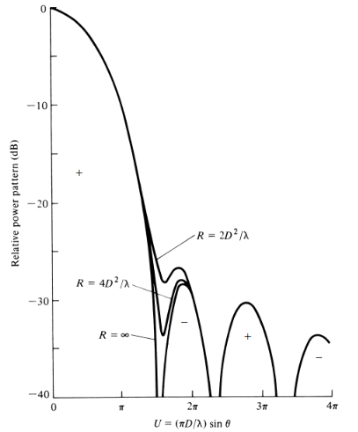

RADIATION PATTERN
Cont..
To illustrate the pattern variation as a function of radial distance beyond the minimum far-ﬁeld distance
Three patterns of a parabolic reﬂector calculated at distances of and inﬁnity. It is observed that the patterns are almost identical, except for some differences in the pattern structure around the ﬁrst null and at a level below 25 dB.
Because inﬁnite distances are not realizable in practice, the most commonly used criterion for minimum distance of far-ﬁeld observations is
Figure 2.9 Calculated radiation patterns of a paraboloid antenna for different distances from the antenna

Slide 19
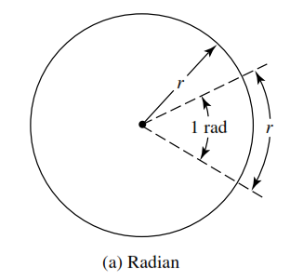
RADIATION PATTERN
Cont..
Radian and Steradian:
The measure of a plane angle is a radian.
One radian is deﬁned as the plane angle with its vertex at the center of a circle of radius r that is subtended by an arc whose length is r.
Since the circumference of a circle of radius r is C = 2πr, there are 2 π rad (2 π r/r) in a full circle.

Slide 20
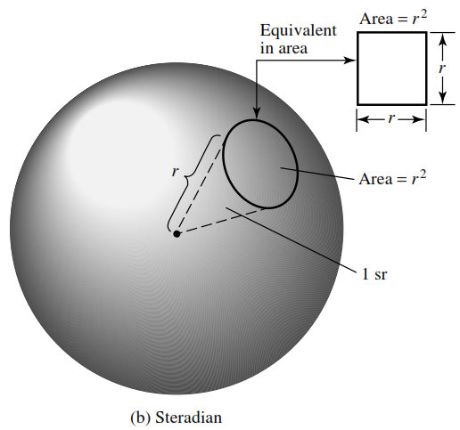


RADIATION PATTERN
Cont..
The measure of a solid angle is a steradian.
One steradian is deﬁned as the solid
angle with its vertex at the center of a sphere of radius r that is subtended by a spherical surface area equal to that of a square with each side of length r.
The area of a sphere of radius r is A =4πr² ,there are 4π sr in a closed sphere.
The inﬁnitesimal area dA on the surface of a sphere of radius r is given by,
Therefore, the element of solid angle dΩ of a sphere can be written as

Slide 21
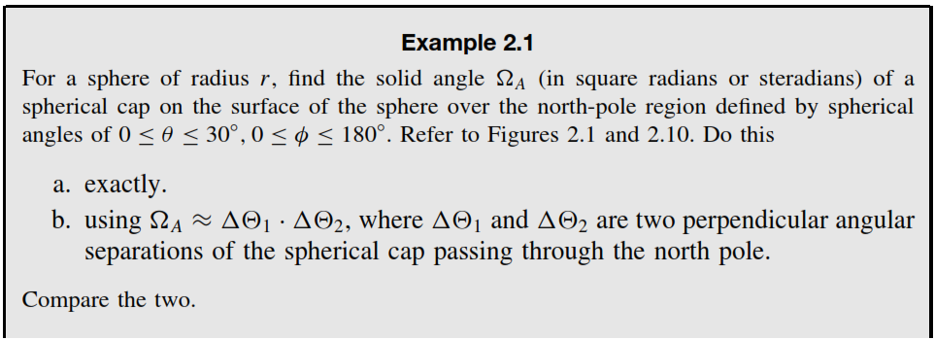
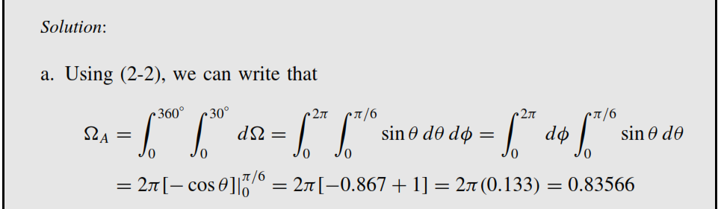

Slide 22
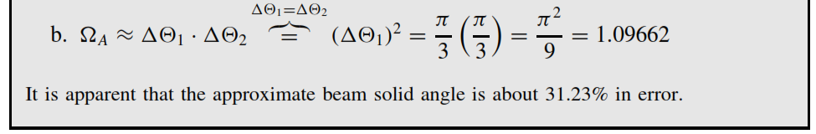
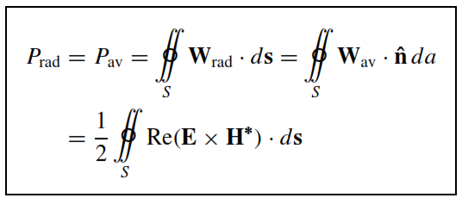
RADIATION POWER DENSITY
RADIATION POWER DENSITY:
The average power radiated by an antenna is given as,

Slide 23
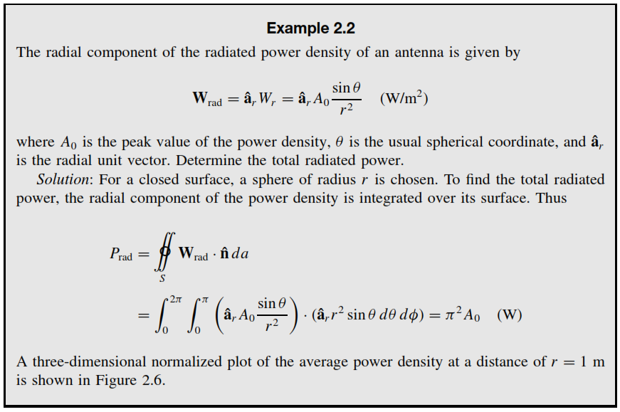
RADIATION POWER DENSITY

Slide 24


RADIATION INTENSITY
RADIATION INTENSITY:
Radiation intensity in a given direction is deﬁned as “the power radiated from an antenna per unit solid angle.” The radiation intensity is a far-ﬁeld parameter, and it can be obtained by simply multiplying the radiation density by the square of the distance.
In mathematical form it is expressed as
Where,
U = radiation intensity (W/unit solid angle)
W_{rad} = radiation density (W/m²)
The power pattern is also a measure of the radiation intensity.
The total power is obtained by integrating the radiation intensity over the entire solid angle of 4π. Thus

Slide 25
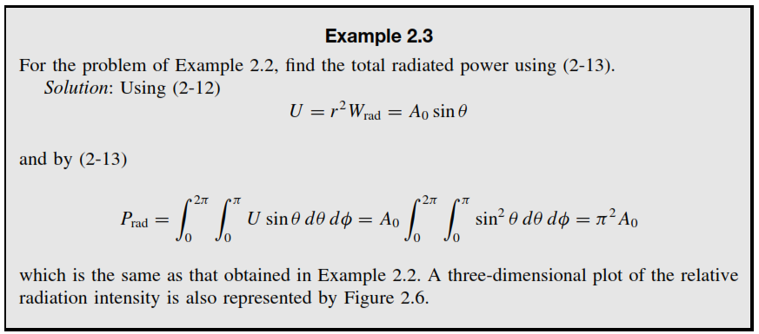

RADIATION INTENSITY
For an isotropic source U will be independent of the angles θ and φ,as was the case for W_{rad}. Thus total radiated power can be written as

Slide 26


DIRECTIVITY
DIRECTIVITY: Directivity of an antenna deﬁned as “the ratio of the radiation intensity in a given direction from the antenna to the radiation intensity averaged over all directions. The average radiation intensity is equal to the total power radiated by the antenna divided by 4π.
If the direction is not speciﬁed, the direction of maximum radiation intensity is implied.”
simply, the directivity of a nonisotropic source is equal to the ratio of its radiation intensity in a given direction over that of an isotropic source. In mathematical form, it can be written as
D = directivity (dimensionless)
U = radiation intensity (W/unit solid angle)
Uo= radiation intensity of isotropic source (W/unit solid angle)
If the direction is not speciﬁed, it implies the direction of maximum radiation intensity (maximum directivity) expressed as
Do = maximum directivity (dimensionless)
U_{max} = maximum radiation intensity
(W/unit solid angle)

Slide 27

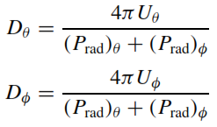
DIRECTIVITY
Cont..
For antennas with orthogonal polarization components, we deﬁne the partial directivity of an antenna for a given polarization in a given direction as “that part of the radiation intensity corresponding to a given polarization divided by the total radiation intensity averaged over all directions.”
With this deﬁnition for the partial directivity, Then in a given direction “the total directivity is the sum of the partial directivities for any two orthogonal polarizations.”
For a spherical coordinate system, the total maximum directivity D for the orthogonal θ and φ components of an antenna can be written as
while the partial directivities D_{θ} and D_{φ} are expressed as,
Directivity of an isotropic antenna is 1.

Slide 28
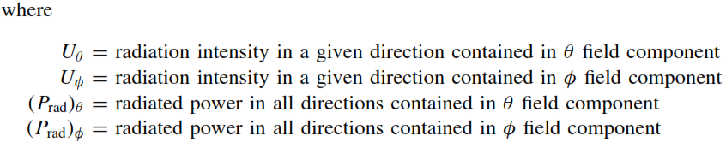
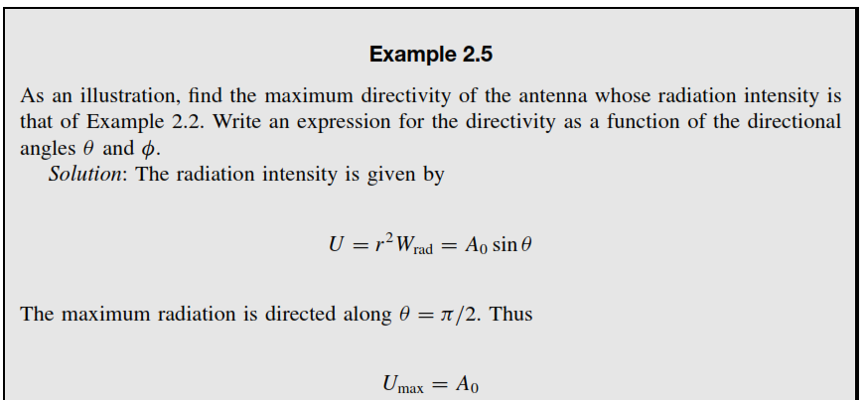
DIRECTIVITY
Cont..

Slide 29
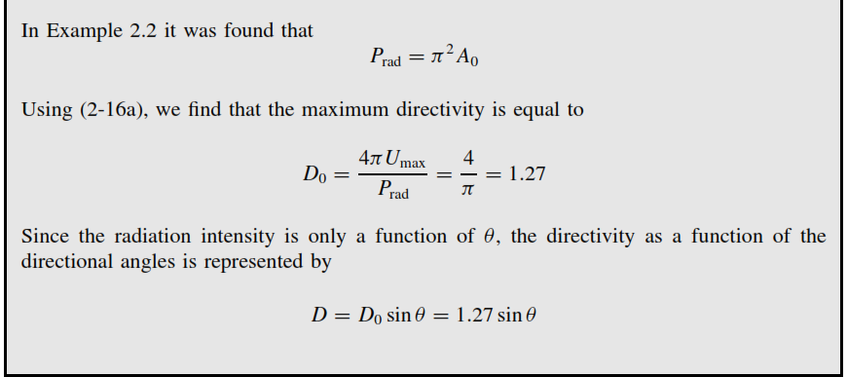
DIRECTIVITY
Cont..

Slide 30
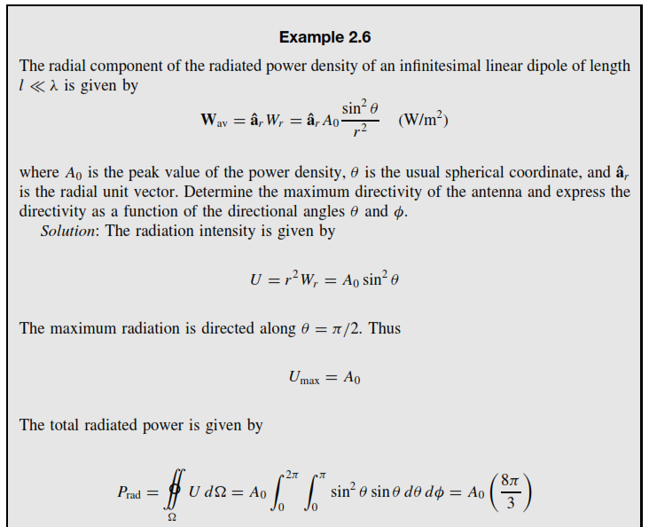
DIRECTIVITY
Cont..

Slide 31
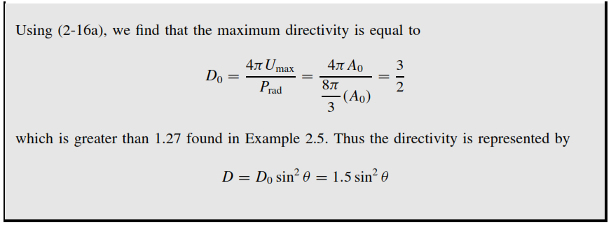
DIRECTIVITY
Cont..
The Directivity of a half wavelength dipole is given as,
D = DoSin³θ = 1.67 Sin³θ
The 2 and 3-dimensional directivity patterns of a /2 dipole and an isolator is shown in figure.

Slide 32
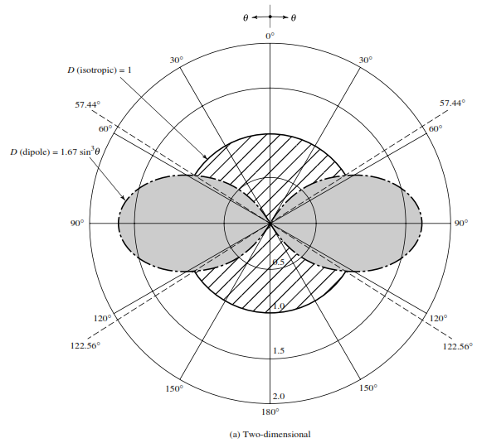
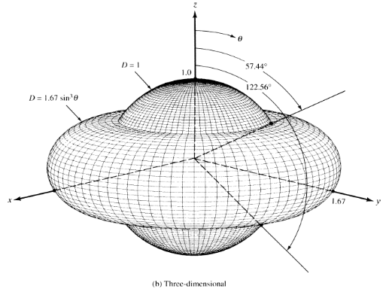
DIRECTIVITY
Cont..
For, 57.44°<θ<122.56°, dipole radiator has greater directivity in those directions than that of an isotropic source. Outside this range of angles, the isotropic radiator has higher directivity (more intense radiation). The maximum directivity of the dipole (relative to the isotropic radiator) occurs when θ = π/2, and it is 1.67 (or 2.23 dB) more intense than that of the isotropic radiator (with the same radiated power).

Slide 33


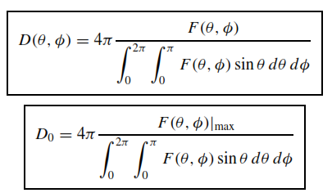
DIRECTIVITY
Cont..
A general expression for the directivity can be developed to include sources with radiation patterns that may be functions of both spherical coordinate angles θ and φ .
Let the radiation intensity of an antenna be of the form,

Slide 34
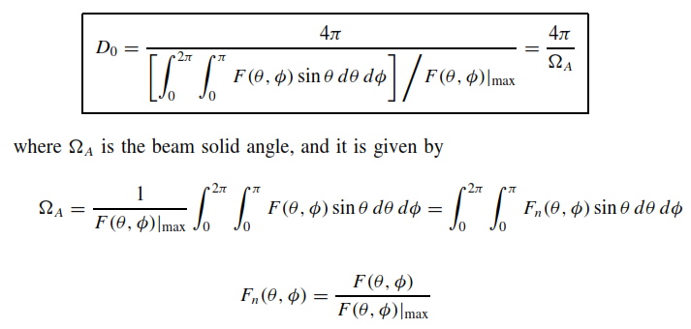
DIRECTIVITY
Cont..

Slide 35
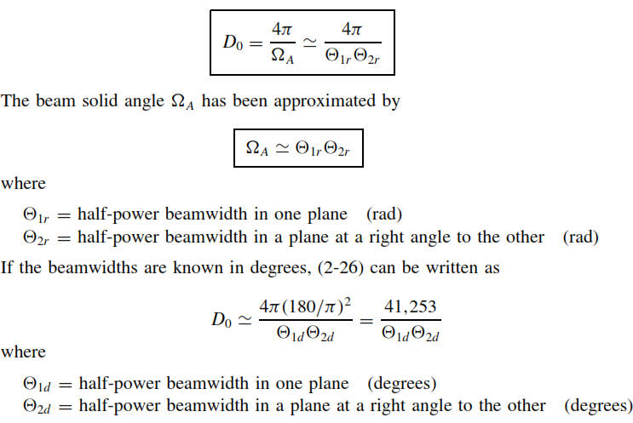
DIRECTIVITY
Cont..

Slide 36

GAIN
Although the gain of the antenna is closely related to the directivity, it is a measure that takes into account the efficiency of the antenna as well as its directional capabilities. But, directivity is a measure that describes only the directional properties of the antenna.
Gain of an antenna (in a given direction) is deﬁned as “ the ratio of the intensity, in a given direction, to the radiation intensity that would be obtained if the power accepted by the antenna were radiated isotropically.
The radiation intensity corresponding to the isotropically radiated power is equal to the power accepted (input) by the antenna divided by 4π.” In equation form this can be expressed as

Slide 37




Gain can also be deﬁned as “the ratio of the power gain in a given direction to the power gain of a reference antenna in its referenced direction.” The power input must be the same for both antennas.
The reference antenna is usually a dipole, horn, or any other antenna whose gain can be calculated or it is known.
we can write that the total radiated power (P_{rad}) is related to the total input power (P_{in}) by
Where, e_{cd} is the antenna radiation efficiency (dimensionless)

Slide 38

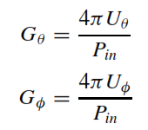
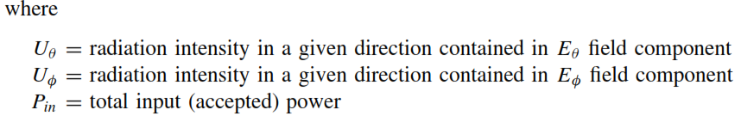
The partial gain of an antenna for a given polarization in a given direction as “The part of the radiation intensity corresponding to a given polarization divided by the total radiation intensity that would be obtained if the power accepted by the antenna were radiated isotropically.”
While the partial gains G_{θ} and G_{φ} are expressed as,

Slide 39
THANK YOU

